Slide 1

Notes:
Notes to facilitators in italics.

Slide 2

Lub Rooj Kawm
Kev Qhia Ob Hom Lus Rau Tsev Neeg
Kev Kawm
Lub Rooj
Kawm
Kev Qhia Ob
Hom Lus Rau Tsev Neeg
Kev Txhawb
Kev Koom Tes
USDE Grant: Dual Language and Immersion Pathways to English Learner Success
Notes:
The Dual Language and Immersion Family Partnership program is supported by a United States Department of Education grant from the Office of English Language Acquisition.
Lub Rooj Kawm Kev Qhia Ob Hoom Lus Rau Tsev Neeg tau txais kev txhawb ntawm United States Department of Education uas yog ib qhov grant los ntawm Office of English Language Acquisition.
Facilitators: try to mix up your parents so that they are sitting in mixed language groups.
We are going to be giving these sessions bilingually rather than separating you into different language groups. Your children are together for instruction and that integration is key to program success. Keep in mind, however, that although we will be doing these sessions bilingually, your children are taught in one language or the other – the teachers don’t translate or use both languages during their instruction.
Tus Qhia: Muab cov niam txiv sib xyaws kom lawv zaum ua ib pawg cov hluas txuam cov laus los yog muab lawv ua ib pawg uas (hais lus sib txawv txhob cia tib pawg hais tib hom lus xwb).
Peb yuav siv lus Hmoob thiab lus Askiv los qhia 3 lub rooj kawm no, kom tsis txhob tau muab nej cais nyias mus raws nyias hom lus. Nej cov me nyuam tuaj kawm hauv chav ua ke ces yeej muab lawv zaum sib txuam pem daws. Qhov no yog qhov yuav kom lawv kawm tau mus zoo. Nco cia tias peb txawm siv ob hom lus los qhia 3 lub rooj kawm no, tiam sis hauv chav cov tub ntxhais kawm peb tsuas siv tib yam lus xwb. Cov xib hwb tsis txhais lus los yog siv ob hom lus nyob hauv li.

Slide 3

Kev Qhia Txog Tus Kheej
Pixabay
Qhia koj lub npe
Muaj pes tsawg tus me nyuam thiab lawv hnub nyoog li cas
Cov me nyuam lub tsev kawm ntawv
Hom lus koj tsev neeg siv/hais tom tsev

Slide 4
Lub Rooj Kawm Cov Ntsiab Lus
Qhov Xub Pib Ntawm Kev Kawm Ob Hom Lus
Kev Paub Hais, Nyeem thiab Sau Ob Hom Lus
3. Kev Nyuaj Los Ntawm Kev Kawm Ob Hom Lus
4. Kev Npaj Kawm Ntawm Qib Siab thiab Txoj Kev
Ua Hauj Lwm
USDE Grant: Dual Language and Immersion Pathways to English Learner Success

Slide 5
Lub hom phiaj zaum no
Kuv tau taub hais tias...
Cov tub ntxhais yuav tau qhab nia rau thaum mus kawm ntawv qib siab yog hais tias lawv xeem tau tus ntawv ntsuas qhia tias lawv keej nyeem, sau thiab hais ob hom lus
Muaj ntau yam hauj lwm rau yus xaiv thiab yus ua yog hais tias yus yog ib tug neeg paub hais, paub nyeem thiab paub sau lwm hom lus

Slide 6
Lub ntsiab #1
Kuv tau taub tias cov tub ntxhais tau qhab nia thaum mus kawm ntawv qib siab yog hais tias lawv xeem tau tus ntawv ntsuas qhia tias lawv keej nyeem, sau thiab hais ob hom lus.
.

Slide 7
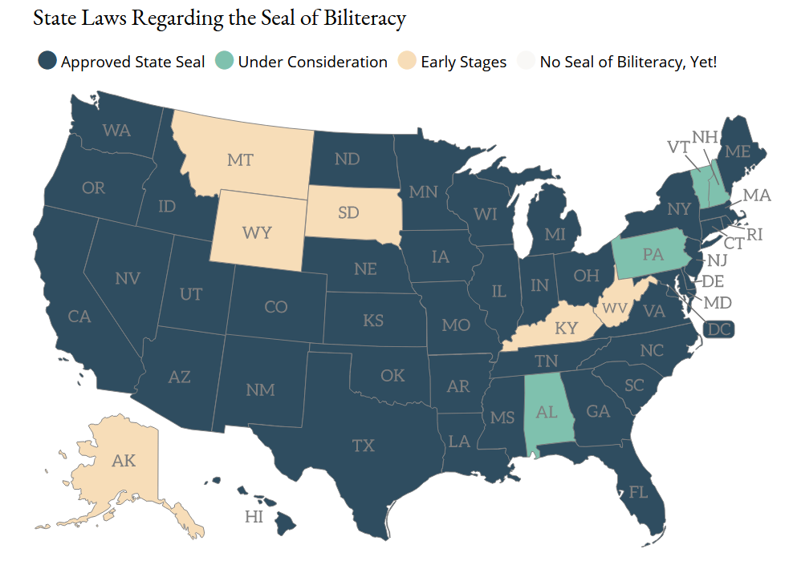
Participation in Seal of Biliteracy Programs
(Seal of Biliteracy, 2020)
Notes:
The first Seal of Biliteracy was created in 2008 as part of a grassroots effort by the nonprofit group, “Californians Together.” Their goal was to recognize high school graduates who had obtained high levels of competency in one or more languages in addition to English. The seal has gained in popularity throughout the United States in recent years.
Thawj thawj qov kev qhuas rau kev paub ob hom lus yog tsim thaum xyoo 2008 uas yog tsim los ntawm lub koom haum, “Californias Together.” Lawv lub hom phiaj yog los qhuas cov tub ntxhais kawm tiav qib siab uas paub hais, sau, thiab nyeem rau ib los sis tshaj ib hom lus uas tsis sauv lus Askiv. Qhov kev qhuas no tau nrov thiab muaj koob muaj np emus thoob plaws lub teb chaws Asmeslicas tau ob peb xyoo los no.

Slide 8

1. Daim ntawv Bilingual and Multilingual Seals and World Language Proficiency certificates yog dab tsi?
Cov tsev kawm ntawv muaj daim ntawv Minnesota bilingual and multilingual seals rau cov tub ntxhais kawm ntawv tiav qib loj yog hais tias nws xeem tau tus ntawv ntsuas meej tias nws yeej paub hais, sau, nyeem thiab tau taub lwm hom lus uas tsis yog lus Askiv.

Slide 9
2. Txoj kev zoo los ntawm tau daim ntawv ob hom lus los sis paub lwm hom lus yog dab tsi??
Minnesota State Colleges and Universities (Minnesota State) yuav muab qhab nia dawb ua ntej rau cov tub ntxhais kawm ntawv tiav rau qib loj thaum lawv xeem tau daim ntawv paub ob hom lus los ntau hom lus.

Slide 10
3. Tau qhab nia li cas rau cov tsev kawm ntawv qib siab hauv Minnesota State colleges and universities
yog xeem tau daim ntawv paub ob hom lus?
World language proficiency certificate Daim Ntawv Qhia | Intermediate-Low Ib Nrab Lawm Hauv | 2 semesters
Gold bilingual or multilingual seal Daim Ntawv Kub Daj | Intermediate High Ib Nrab Siab | 3 semesters per language
Platinum bilingual or multilingual seal Daim Ntawv Kub Dawb | Advanced Low Tau Siab | 4 semesters per language
(Adapted from Minneapolis Public Schools, n.d.)

Slide 11
4. Cov tub ntxhais kawm ntawv yuav tsum xeem dhau dab tsi ntxiv thiab?
Tsis yog xwb uas tus tub ntxhais xeem tau qhia tias nws yeej paub lwm hom lus uas tsis yog lus Askiv, tus tub ntxhais ntawd yuav tsum xeem tau:
Paub lus Askiv los ntawv Minnesota cov cai ntsuas kev kawm lus Askiv
Kawm tiav thiab xeem tau zoo tag nrho cov qhab nia rau kev kawm lus Askiv

Slide 12
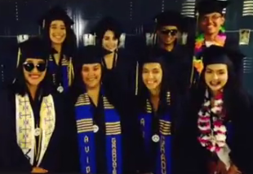

SEALS OF BILINGUALISM
(District 201, 2019)
Notes:
Click on the video icon for video. This is all in English, but it does show an English and a Chinese home language (or heritage?) speaker as well as Spanish speakers.
You can stop at 2:06. (in case link doesn’t work: https://www.youtube.com/watch?v=8uBStCM9Fw8)
Even though most of these students are Spanish home language speakers, you should point out that many seals have been awarded to English speaking students who
have learned Hmong (and other languages) as a second language.

Slide 13



Chav Kawm Siab (AP) & kawm txog cov ntaub ntawv tseem ceeb rau tej neeg (literature) uas yog siv lwm hom lus los kawm
Muab qhab nia rau hom lus yus paub thiab keej vim yus xeem tau zoo (based on Language Proficiency Exam)
Xeem tau zoo rau lawv tus ntawv IB diploma
Notes:
Students with high levels of bilingualism and biliteracy can earn college credits even before going to college through several different paths. These are great ways to earn college credit for FREE! Read the slide. Provide information only about the options specific to your district.
Cov me myuam paub hais, siv, sau thiab nyeem ob hom lus zoo zoo, yuav muaj kev pab rau lawv mus kawm yuav qhab nias (credits) ua ntej thaum lawv mus kawm ntawv qib siab. Nws muaj ob peb txoj hau kev rau koj tus me nyuam taug los yog kawm yuav qha nias (credit) dawb.

Slide 14

Jump Start Your Future!
https://www.youtube.com/watch?v=oFUF226t5Q4

Slide 15

flickr
Koj kawm tau li cas txog koj tus me nyuam txoj kev tau qhab nia ( kaws tau nyiaj) thaum mus kawm ntawv qib siab yog hais tias koj tus me nyuam xeem tau siab txog nws txoj kev paub ob hom lus rau lus Askiv thiab lus Hmoob?
Vim li cas thiaj li tseem ceeb rau koj paub tam sim no thaum koj tus me nyuam tseem tab tom pib kawm ntawv nyob rau qib me ?
Notes:
Discuss at tables. Share out a few ideas.
Sawv daws nyob ntawm lub rooj los mus sib tham sib qhia tswv yim. Qhia ob peb lub tswv yim tawm pub rau sawv daws hnov.

Slide 16
Lub ntsiab #2
Kuv tau taub muaj ntau yam hauj lwm rau yus xaiv thiab yus ua yog hais tias yus yog ib tug neeg paub hais, paub nyeem thiab paub sau lwm hom lus
.

Slide 17


Hauj Lwm Ntau Rau Cov Neeg Paub Ob Hom Lus
Hauj Lwm yog paub ob hom lus: Paub lwm hom lus dej num ntau
Cov kawm ntawv tiav qib siab paub ob hom lus xav tau, NIU hais los ntawv kev nug
Paub lwm hom lus. Cov hauj lwm paub ob hom lus mauj ntau tuaj nyob Minnesota.
Notes:
Bilingual speakers are in demand right now and will be even more so in the future. Here are just a few headlines from various news outlets. What can your child expect from a bilingual career?
Lub sij hawm tam sis no los sis rau pem suab, cov neeg paub ob hom lus yog cov neeg uas cov chaw ua hauj lwm nhriav heev.
Nov yog ib qho me me xov xwm tshaj tawm los ntawm ob peb qhov chaw los. Yog li txoj hauj lwm koj tus me nyuam yuav ua uas siv ob hom lus nes yuav zoo li cas?

Slide 18
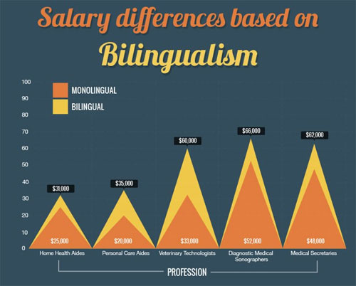
Kev Tau Nyiaj Txiag Los Ntawm Paub Ob Hom Lus
(Alpert, 2015)
Notes:
Very often, bilingual speakers earn more money than monolinguals. Here is an example of salary differences in the health care field based on bilingualism.
Feem ntau, cov paub ob hom lus yog cov tau nyiaj txiaj ntau dua cov paub ib hom lus xwb. Nov yog ib yam piv txwm txog nyiaj hli tau ntawm cov neeg paub ob hom lus nyob rau qhov chaw saib xyua cov neeg muaj mob muaj nkeeg uas yuav tau siv lwm hom lus nyob rau hauv lawv txoj dej num.

Slide 19
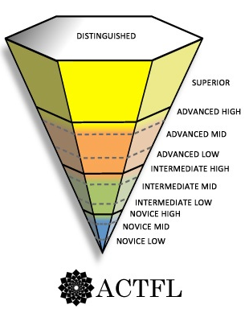
Paub Lus Zoo Rau Lwm Hom Lus
Feem coob KOHL
Yuav hluag tag ntawm KOHL
Tsawg tshaj li ib nrab ntawm cov kawm ntawv li nias hnub no
(ACTFL, 2012)
Notes:
A K-12 DLI experience is not enough to achieve the level of proficiency needed for the most demanding careers, such as a bilingual physician or attorney, but it puts your child on a very solid path towards that high proficiency goal. Virtually all students who are enrolled early in immersion programs succeed in reaching the ACTFL Intermediate levels of proficiency by the end of high school. At these levels, students are able to successfully handle everyday conversations in the target language. Many immersion students, in fact, reach Advanced levels of proficiency by grade 12. (Emphasize by grade 12.) In traditional four-year high school language programs, less than half the students completing the program have reached these levels of proficiency.
Txhawm tias twb tau kawm ob hom lus pib thaum K mus txog rau qib 12 los yeej yuav hais tsis tau tias tus neeg ntawd yuav ce mus txog ntua rau ntu uas paub hom lus zoo zoo heev uas yuav ua tau txoj hauj lwm ntawd kiag, nyob li txoj hauj lwm yog ib tug kws kho mob paub ob hom lus los sis tus kws lij choj paub ob hom lus. Tiam sis mas yuav pab muab koj tus me nyuam coj mus tauj rau txoj kev mus kom txog rau ntu paub lus zoo zoo heev zuj zus. Qhov pom tseeb ces txhua txhua tus me nyuam uas pib kawm rau chav kawm ob hom lus thaum yau los ces lawv yeej xeem tau mus txog rau tus paub lus ib nrab ntawm tus ntsuas ACTFL thaum lawv kawm ntawv tiav qib loj (high school). Nyob rau qib no, cov tub ntxhais yeej paub sib tham pem mus mus los los rau hom lus lawv tau kawm. Coob leej coob tus uas tau pib kawm rau chav ob hom lus kuj xeem tau mus rau ntu siab (Advance) ntawm tus ACTFL thaum lawv kawm tiav qib 12. ( thaum kawm tag nyob rau qib 12.) Hom nyob rau cov tsev kawm ntawv qhia lwm hom lus li plaub xyoo xwb, tsawg tshaj li ib nrab ntawm cov me nyuam kawm tiav qib 12 ce mus txog rau ntu ua paub lus li ib nrab ntawm xwb.

Slide 20






Kev paub ob hom lus siv nyob hauv tshuab hlwb hlau
pxhere
pxhere
Kev tua nkees
Cov ntaub ntawv khaws
cia saum huab cua.
pixabay
Kev tsim nyob hauv vas sab
pxhere
maxpixel
Yeeb Yaj Kiab, xov tooj cua
Cov twj mus nrhiav hauv
tshuab hlwb hau
Thiab
Notes:
Bilinguals have an advantage in the digital economy, which is global by nature and requires a globally-minded work force.
Kev paub ob hom lus yuav yeej lwm tus nyob rau sab siv tshuab hlwb hau, uas yog ib yam zoo muaj peev xwm mus thoob ntuj thiab yuav siv lub hlwb uas xav mus deb deb thiab dav dav rau sab ua dej num.

Slide 21
Rov Hais Dua:
Cov me nyuam thoj nam tawg rog uas paub nyeem, sau thiab hais lus Askiv thiab lwm hom lus muaj ntau yam hauj lwm rau nws xaiv thiab ua duas.
Yog koj yog ib tus neeg thoj nam tawg rog es paub lus Askiv xwb ces tau nyiam tsawg dua li $2,000 mus rau $5,000 tauj ib xyoo twg.
Hos yog koj yog ib tug neeg thoj nam tawg rog es paub ob hom lus, Askiv thiab yus hom lus uas siv tom vaj tom tsev - muab hais los ces yog “Tus neeg txawj ob hom lus” – yuav tau nyiam ntau tshaj tus paub lus Askiv xwb.
(Agirdag, 2014; Navarez, 2015; Rumbaut, 2014)
Notes:
According to a report by the Civil Rights Project at UCLA and the Educational Testing Service…Read the slide.
After reading bullet points add…
In fact, a study in Belgium found that balanced bilinguals earn about $5,200 more annually at the beginning of their careers than do monolinguals – the findings were the same for different language groups. So there is a substantial loss to a person in earnings over time if they lose the home language.
Authors: Cov Kws Sau

Slide 22
Hauj Lwm Ntau Rau Cov Neeg Paub Ob Hom Lus
Keb tshawb fawb qhia txog tus neeg twg:
  Siv ob hom lus heev heev–yog tus neeg siv ob hom lus rau nws txoj hauj lwm thiab nws tus keej
  Keej sau and nyeem ob hom lus heev
  Yog cov yuav mus kawm ntawv qib siab (cov 4 xyoo college kom pab lawv tau hauj lwm zoo zuj zus mus;
  Tau txoj hauj lwm zoo heev, muaj meej mom, thiab tau nyiam zoo ntau thiab
  Yuav muaj caij rau tus neeg nce theem siab zuj zus rau nws txoj hawj lwm.
  Txoj kev zoo uas paub ob hom lus yuav tsum tseem ceeb zuj zus rau cov tub ntxhais nyob rau tiam tam si no kev ua hauj lwm.
(Porras, Ee & Gándara, 2014; Santibañez & Zárate, 2014)
Notes:
Read the slide – be sure to emphasize the critical importance of HIGH levels of biingualism and biliteracy – THAT’s what makes the difference when it comes to college and careers.

Slide 23

Lub Neej Pem Suab Pib Tam Sim No
Cov tub ntxhais kawm ntawv qhib loj es nyob rau chav kawm ob hom lus, thaum lawv pib puag thaum qib me los txog rau qib loj muaj:
Mob siab duas thiab kawm tau ntawv duas;
Npaj siab yuav mus kawm qib siab;
Paub nrhiav tswv yim los pab thiab paub yuav lis ntaub ntawv mus kawm rau qib siab;
Thiab zoo siab tias lawv paub ob hom lus.
H
N
U
B
N
O
lozada
T
A
G
K
I
S
dreamstime
(Lindholm-Leary & Borsato, 2001)

Slide 24

Language Proficiency and Careers of the Future
We don’t know what the future holds, but….
“Integration of our global economy is not the only driving force for the need for higher-level soft skills; large global migration driven by both economic and political forces also has a large impact on workforce demands. To respond to both our current and future workforce needs, we have to redefine what an educated and talented workforce looks like. The answer includes one that is multilingual and multicultural.”
Pixabay
Price, 2018
Notes:
Paraphrase this for the participants, highlighting the last two sentences.

Slide 25

Notes:
10 minutes
10 Feeb

Slide 26
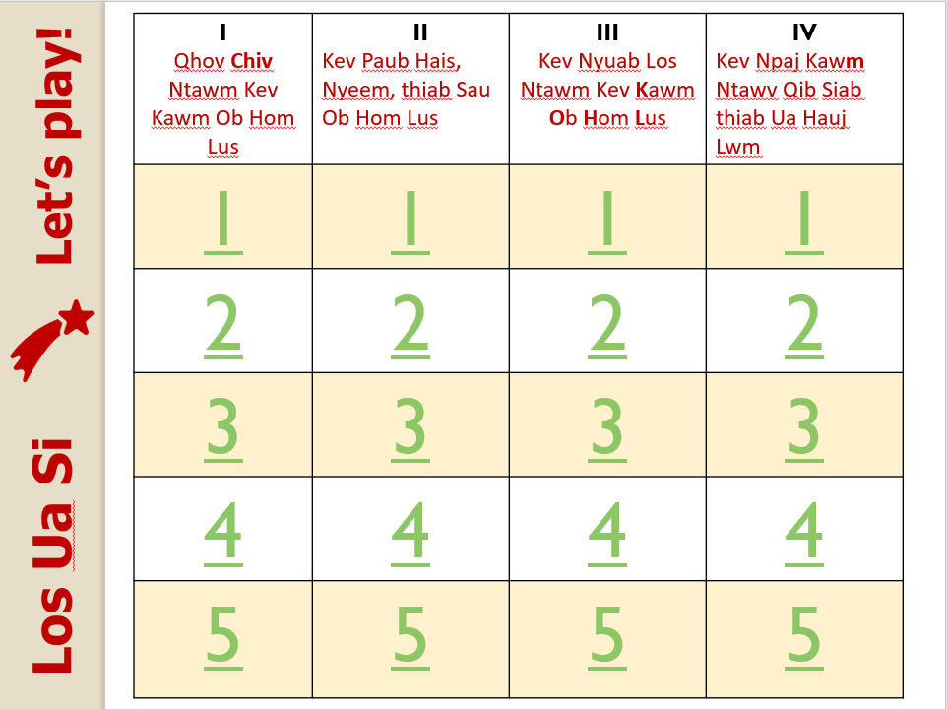

Slide 27
Yuav Tshwm Sim Tom Ntej No!
Mus rau peb lub website yog xav paub ntau txoj cov ntsiab tau kawm tag lawm los yog lwm yam txog kev kawm ob hom lus thiab.
Kev Kawm
Lub Rooj
Kawm
Kev Qhia Ob
Hom Lus Rau Tsev Neeg
Kev Txhawb
Kev Koom Tes
http://carla.umn.edu/immersion/parentinfo/index.html
USDE Grant: Dual Language and Immersion Pathways to English Learner Success
Notes:
The University of Minnesota team is developing a website that will provide you with additional resources so you can learn more about the topics you learn about in 4 the evening sessions. We’ll share the website address once it’s ready.
Lub tsev kawm ntawv qib siab, (University of Minnesota) yuav tsim ib lub (website) los mus nrhiav kev pab rau cov ntsiab lus tau kawm tag los 4 lub lim tiam no. Peb mas qhia nej yog thaum ua tiav lawv.

Slide 28
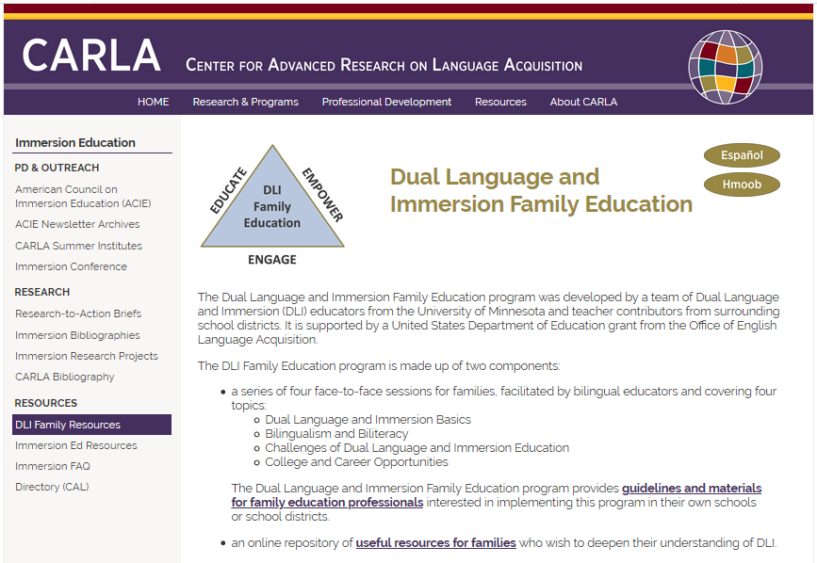
http://carla.umn.edu/immersion/parentinfo/index.html

Slide 29
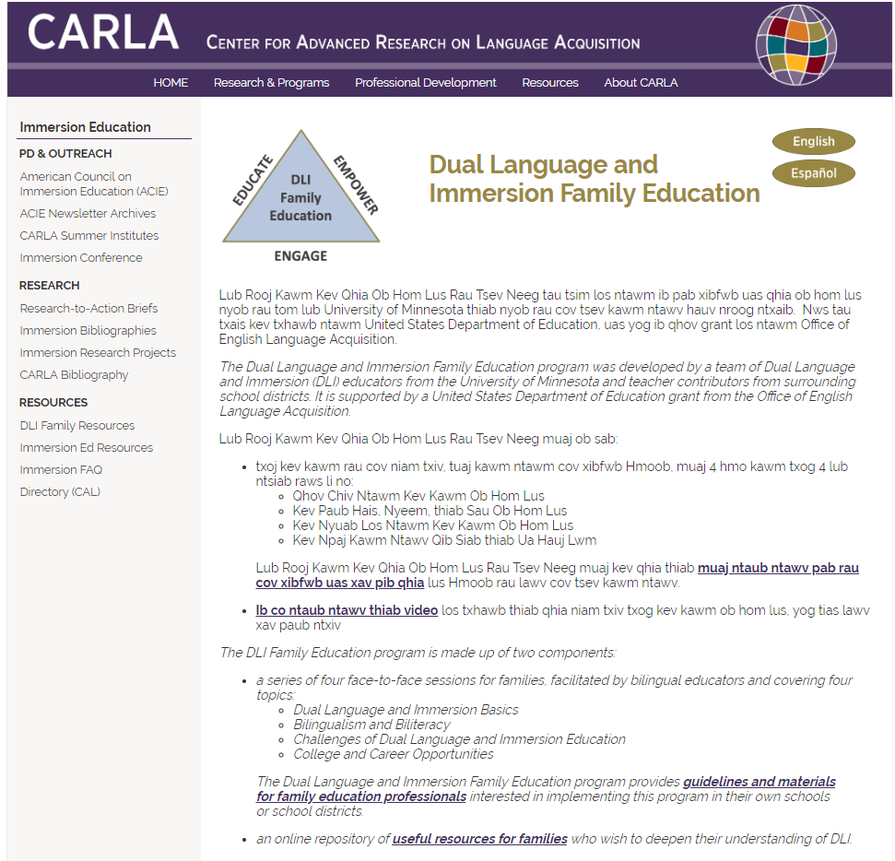

Slide 30
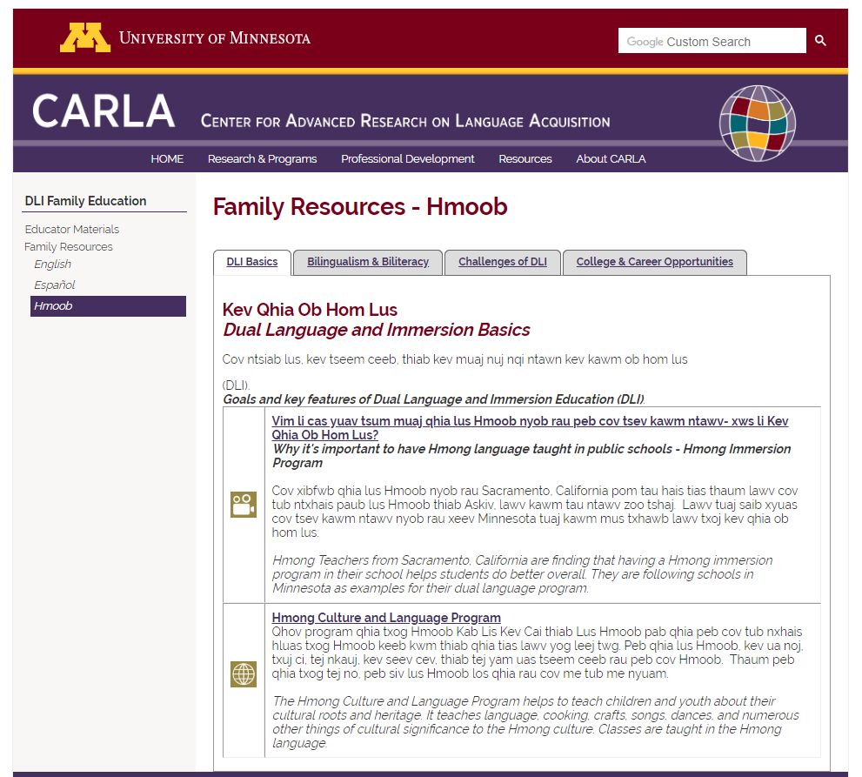

Slide 31

Ua tsaug rau koj tuaj koom peb hmo no
Thiab rau koj txoj kev los koom tes nrog peb!
Thov mus teb cov lus soj ntsuam uas yuav qhia tau rau peb tias koj kawm tau dab tsi thiab ua li peb ho yuav ua li cas thiaj li ua kom txoj kev kawm no zoo tshaj qhov qub.
LUS SOJ NSUAM
Pixabay
USDE Grant: Dual Language and Immersion Pathways to English Learner Success

Slide 32

Pixabay
Lub Cai Qhuas Los Txog Lawm!
Notes:
You made it! You’ve completed all four workshops! It’s time to get your certificate and time to celebrate! We are so grateful for your participation and hope that we’ve helped you to understand more about your children’s educational program and how you can help your children to succeed in school and beyond!
Zoo heev! Koj kawm tiav lawm laub! Txoj caij peb muab ib daim ntawv qhua thiab muaj lub sij hawm no los qhua koj txoj kev muaj siab tuaj koom peb. Peb xav hais tias koj yuav tau taub thiab paub zoo dua txog koj tus me nyuam txoj kev kawm ntawv hauv chav kawm ob hom lus ces koj yuav paub los mus pab txhawb li cas kom nws kawm tau ntawv mus zoo tam sis no thiab lawm yav pem suab.

Slide 33
Cov Ntaub Ntawv Tshawb Fawb Siv Los Qhia (References)
ACTFL – American Council on the Teaching of Foreign Languages. (2012). ACTFL proficiency guidelines. Alexandria, VA: ACTFL. Available at: https://www.actfl.org/publications/guidelines-and-manuals/actfl-proficiency-guidelines-2012.
ACTFL. (2015). Oral proficiency levels in the workplace. Retrieved from https://www.actfl.org/sites/default/files/pdfs/TLE_pdf/OralProficiencyWorkplacePoster.pdf.
Alpert, D. (2015). Education in multiple languages gives kids a big boost, which means high demand for DC’s programs. Greater, Greater Washington. Retrieved from https://ggwash.org/view/38406/education-in-multiple-languages-gives-kids-a-big-boost-which-means-high-demand-for-dcs-programs.
Agirdag, O. (2014). The long-term effects of bilingualism on children of immigration: Student bilingualism and future earnings. International Journal of Bilingual Education and Bilingualism, 17(4), 449–464.
District 201. (2019). The Seal of Biliteracy at J. Sterling Morton High School. Videos of students’ reflections on the Seal of Biliteracy. Retrieved from https://il01904869.schoolwires.net/Page/681.
Minneapolis Public Schools. (n.d.). Bilingual seals and world language proficiency certificates. Retrieved from http://worldlanguages.mpls.k12.mn.us/bilingual_seal_testing.
Minnesota Department of Education. (2020). Minnesota Bilingual Seals Program. Retrieved from https://education.mn.gov/MDE/dse/stds/world/seals/index.htm.
Navarez, G. (2015). Bilinguals have been college outcomes, labor advantages: New study. NBC News. Retrieved from https://www.nbcnews.com/news/latino/bilinguals-have-better-college-outcomes-labor-advantages-n444046.
Price, S. (2018). Redefining the Talented Workforce. Retrieved from https://englishclassviaskype.com/blog/how-to-learn-english/redefining-the-talented-workforce/.

Slide 34
Cov Ntaub Ntawv Tshawb Fawb Siv Los Qhia (References)
Porras, D.A., Ee, J., & Gándara, P.C. (2014). Employer preferences: Do bilingual applicants and employees experience an advantage? In R.M. Callahan & P.C. Gándara (Eds.), The bilingual advantage: Language, literacy and the US labor market (234–257). Bristol, UK: Multilingual Matters.
Rumbaut, R.G. (2014). English plus: Exploring the socioeconomic benefits of bilingualism in Southern California. In R.M. Callahan & P.C. Gándara (Eds.), The bilingual advantage: Language, literacy and the US labor market (182–210). Bristol, UK: Multilingual Matters.
Santibañez, L., & Zárate, M.E. (2014). Bilinguals in the US and college enrollment. In R.M. Callahan & P.C. Gándara (Eds.), The bilingual advantage: Language, literacy and the US labor market (211–233). Bristol, UK: Multilingual Matters.
Seal of Biliteracy. (2019). Seal of Biliteracy. Retrieved from https://sealofbiliteracy.org/. [Map retrieved on November 3, 2019.]
Acknowledgements
Clipart taken from Clipart.email, Clipartpanda, dreamstime, flickr, Maxpixel, Phillipmartin, Pickit, Pixabay, and pxhere are copyright-free and do not require permission or attribution.
The following images are reproduced with permission from their respective sources:
Slide 23: R.J. Lozada (https://vimeo.com/55717676)

Slide 35
Cov Kws Sau
Cov neeg pab tsim cov lus qhia no
University of Minnesota:
Maureen Curran-Dorsano
Diane J. Tedick
Corinne Mathieu
Ua tsaug tshwj xeeb rau peb cov txhais ntaub ntawv:
Bounthavy Kiatoukaysy
See Pha Vang
May Lee Xiong
Phoua Yang
thiab rau peb tus los tawm tswv yim txhim kho:
Edward M. Olivos,
University of Oregon
Amanda Lea (Eastern Carver County)
Cathy Camarena (St. Paul)
Teresa Chavez (Roseville)
Carolina DuFault (Risen Christ)
Tara W. Fortune (UMN)
Leticia Guadarrama (Minneapolis)
Liz Hathaway-Castelán (St. Paul)
Laura Hofer (Richfield)
Bounthavy Kiatoukaysy (St. Paul)
Corina Pastrana (Minneapolis)
Melissa Richards de Campaña (St. Paul)
Anita Sasse (Northfield)
Kate Trexel (UMN)
Megan Unger (Minneapolis)

