Slide 1

Notes:
Notes to facilitators in italics.
Welcome the participants to the session. Introduce yourself and your role at the school/district.
Let them know there is one scheduled break but they are free to take personal breaks as necessary.
Cov ntawv tus cob qhia yuav hais yog cov ntawv italics
Qhib lus txhais tos cov niam txiv tuaj kawm hmo no. Qhia koj tus kheej thiab koj txoj hauj lwm nyob hauv tsev kawm ntawv.
Qhia rau lawv paub tias hmo no sawv daws muaj so ib zaug tiam sis yogleej twg ho xav muaj chaw mus so ntxiv no los yeej meem mus so tau.
Thank you for coming here tonight. We hope you enjoy the learning activities we have planned for you. Please do not hesitate to ask questions along the way.
Ua tsaug nej sawv daws tuaj hmo no. Peb cia siab tias nej yuav nyiam thiab txaus siab rau cov kev kawm peb npaj tuaj qhia nej hmo no. Peb sawv daws sib cog kawm mus, yog nej tsis tau taub qhov twg los yeej meem nug.

Slide 2

Lub Rooj Kawm
Kev Qhia Ob Hom Lus Rau Tsev Neeg
Kev Kawm
Lub Rooj
Kawm
Kev Qhia Ob
Hom Lus Rau Tsev Neeg
Kev Txhawb
Kev Koom Tes
USDE Grant: Dual Language and Immersion Pathways to English Learner Success
Notes:
The Dual Language and Immersion Family Partnership program is supported by a United States Department of Education grant from the Office of English Language Acquisition.
Lub Rooj Kawm Kev Qhia Ob Hoom Lus Rau Tsev Neeg tau txais kev txhawb ntawm United States Department of Education uas yog ib qhov grant los ntawm Office of English Language Acquisition.
Facilitators: try to mix up your parents so that they are sitting in mixed language groups.
We are going to be giving these sessions bilingually rather than separating you into different language groups. Your children are together for instruction and that integration is key to program success. Keep in mind, however, that although we will be doing these sessions bilingually, your children are taught in one language or the other – the teachers don’t translate or use both languages during their instruction.
Tus Qhia: Muab cov niam txiv sib xyaws kom lawv zaum ua ib pawg cov hluas txuam cov laus los yog muab lawv ua ib pawg uas (hais lus sib txawv txhob cia tib pawg hais tib hom lus xwb).
Peb yuav siv lus Hmoob thiab lus Askiv los qhia 3 lub rooj kawm no, kom tsis txhob tau muab nej cais nyias mus raws nyias hom lus. Nej cov me nyuam tuaj kawm hauv chav ua ke ces yeej muab lawv zaum sib txuam pem daws. Qhov no yog qhov yuav kom lawv kawm tau mus zoo. Nco cia tias peb txawm siv ob hom lus los qhia 3 lub rooj kawm no, tiam sis hauv chav cov tub ntxhais kawm peb tsuas siv tib yam lus xwb. Cov xib hwb tsis txhais lus los yog siv ob hom lus nyob hauv li.

Slide 3

Qhia Txog Koj Tus Kheej
Pixabay
Qhia koj lub npe
Muaj pes tsawg tus me nyuam thiab lawv hnub nyoog li cas
Cov me nyuam lub tsev kawm ntawv
Hom lus koj tsev neeg siv/hais tom tsev
Yog vim li cas koj thiaj tuaj koom hmo no
Notes:
Depending on the size of the group, do this as a whole group (fewer than 10) or at tables.
10 minutes
Nyob ntawm seb pab neeg tuaj kawm ntawm coob paum li cas, xaiv seb kom sawv daws koom sib qhia tag rhos ua ke ( tsawg tshaj li 10 leej) los sis sib qhia ntawm lub rooj zaum ua ke xwb.
10 feem

Slide 4
Lub Rooj Kawm Cov Ntsiab Lus
Qhov Chiv Ntawm Kev Kawm Ob Hom Lus
Kev Paub Hais, Nyeem, thiab Sau Ob Hom Lus
Kev Nyuab Los Ntawm Kev Kawm Ob Hom Lus
Kev Npaj Kawm Ntawv Qib Siab thiab Ua Hauj Lwm

Slide 5
Lub Hom Phiaj Hnub No
  Kuv tau taub
  Txoj kev kawm kom paub ob hom lus zoo li cas thiab txoj kev taug ib ntu zuj zus kawm kom paub hais, sau, thiab nyeem ob hom zoo li cas;
  Txoj kev kawm kom paub ob hom lus, sau, thiab nyeem tau ob hom ntawv hauv chav kawm ob hom lus qhia zoo li cas.

Slide 6
Lub ntsiab #1
Txoj kev kawm kom paub ob hom lus zoo li cas thiab txoj kev taug ib ntu zuj zus kawm kom paub hais, sau, thiab nyeem ob hom zoo li cas.

Slide 7


Kev Kawm Ob Hom Lus Yog Li Cas?
Paub Ob Hom Lus = txawj hais thiab to taub ob hom lus tib yam nkaus.
Pixit
Notes:
Nej ib txhia tuaj hmo no paub ob hom lus, nej los yeej xav kom nej cov me nyuam paub ib yam li nej thiab. Nej ib co los kuj xav kom nej tus me nyuam paub lwm hom lus uas nej tsis muaj lub cib fim tau los kawm. Nej sawv daws yeej pom hais tias kev paub lwm hom lus ntxiv muaj nqis npaum li cas, qhov nov peb yuav pom nyob rau hauv daim yeej yam kiab no.

Slide 8
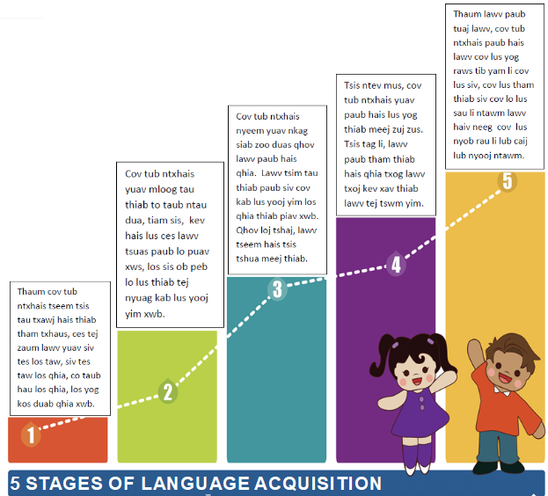
Paub siv lus tob thiab Hais Npliag Lias
Kev Paub Ob Hom Lus
Nkag Siab thiab Txawj Siv
Hais thiab To Taub
Mloog thiab Xyaum
Hnov thiab Qog
(Mi Chu Chu Tren, n.d.,
adapted from Krashen & Terrell, 1983)
5 Ntu Ntawm Txoj Kev Kawm Lwm Hom Lus
Notes:
Kev Kawm Ua Ke Ntawm Ib Pab. Muab daim ntawv “5 Ntu Ntawm Kev Kawm Paub Ib Hom Lus” rau ib lub rooj.
Yog li, kev paub ob hom lus zoo li cas rau li cas? Nov yog 5 kab lus (muab qhia rau sawv daws kom lawv pom seb zoo li cas) uas qhia txog ib ntu zuj zus txog txoj kev kawm ib hom lus twg los yog paub ib hom lus twg. Nyob rau ntawm nej lub rooj, siv seb nej sawv daws puas yuav muab tau cov ntu kawm lus no los teeb kom yog yog ib theem rau ib theem thaum pib mus txog rau ntu 5.
Thaum cov niam txiv muab cov ntu teeb tag lawm, qhia cov ntu nyob hauv PPT rau cov niam txiv saib seb lawv puas teeb yog. Koj tau nias lub thawv daj, qhia thiab ntxiv lub ntsiab lus rau ib ntu zuj zus mus kom tag 5 ntu.

Slide 9
Paub siv lus tob thiab Hais Npliag Lias
Nkag Siab thiab Txawj Siv
Hais thiab To Taub
Txoj kev kawm ntawv zoo li cas
Tsev neeg keeb kwm
Muaj sij hawm ntau npaum li cas rau kev siv hom lus
Kev sib nraug zoo ntawm ob hom lus yog dab tsi
Mloog thiab Xyaum
Hnov thiab Qog
5 Ntu Ntawm Txoj Kev Kawm Lwm Hom Lus
Notes:
Txhua txhua tus neeg kawm lwm hom lus yuav tau taug los sis mus kom dhau 5 ntu kev kawm no. Tiam sis ib tug neeg twg, nyias txawv nyias ces tej tus neeg yuav siv sij hawm ntej me ntsis mas li mus txog ntu kawg los ntu paub hom lus zoo zoo ib yam li nws hom lus. Muaj ib co kev los cuam tshuam rau tej tus neeg nws txoj kev kawm lus. Ib co kev cuam tshuam no yog.
Muaj kev kawm txog hom lus kawm ntawd. Kev kawm nyob rau hauv chav kawm ob hom lus yuav pab txhawb koj tus me nyuam mus rau txoj kev paub ob hom lus.
Koj tsev neeg coj zoo li cas. Yog hais tias koj hom lus yog hom lus koj muaj me tub me nyuam nyob rau hauv chav kawm ob hom lus ( xws li kawm Hmoob), koj tus me nyuam yuav muaj siab hais hom lus nws kawm ntawd nyob tom vaj tom tsev los sis tom tsev kawm ntawv. Tsis tag li, koj tus me nyuam los yuav muaj ntau lub sij hawm los siv hom lus nws kawm ntawd nrog nws cov neeg txheeb ze thiab cov neeg nyob hauv zej hauv zos.
Muaj caij nyoog los siv hom lus kawm. Peb sawv daws yeej paub zoo hais tias kev paub ib hom lus zoo mas yog tau siv hom lus tag mus li mas tus me nyuam thiaj yuav paub. Yog li peb ua niam ua txiv peb yuav tau rhiav caij rhiav nyoog pub rau tus me nyuam xyaum hom lus kawm ntawd nrog coob leej coob tus tsis hais rau tus me nyuam ua xub hais lus Askiv los yog xub hais lus Hmoob. Txoj kev xyaum lus no tsis hais yog nrog ib tug neeg tham tim ntsej tim muag kiag los yog saib yeeb yaj kiab, ua kev lom zem hauv internet, mus ncig kawm txog hom lus ntawm keeb kwm, los yog mus ncig teb chaw. Muaj ntau txoj kev rau yus ua niam ua txiv rhiav lub caij lub nyoog rau tus me nyuam siv hom lus nws kawm.
Qhia qhov zoo ib yam thiab qhov txawv ntawm ob hom lus. Li lus Askiv thiab lus Mev muaj ntau cov lus muaj ntsis zoo ib yam xws li- family/familia, television/televisión – lus Askiv thiab lus Hmoob tsis muaj. Yog li cov me nyuamuas xub paub lus Mev yuav kawm lus Askiv yooj yim zog los sai dua cov me nyuam uas xub paub lus Hmoob vim lus Mev thiab lus Askiv muaj ntsis sib xws. Qhov ntawm yeej muaj tseeb rau cov me nyuam Askiv kawm lus Mev thiab.

Slide 10


Lus Tham Pem Piv Lus Siv Hauv Ntaub Ntawv
Pixit
Pixit
Lus Tham Pem
Lus sib tham, yooj yim, cov lus tham mus tham los
Lus tham thaum ua si, tham pem nrog lwm tus neeg
Lus Siv Nyob Hauv Ntaub Ntawv
Lus siv hauv ntaub ntawv thiab hauv tsev kawm ntawv
Tseem ceeb siv rau kev kawm ntawv thiab kev ua hauv lwm
Notes:
Rau cov me nyuam Mev thiab me nyuam Hmong- cov lus sib tham pem yuav pib nyob tom vaj tom tsev. Nyob tom tsev kawm ntawv, cov lus sib tham yuav siv thaum lawv noj sus, ua si, thiab caij bus. Hos cov me nyuam hais lus Askiv xwb, lawv kawm cov lus tham pem nyuam duas thiab laib qhia ib yam li cov lus siv nyob hauv ntaub ntawv.
Cov lus siv hauv ntaub ntawv yog cov lus muab coj los qhia hauv tsev kawm ntawv thiab nyob hauv cov ntawv nyeem. Thaum siv cov lus hauv ntaub ntawv yuav tau siv cov lus no, “ vim li ntawm”, “tiam sis”, “ yog li ntawm” thiab cov lus uas yeej siv los qhia lub ntsiab kawm nkaus nkaus xwb (content) piv li leb thiab keeb txuj (science).
Cov lus siv hauv ntaub ntawv tseem ceeb heev rau tus me nyuam txoj kev kawm kom mus tau zoo nyob hauv tsev kawm ntawv thiab thaum mus ua txoj hauj lwm nyob rau lub ntiaj teb no. Kev yuav paub cov lus siv hauv ntaub ntawv yuav siv li 5-7 xyoo kawm. Vim li no thiaj li tseem ceeb heev rau tus me nyuam kawm Ob Hom Lus nyob hauv chav no kawm mus ntxiv zuj zus rau qib nrab thiab qib loj lo sis kawm ntxiv lawm pem suab.

Slide 11
Lus Tham Pem
Lus Siv Nyob Ntaub Ntawv
1. Tsis muaj nag es tej qoob
loo tuag tag lawm.
2. Cov neeg tsis muaj dab tsi
noj es lawv thiaj tuag
coob coob.
3. Cov tub rog tau txais lub
kib vim tias lawv muaj
peev xwm heev.
4. Tus kab hloov mus ua tus
npauj npaim tshiab.
Lub ntuj qhua qhua ua rau tej qoob loo hlob tsis taus.
Lub ntuj ntsuag thiab qhua tag es neeg thiaj tuag tshaib tag lawm.
Cov tub rog uas muaj peev xwm tau txais ib daim paj tshab.
Ib nyuag ncua tom qab, tus me kab npauj plhis plho mus ua ib tug me npauj npaim.
(some examples from Gibbons, 2015)
Notes:
Thaum tseem pib kawm xwb, cov lus qhia rau cov me nyuam ces yog cov lus tham pem. Cov me nyuam xub pib tham txog lawv tus kheej, lawv tsev neeg, lawv tus tsiaj yug thiab cov lus qhia rau leb thiab keeb txuj los yooj yooj yim. Thaum tus me nyuam kawm mus ntxiv, lub ntsiab kev kawm pib nyuaj zus zuj thiab cov lus qhia yuav yog cov lus sau nyob hauv ntaub ntawv. Qhov no yog ib co lus piv xws txog ntawm ob yam lus.
Nyeem cov kab lus uas sau los ua piv txwv. Cov kab lus ces yeej muaj teeb puab rau ntawm ib sab kom zoo ib yam thiab sib xws es thaum nyeem es kom pom tias sab laug cov lus yeej yooj yim dua kab lus nyob sab xis, cov lus nyuaj dua thiab yog cov lus sau nyob hauv ntaub ntawv. Xaus lus qhia tias cov lus siv rau hauv cov PPT or nyob rau hmo no yog cov lus sau rau hauv ntaub ntawv.

Slide 12



+
=
Lus Tham Pem
Kev Paub Hais
Lus Siv Nyob Hauv Ntaub Ntawv
Ob pab tub ntxhais no yuav tau rau siab thiab mob siab kawm heev rau txoj kev kawm lus no kom mus zoo ib yam!

Slide 13


Sib Tham
Rov xav dua txoj kev koj twb kawm tag los lawm txog 5 ntu thiab kev kawm ob hom lus – lus tham pem thiab lus siv nyob hauv ntaub ntawv uas cov tub ntxhais yuav tsum paub thiaj hais tau hais tias nws yog tus neeg paub ob hom lus.
Pixabay

Slide 14



Kev Paub Nyeem Thiab Sau Ob Hom Lus Yog Li Cas?
Biliteracy = paub sau thiab nyeem ob hom lus.

Slide 15
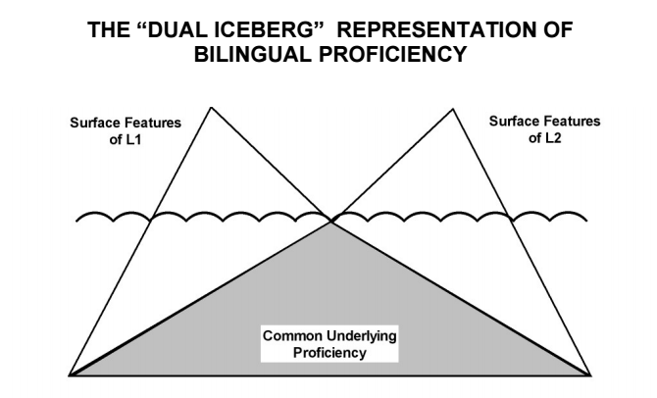
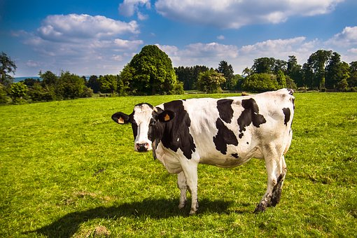
Kawm Nyeem Thiab Sau Ob Hom Lus
Ob Sab Ntawm Thooj Daus Ntab Kev Kawm Ob Hom Lus
Sab paub txog yam lus 1
Sab paub txog yam lus 2
nyuj
cow
Qhov zoo ib yam ntawm cov lus
(Cummins, 1980)
Notes:
Yuav kom peb tau taub kev paub Ob Hom Lus zoo, peb yuav tau muab Thooj Pob Daus nyob hauv hiav txwv los ua piv txwv qhia txog kev paub Ob Hom Lus zoo zoo. Nws zoo li cas. Peb paub thiab ntsia lub thooj pob daus- nws muaj ob sab. Ib sab nyob saum plaim dej ho ib sab nyob ruab deg. Sab nyob ruab deg loj tshaj thooj pob daus saum plaim dej. Thooj pob daus piv txwv no qhia tau hais tias qhov paub thiab txawj ntawv kev kawm lus zoo tshaj yog nyob sab hauv ruab deg. Hos sab saum thooj pob daus yog qhov neeg pom thiab paub txog cov lus kawm zoo li cas ntawm ob hom lus. Ntawm nov qhia tias ob hom lus sib txawv li cas. Piv txwv lo lus “ cow” tsis siv rau lwm haiv neeg cov lus tiam sis lub tswv yim ces yog hais tias yog tus tsiaj tib yam nkaus. Qhov nov ces yog ib lub tswv yim coj mus siv tau thaum yus nyeem ntawv. Tus me nyuam mev paub hais tias vaca yog nyuj, ces tsis tas lawv tseem yuav mus kawm tias “cow” yog dab tsi lawm. Cov me nyuam yuav tau siv ntau lub tswv yim uas lawv tau kawm ntawv ib hom lus ces coj mus siv rau hom lus tshiab lawv kawm. Yog yus paub thiab tau taub lub ntsiab lus kawm lawm ces coj mus siv pab rau yam lus tshiab yus tseem tam tom kawm.
Yog li, txawm ob lo lus nyob sab saud tsis zoo ib yam thiab nyias muaj nyias lawm los, lub ntsiab yog tib qho ces pab ua rau nws paub thiab nkag siab rau los lus hais tias yog ib yam. Qhov no siv tau rau thaum kawm txog ib yam dab tsi, piv xwv rau yus tus keej los yog txoj kev xav ntawm tus keej lub tswj yim. Txoj kev kawm no siv tau thaum nyeem ntawv ib yam. Cov tub ntxhais yuav tau kawm nyeem lo lus nyuj tiam sis lawv tsis tas kawm tias tus cow yog dab tsi vim tias lawv twb to taub tias tus cow yog dab tsi lawm.

Slide 16
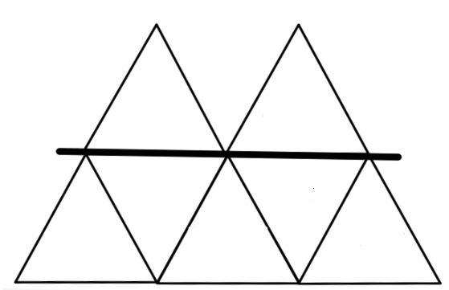
Kawm Nyeem Thiab Sau Ob Hom Lus
Siv dua los pab.
Cov cais hom
Nyeem sab twg rau sab twg
Nyeem kom zoo li lus sib
tham
Cov cim
Muab suab los sib
txuas
Lus sib dhos
Cov cais
hom
Cov cim
Nyeem sab twg rau sab
twg
Muab suab los
sib txuas
Siv dua
los pab
Nyeem kom
zoo li lus sib tham
Lus sib dhos
Notes:
Students also rely on many reading strategies that they have already learned in one language in order to read in the other language. So children aren’t learning everything all over again – they just learn a new way to express the concepts in the new language. Here are some examples of early literacy reading concepts. Some are “above the surface” – they have to be learned for a particular language. Some are “below the surface” and can be transferred from one language to another.
Whole-group activity. You should have on hand a read-aloud in each language so that you can demonstrate each one of these strategies. Call out the first item on the list (in the red box) and give an example in Spanish and English. Ask the group if it goes above or below the surface. Be sure to follow the order of the list
Thaum tub ntxhais nyeem ntawv, lawv siv ntau ntau lub tswv yim uas lawv twb paub los tau siv los ntawm lub sij hawm lawv tau xyaum kawm ib hom lus lawv paub lawm los pab lawv kawm ib hom lus tshiab. Yog li cov tub ntxhais yuav tsis kawm txhua txhua yam tshiab thaum lawv kawm lwm hom lus - lawv tsuas kawm hais tias los lus rau qhov no hais li cas xwb. Ib co lus kawm ces yuav nyob rau “ sab saum” txoj kab- cov lus no yog cov lus rau hom lus ntawd. Ib co ces yuav nyob rau “sab hauv” yog cov lus siv tau rau ob hom lus tib yam nkaus.
Kawm Ua Ib Pab Ua Ke. Hais lo lus nyob hauv lub ntsais peb fab. Qhia ib yam piv txwv uas yog Hmoob thiab Askiv. Nug cov niam txiv sev yuav nyob rau sab saum txoj kab los nyob sab hauv txoj kab. Ua raws li no: 1. Siv dua los pab. 2. Cov cais hom 3. Nyeem sab twg rau sab twg. 4. Nyeem kom zoo li lus sib tham pem 5. Cov cim 6. Muab cov suab los sib ntxiv ua ke 7. cov lus sib dhos

Slide 17
Lub ntsiab #2
Kuv to taub txoj kev qhia ob hom lus nyob rau chav kawm ob hom lus.

Slide 18

Keej nyeem, keej sau thiab keej hais ob hom lus
Txog ntawm Kev Kawm Lus Hmoob
Tag nrho cov tub ntxhais kawm ob hom lus, yeej kawm tau yam lus tshiab ntawd (Hmoob)
Cov tub ntxhais Hmoob kawm tau lus Hmoob zoo tshaj cov tub ntxhais uas tsis yog Hmoob, tiam sis qhov lawv keej ntawv poob rau ob qho:
  seb lawv puas siv lus Hmoob tom tsev;
  seb lawv puas kawm thiab siv cov lus Hmoob
  tob thiab muaj ntaub ntawv nyuab nyob rau
  hauv chav kawm ob hom lus.
R.J. Lozada
(Lindholm-Leary & Genesee, 2014)

Slide 19

Keej nyeem, keej sau thiab keej hais ob hom lus
Txog ntawm Kev Kawm Lus Hmoob
Cov tub ntxhais (nyob rau chav kawm ob hom) uas hais lus Askiv tom vaj tom tsev, yeej tseem kawm tau ntawv thiab lus Hmoob zoo dua cov tub ntxhais uas kawm ntawv Hmoob li yav thaum ub (traditional way), tiam sis:
a. lawv hais lus Hmoob tsis tshua raug lawm
    b. lawv tsis paub lus Hmoob txaus
R.J. Lozada
(Center for Applied Second Language Studies, 2013 Lindholm-Leary & Genesee, 2014)

Slide 20

Keej nyeem, keej sau thiab keej hais ob hom lus
Txog ntawm Kev Kawm Lus Hmoob
Txawm li cas los, cov tub ntxhais Hmoob uas xub paub hais lus Askiv yuav siv txhua txhua lub sij hawm tawm sab nrauv thiab mus kawm ntxiv kom dhau qib 12. Uas tau siv thiab hais lus Hmoob ntau li ntau tau yog hais tias xav kom paub hais lus meej meej, zoo zoo thiab paub cov lus tob thiaj mus txog rau qhib siab kev paub lus (advance level) ntawm ACTFL.
(Genesee, 2007)
Notes:
As very few colleges offer Hmong language courses, it is even more important that students use their language at home and in the broader Hmong community during and after high school.
Tsis muaj puas tsawg lub tsev kawm ntawv qib siab qhia ntawv Hmoob, yog li mas haj yam muaj nqis heev tias kom cov tub ntxhais siv lawv hom lus tom vaj tom tsev thiab tom lub zej zog thaum tseem nyob qib loj thiab thaum kawm tiav.

Slide 21

Keej nyeem, keej sau thiab keej hais ob hom lus
Txog ntawm Kev Kawm Lus Askiv
Tag nrho cov tub ntxhais kawm ob hom lus kawm
tau sib npaug los sis zoo tshaj cov tub ntxhais zoo
xws li lawv uas kawm lus Askiv xwb. Vim li cas ho yog li?
  Vim chav kawm ob hom lus pab txhawb nws txoj kev kawm lus Askiv.
  Vim dhau nws chav rau nraud lawm,
  yeej tseem hnov lus Askiv tas li, thiab
  tseem hnov tom tsev thiab.
Needpix
(Lindholm-Leary & Genesee, 2014)

Slide 22

Keej nyeem, keej sau thiab keej hais ob hom lus
Txog ntawm Kev Kawm Lus Askiv
Cov tub ntxhais uas xub hais lus Hmoob nyob ib puag ncig ntawm lawv yog lus Askis ntau-mas yog li yuav tau txhawb kom lawv yeej meem siv lawv cov lus tom vaj tom tsev los yog rau sab nrauv. Tab sis lawv los yuav tau kawm ntau xyoo ntxiv kom lawv paub zoo rau sab kev kawm Askis thiab.
(Genesee, 2007)
Notes:
Typically these students are doing well in English by Grade 5 or 6. But they need a lot of support in developing academic English – we’ll talk more about that in the next session.
Feem ntau cov tub ntxhais kawm ob hom lus kawm tau Askis zoo thaum lawv kawm nce mus txog qib 5 los yog qib 6. Tab sis lawv yuav tsum tau txais kev txawb rau kev kawm Askiv-Peb mam tham ntxiv txog qhov no lwm hmo.

Slide 23

Txoj kev mus kom Keej nyeem, sau,
& hais ob hom lus
pixshark
Txoj kev yuav tsis tus tus. Nyeem seb tej kev nyuab siab
koj yuav ntsib yog dab tsi?
Pab tawm tswv yim seb thaum ntsib cov kev nyuab siab no, yuav ua dab tsi los pab?

Slide 24


Pixabay
Koj tus me nyuam yuav npau taws thiab chim heev vim nws sib zog tshaj rau qhov nws kawm ob hom lus.
Ntawm niam thiab txiv los kuj npau taws ib yam thiab vim yus pab tsis tau nws.
Qhov tseem ceeb ces kom to taub tias yeej yog ib lus caij nyoog zoo li no. Txhob cia qhov nov los ua teeb meem loj rau koj thiab koj tus me nyuam. Qhov nyuaj no, yeej txawj dhau mus thiab muaj nuj nqis heev rau yav pem suab.
Thaum koj tus me nyuam nyob qib 5, yam nws kawm los yog lub ntsiab kawm(content) yuav nyuaj thiab cov nyom heev. Tej zaum nws yuav tsis xav kawm li lawm, los yog nws yuav xav tias cas nws tsis kawm ntawv Askiv xwb. Koj ua niam ua txiv los yuav nyuaj siab thiab vim koj pab tsis tau nws txoj kev kawm lawm. Qhov nyuaj tshaj ntxiv rau koj yog kawm hom lus koj tsis paub thiab.

Slide 25

Ib tug neeg keej thiab paub ob hom lus tsis yoom yim. Ua ntej nws paub hais ,nyeem, thiab sau yeej siv sij hawm ntev heev los kawm.
Kev kawm ob hom lus yuav tau kawm thau mus ntxiv rau qib loj (high school) los yog ntxiv mus thiab.
Kev tshawb fawb qhia tias cov me nyuam kawm chav ob hom lus yog txoj kev los txhawb thiab pab lawv kawm tau lus Askiv zoo tshaj thiab tseem paub lwm hom lus zoo thiab.
Thaum koj tus me nyuam kawm tiav hauv qib me (elementary) es nws yuav mus kawm rau qib nrab (middle school). Nws tsis xav mus kawm chav ob hom lus ntxiv lawm. Nws yuav rov mus kawm ntawv Askiv lawm xwb. Koj tus kheej los kuj pom zoo ib yam nws thiab.

Slide 26

Notes:
10 minutes
10 Feeb

Slide 27

bealearninghero.org
Ua ib leej niam thiab txiv haib haib rau
kev kawm ob hom lus!
Notes:
Enrolling your child in a DLI program is not enough to ensure that your child will be bilingual and biliterate. Parents have an important role to play – and it will be different depending on whether your home language is English or Hmong.
Activity: Divide the group into four (for small groups, they may work in pairs). Each group gets one slide (part of handout) to discuss. They should address each how-to tip from their point of view as an English home language or Hmong home language speaker. They can share ways they have been or hope to be a DLI superparent. After 5 minutes, do a share-out, going through the four slides, with each group sharing their ideas.
Tsis yog hais tias koj muab koj tus me nyuam mus kawm rau chav kawm ob hom lus xwb ces koj tus me nyuam yeej yuav cia li paub ob hom lus. Tus niam txiv no muaj ib txoj dej num tseem ceeb heev - nws yuav txawv me ntsis rau koj los ntawm hais tias tom vaj tom tsev seb koj tsev neeg hais lus Askiv los yog hais lus Hmoob.
Muab cov niam txiv faib ua plaub pab. ( yog hais tias tsis coob ces ob leej ua khub los tag rho sawv daws los kawm ua ke los tau)
Ib pab tau ib sab ( ntawm daim ntawm muab rau lawv) coj los sib tham qhia tswv yim. Lawv yuav tau tham sib qhia tswv yim los ntawm hais tias lawv yog tsev hais lus Askiv los yog hais lus Hmoob tom tsev. Lawv sib qhia txog txoj kev uas ib leej niam leej txiv keej thiab haib haib ua tus me nyuam kawm chav ob hom lus. Siv li 5 feeb, tshaj ib cov tswv yim tawm rau sawv daws hnov, qhia mus ntxiv rau ntawm 4 daig slides, nco ntsoov kom txhua txhua pab qhia lawv cov tswv yim pub rau sawv daws.

Slide 28
Ua Ib leej niam thiab txiv haib hais rau kev kawm
ob hom lus #1
Txhawb yus lus nyob tom vaj tom tsev. Hais yus hom lus nrog cov me nyuam nyob tom yus vaj yus tsev yog qhov tseem ceeb tshaj plaws uas yus pab tau yus tus me nyuam.
Qhia yus tus npau suav thiab kev ntsaw rau yus tus me nyuam txoj nws kev kawm ob hom lus.

Slide 29
Ua Ib leej niam thiab txiv haib hais rau kev kawm
ob hom lus #2
Nyeem ntawv rau yus tus me nyuam siv hom lus yus paub tshaj plaws los pab txhawb yus tus me nyuam hom lus tom vaj tom tsev thiab qhia txog tus zoo qaus tias nyeem ntawv pliag pliag zoo li cas.
Mloog yus tus me nyuam nyeem ntawv, txawm hais tias yus tsis paub hais los sis nyeem tsis tau hom lus ntawd.

Slide 30
Ua Ib leej niam thiab txiv haib hais rau kev kawm
ob hom lus #3
Nqa txoj kev kawm ob hom lus los rau hauv koj vaj koj tsev: mloog nkauj, saib this vis, saib DVDs, mus rau cov website qhia hom lus, mloog ntawv nyeem hom lus kawm, thiab ntau ntau lwm yam.
Nrhiav txhua txhua lus caij kom tau siv hom lus kawm: mus noj mov tom khw, mus ncig khw ua si, mus saib cov txheeb ze los sis cov phooj ywg paub hom lus kom tau siv cov lus

Slide 31
Ua Ib leej niam thiab txiv haib hais rau kev kawm
ob hom lus #4
Nug txog tus me nyuam cov dej num nqa los ua tom tsev es kom tus me nyuam qhia rau koj siv thawj hom lus paub los kawm.
Nrhiav it tug “ phooj ywg ua dej num tom tsev”. Yog hais tias koj tus me nyuam tsis tau taub cov dej num, nws hu mus nug thiab pab nws.

Slide 32
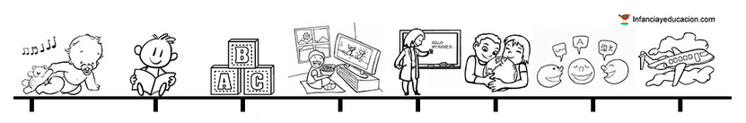
Thawj txoj hauv kev kawm lus pib thaum tus me nyuam tseem yau. Kev paub ib hom lus twg yog txoj kev tus me nyuam niaj hnub hnov thiab tau siv hom lus txhua lub sij hawm nyob hauv nws lub neej.

Slide 33

Paub Lus
Muaj
Nuj Nqi Heev

Slide 34

Lus Khab Ojibwe
Lus Mev
Lus Hmoob
Notes:
In the U.S., English is the Pac-man of all languages! Across the United States we have tens of thousands of children who come into our school system as bilinguals and leave the system as monolinguals. This break with the language oftentimes means a loss of cultural identity as well.
Vim hais tias lus Askiv yog zoo li tus Pac-mam noj tag sawv daws cov lus lawm. Nyob rau lub teb chaws no, peb muaj phav phav tus me nyuam tuaj kawm ntawv paub hais lawv hom lus tiam sis thaum lawv kawm tiav ces lawv tsuas paub hais lus Askiv lawm xwb. Qhov no txhais tau tias lawv ploj/xiam lawv tsis paub lawv yog leej twg thiab lawv poob lawv tej kev cai tib si lawm thiab.

Slide 35
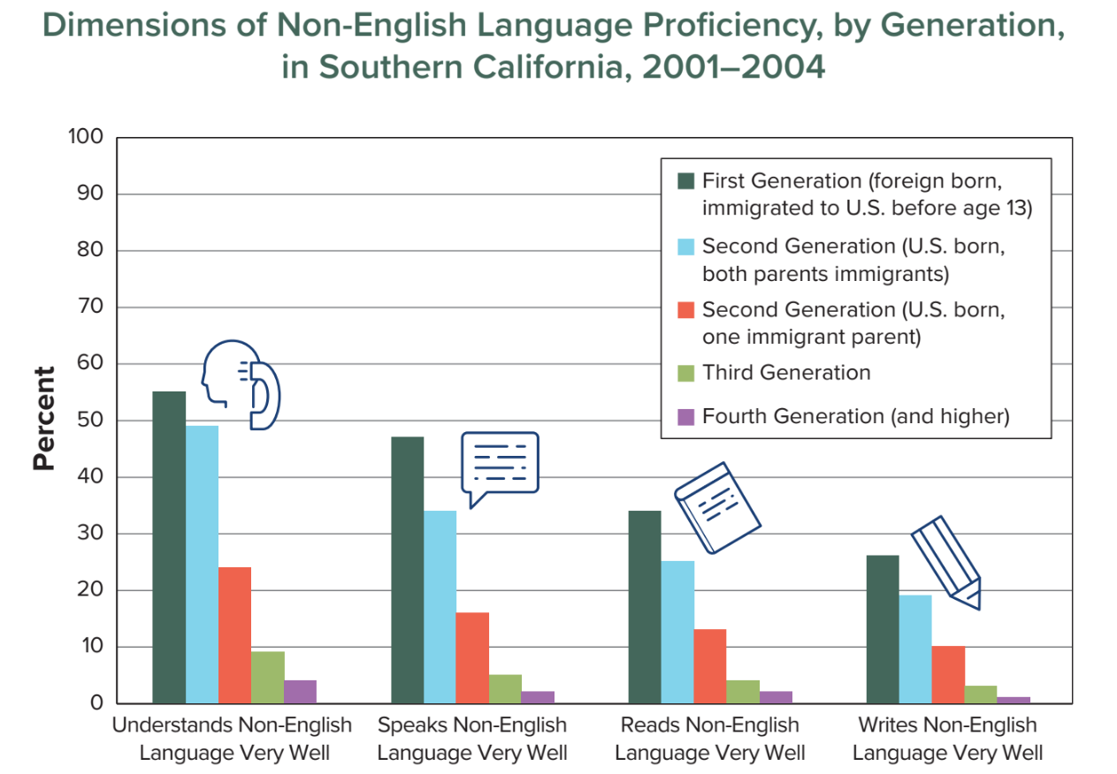
Kev Poob Lus Rau Cov Tsis Paub Lus Askiv Ib Tiam rau Ib Tiam
(American Academy of Arts and Sciences 2016)
Notes:
Walk them through the chart. Focus on the speaking data (the second set of bars).
For immigrant families, the ability to understand, speak, read, and write the home language disappears very quickly. A study in Southern California found that only 45% of first-generation adults who immigrated to the United States before the age of 13 could still speak the language of their parents well. Only 35% of second generation immigrants could speak their home language. And only 5% of third generation immigrants could speak the language of their grandparents. Without making a conscious effort to maintain it, families can lose their home language in 3 to 4 generations, showing just how powerful English is in the U.S. Take an informal survey of how many participants have experienced this.
Qhia lub rooj tshawb fawb. Qhov loj kom saib rau qhov tshawb fawb txog qhov hais lus (the second set of bars).
Cov tsev neeg uas tsiv tuaj nyob teb chaws no, kom lawv tau taub tias, kev hais lus, nyeem, thiab sau yus hom lus ploj zuj zus mus sai heev. Ib qho kev tshawb fawb nyob hauv lub xeev California nram qab teb pom tau tias tsuas tshuav 45% uas thawj tiam cov neeg laus tuaj nyob teb chaws no ua ntej thaum lawv muaj 13 xyoos tseem hais tau lawv hom lus. Tshuav 35% uas yog tiam ob tsiv tuaj nyob teb chaws no uas tseem paub hais lawv hom lus. Thaum kawg, tshuav 5% uas yog tiam thib peb tseem thiaj hais tau lawv hom lus lawm xwb. Yog tias peb tsis xyuas zoo, cov tsev neeg cov lus yuav ploj mus lawm nyob rau tiam 3 thiab 4, qhia tau tias lus Askis muaj zog npaum li cas. Nug thiab koj cov niam txiv tsa tes seb mauj puas tsawg leej pom los yog muaj ib yam li no nyob hauv nws lub neej.

Slide 36
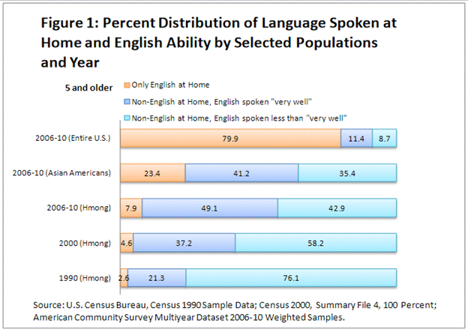
Tej Feem Qhia Txog Hom Lus Hais Tom Tsev thiab Kev Paub Lus Askiv Xaiv
Los Ntawv Haiv Neeg thiab Lub Xyoo
Notes:
This chart shows that from 1990 to 2010, the percentage of Hmong home language speakers who speak “Only English at Home” has grown steadily from 2.6% to 4.6% to 7.9%. This chart suggests that number will continue to grow if there is no effort to maintain the home language.
Daim ntawv teeb qhia neeg coob npaum li cas no thauv tawm qhia tias cov paub paub lus Hmoob uas yog neeg Hmoob ces tsawg zuj zus lawm
Qhia txoj kab hais lus Hmoob rau cov niam txiv paub tias lub sij hawm ntev zuj zus mus ces lus Askiv yuav yog hom lus hais rau hauv vaj hauv tsev thiab Hmoob yuav paub lus Askiv zoo zuj zu tuaj lawm. Thaum cov Hmoob paub lus Askiv zoo coob zuj zus tuaj lawm, yuav nyuaj zuj zus khaws thiab tuav lus Hmoob rau hauv lub vaj hauv tsev lawm.

Slide 37
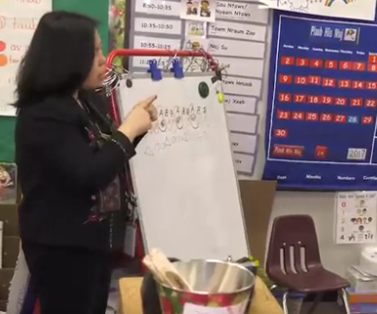

Qhov kev saib (Video) no ua txog hauv tsev kawm ntawv Saint Paul Public School kev cog lus los tsim kho ceev Hmoob tej lus thiab kab lis kev cai tseg.

Slide 38

publicdomainpictures.net
Notes:
If you are an English home language parent, you have different challenges. Despite the tremendous growth in Dual Language and Immersion programs over the last 45 years, you are still swimming against the tide. Most Americans - who could include your family, friends and coworkers - don’t know about, don’t understand or don’t agree with DLI education and you may be criticized for the choice you made. Your child will also have a harder time developing high levels of proficiency without additional exposure to the second language.
Yog tias koj yog ib tug niam txiv hais lus Askiv hauv koj lub tsev, koj muaj lwm yam kev cov nyom. Koj tus me nyuam lub sij hawm kawm lwm hom lus tsawg tsawg xwb, mas yog li koj yuav tau nrhiav txoj hau kev los pab txhawb nws txoj kev kawm. Txawm hais tias kev kawm ob hom lus ua tau zoo los lawm deb heev li 45 xyoo no los kev kawm ob hom lus tseem niaj hnub raug thuam. Feem ntau cov neeg Ameliska, tej zaum tseem yog koj tsev neeg thiab, cov phooj ywg, los sis cov txheeb ze, lawv tsis tau taub thiab lawv tsis ntseeg kev kawm Ob Hom Lus ces lawv yuav thuam koj tsis zoo vim koj cia koj tus me nyuam mus kawm Chav Kawm Ob Hom. Koj tus me nyuam yuav laj kawm kom mus txog rau ntu uas nws paub zoo zoo heev yog hais tias nws tsis muaj kev pab txhawb qhov twg los ntxiv rau nws txoj kev kawm lwm hom lus.

Slide 39

Pickit
“Paub ib hom lus qhib lub qhov rooj.
Paub ob hom lus qhib ntau txoj kev thoob ntuj.”
– Frank Smith

Slide 40

Peb ua nej tsaug nej tuaj koom hmo no!
Ua tsaug!
Thov pab sau kev ntsuam xyuas ntsig txog lub rooj hmo no. Nej cov lus qhia kho muaj nuj nqis heev rau peb!
LUS SOJ NSUAM
Pixabay
USDE Grant: Dual Language and Immersion Pathways to English Learner Success

Slide 41
Cov Ntaub Ntawv Tshawb Fawb Siv Los Qhia (References)
American Academy of Arts and Sciences. (2016). The state of languages in the U.S.: A statistical portrait. Cambridge, MA: Author. Retrieved from https://www.amacad.org/content/publications/publication.aspx?d=22429.
Center for Applied Second Language Studies. (2013). What levels of proficiency do immersion students achieve? Retrieved from https://casls.uoregon.edu/wp-content/uploads/pdfs/tenquestions/TBQImmersionStudentProficiencyRevised.pdf.
Cummins, J. (1980). The entry and exit fallacy in bilingual education. NABE Journal, 4, 1–7.
Fortune, T. W. (July, 2018). Dual language and immersion education: An introduction. Presentation given during the 2018 Center for Advanced Research on Language Acquisition (CARLA) Summer Institute: Immersion 101: An Introduction to Immersion Education, University of Minnesota, Minneapolis, MN.
Genesee, F. (2007). Top ten most consistent findings from research on foreign language immersion. The ACIE Newsletter, 10(3), 7 & 10.
Gibbons, P. (2015). Scaffolding language scaffolding learning: Teaching English language learners in the mainstream classroom (2nd ed.). Portsmouth, NH: Heinemann.
Krashen, S.D., & Terrell, T.D. (1983). The natural approach: Language acquisition in the classroom. NY: Prentice Hall Macmillan.
Lindholm-Leary, K.J., & Genesee, F. (2014). Student outcomes in one-way, two-way, and indigenous language immersion education. Journal of Immersion and Content-Based Language Education, 2(2), 165–180.
Mi Chu Chu Tren. (n.d.). Stages of second language acquisition. Retrieved from http://michuchutren.com/stages-second-language-acquisition/.

Slide 42
Acknowledgements and Permissions
Clipart taken from Classroom Clipart, Creative Commons, Flickr (CC), Freepnglogos, Pickit, Pixabay, Pixshark and Publicdomain are copyright-free and do not require permission or attributions.
The following images are reproduced with permission from their respective sources:
Slide 8: Mi Chu Chu Tren (https://michuchutren.com)
Slide 27: Be a Learning Hero (https://bealearninghero.org)
Slide 32: Infancia y educación (http://www.infanciayeducacion.com)
Slide 35: American Academy of Arts and Sciences (https://www.amacad.org/publication/state-languages-us-statistical-portrait/section/4)
Slides 18 & 19: R.J. Lozada (https://vimeo.com/55717676)

Slide 43
Cov Kws Sau
Cov neeg pab tsim cov lus qhia no
University of Minnesota:
Maureen Curran-Dorsano
Diane J. Tedick
Corinne Mathieu
Ua tsaug tshwj xeeb rau peb cov txhais ntaub ntawv:
Bounthavy Kiatoukaysy
See Pha Vang
May Lee Xiong
Phoua Yang
thiab rau peb tus los tawm tswv yim txhim kho:
Edward M. Olivos,
University of Oregon
Amanda Lea (Eastern Carver County)
Cathy Camarena (St. Paul)
Teresa Chavez (Roseville)
Carolina DuFault (Risen Christ)
Tara W. Fortune (UMN)
Leticia Guadarrama (Minneapolis)
Liz Hathaway-Castelán (St. Paul)
Laura Hofer (Richfield)
Bounthavy Kiatoukaysy (St. Paul)
Corina Pastrana (Minneapolis)
Melissa Richards de Campaña (St. Paul)
Anita Sasse (Northfield)
Kate Trexel (UMN)
Megan Unger (Minneapolis)

