Slide 1

Notes:
Notes to facilitators in italics.
Welcome the participants to the session. Introduce yourself and your role at the school/district.
Let them know there is one scheduled break but they are free to take personal breaks as necessary.
Cov ntawv tus cob qhia yuav hais yog cov ntawv italics
Qhib lus txhais tos cov niam txiv tuaj kawm hmo no. Qhia koj tus kheej thiab koj txoj hauj lwm nyob hauv tsev kawm ntawv.
Qhia rau lawv paub tias hmo no sawv daws muaj so ib zaug tiam sis yogleej twg ho xav muaj chaw mus so ntxiv no los yeej meem mus so tau.
Thank you for coming here tonight. We hope you enjoy the learning activities we have planned for you. Please do not hesitate to ask questions along the way.
Ua tsaug nej sawv daws tuaj hmo no. Peb cia siab tias nej yuav nyiam thiab txaus siab rau cov kev kawm peb npaj tuaj qhia nej hmo no. Peb sawv daws sib cog kawm mus, yog nej tsis tau taub qhov twg los yeej meem nug.

Slide 2

Lub Rooj Kawm
Kev Qhia Ob Hom Lus Rau Tsev Neeg
Kev Kawm
Lub Rooj
Kawm
Kev Qhia Ob
Hom Lus Rau Tsev Neeg
Kev Txhawb
Kev Koom Tes
USDE Grant: Dual Language and Immersion Pathways to English Learner Success
Notes:
The Dual Language and Immersion Family Partnership program is supported by a United States Department of Education grant from the Office of English Language Acquisition.
Lub Rooj Kawm Kev Qhia Ob Hoom Lus Rau Tsev Neeg tau txais kev txhawb ntawm United States Department of Education uas yog ib qhov grant los ntawm Office of English Language Acquisition.
Facilitators: try to mix up your parents so that they are sitting in mixed language groups.
We are going to be giving these sessions bilingually rather than separating you into different language groups. Your children are together for instruction and that integration is key to program success. Keep in mind, however, that although we will be doing these sessions bilingually, your children are taught in one language or the other – the teachers don’t translate or use both languages during their instruction.
Tus Qhia: Muab cov niam txiv sib xyaws kom lawv zaum ua ib pawg cov hluas txuam cov laus los yog muab lawv ua ib pawg uas (hais lus sib txawv txhob cia tib pawg hais tib hom lus xwb).
Peb yuav siv lus Hmoob thiab lus Askiv los qhia 3 lub rooj kawm no, kom tsis txhob tau muab nej cais nyias mus raws nyias hom lus. Nej cov me nyuam tuaj kawm hauv chav ua ke ces yeej muab lawv zaum sib txuam pem daws. Qhov no yog qhov yuav kom lawv kawm tau mus zoo. Nco cia tias peb txawm siv ob hom lus los qhia 3 lub rooj kawm no, tiam sis hauv chav cov tub ntxhais kawm peb tsuas siv tib yam lus xwb. Cov xib hwb tsis txhais lus los yog siv ob hom lus nyob hauv li.

Slide 3

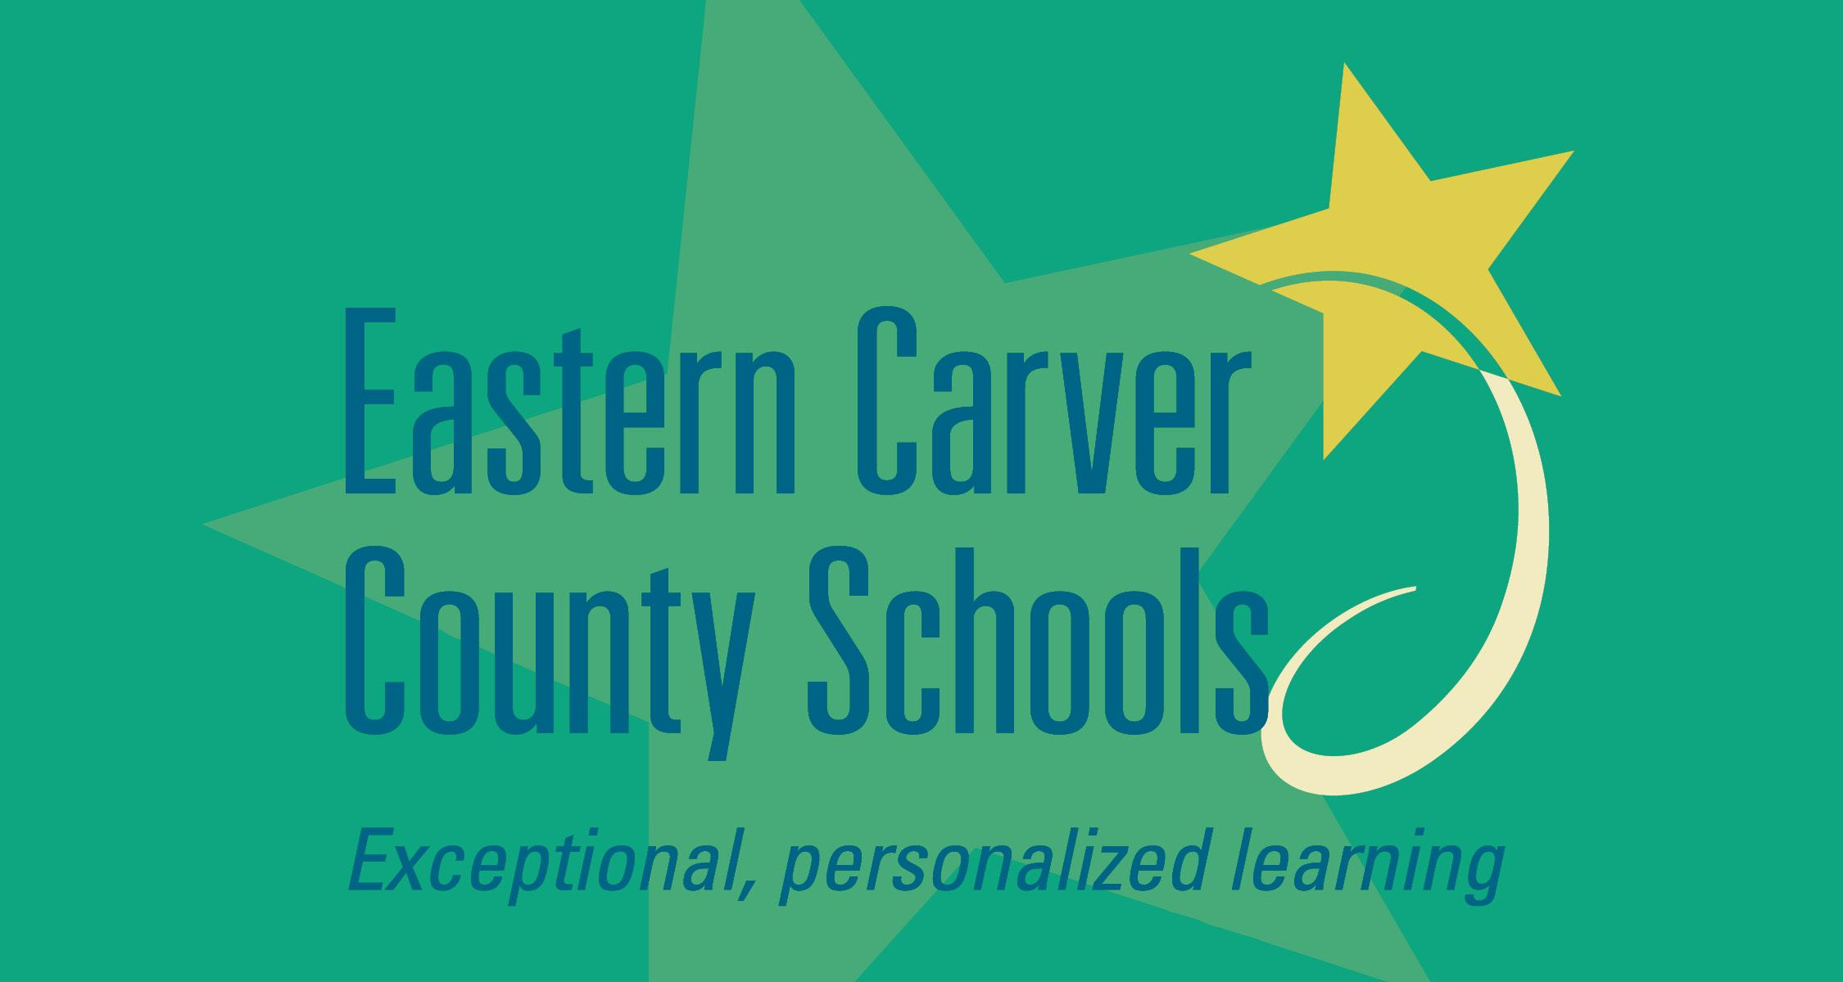





Cov Tsev Kawm Ntawv Uas Tau Sib Koom Tes
USDE Grant: Dual Language and Immersion Pathways to English Learner Success
Notes:
This grant was awarded to the University of Minnesota in partnership with the following districts/programs: Eastern Carver County Schools, Minneapolis Public Schools, Northfield Public Schools, Risen Christ Catholic School, Roseville Area Schools, and Saint Paul Public Schools.
Hais txog ntawm pob nyiaj, lawv muab rau lub tsev kawm ntawv qib siab, University of Minnesota tau muab coj los sib koom tes nrog lwm cov tsev kawm ntawv xws li: Eastern Carver County Schools, Minneapolis Public Schools, Northfield Public Schools, Risen Christ Catholic School, Roseville Area Schools, and Saint Paul Public Schools.

Slide 4

Qhia Txog Koj Tus Kheej
Pixabay
Qhia koj lub npe
Muaj pes tsawg tus me nyuam thiab lawv hnub nyoog li cas
Cov me nyuam lub tsev kawm ntawv
Hom lus koj tsev neeg siv/hais tom tsev
Yog vim li cas koj thiaj tuaj koom hmo no
Notes:
Depending on the size of the group, do this as a whole group (fewer than 10) or at tables.
10 minutes
Nyob ntawm seb pab neeg tuaj kawm ntawm coob paum li cas, xaiv seb kom sawv daws koom sib qhia tag rhos ua ke ( tsawg tshaj li 10 leej) los sis sib qhia ntawm lub rooj zaum ua ke xwb.
10 feem

Slide 5
Lub Zeem Muag
Yog kom paub txhawb dag zog thiab qhia txog kev kawm ob hom lus los ntawm kev sib koom tes, kev kawm , thiab kev txhawb tsev neeg.
USDE Grant: Dual Language and Immersion Pathways to English Learner Success
Notes:
Because many of the parents are L2 learners themselves, it is important to “read the room”: check frequently for understanding, rephrase as necessary, keep the acronyms to a minimum. Use your “teacher talk.” Assure parents that they should not hesitate to ask for clarification.
Vim tias coob tus niam txiv, lawv tus keej los yog tus neeg kawm lwm hom lus thiab, qhov tseem ceeb ces “yuav tsum paub cov niam txiv kom zoo” : Xyuas seb sawv daws puas nkag siab, rov hais tas los hais dua kom tau taub, siv cov (acronyms)- lus luv luv rau ib kab lus tsawg li tsawg tau. Siv koj tus cwj pwm “xib hwb hais lus li cas.” Nco ntsoov qhia thiab hais rau cov niam txiv tias yog muaj yam twg lawv tsis tau taub yeej meem nug kom lawv nkag siab.
The mission for this program is: READ the slide.
Lub zeem muag rau lub rooj kawm no: Nyeem daim xai lias

Slide 6
Kev Kawm
Kev Kawm Tau Ntawv Zoo Thiab Vam Meej Ntxiv Tom Ntej
Kev Txawb
Tsev neeg
Kev Koom Tes
Cov xib hwb & hauv tsev kawm ntawv
USDE Grant: Dual Language and Immersion Pathways to English Learner Success
Notes:
So what does this mean? First, students, families, teachers and other school professionals work in partnership to ensure that students achieve success while in school and beyond into the future. Note: point to the 3 points of the triangle to emphasize this partnership.
Qhov no txhais tau li cas? Qhov ib, cov tub ntxhais kawm ntawv, cov tsev neeg, cov xib hwb thiab lwm cov neeg hauv tsev kawm ntawv sib koom tes txhawb kom cov tub ntxhais kawm tau ntawv zoo lawm tom ntej. Nco cia: taw qhia thiab tham txog 3 lub ces kaum ntawm lub ntsais no.
It’s important for parents and families to be engaged in their children’s education. To be engaged means giving your full attention to something, to be in it – to give it your all. The same expectation holds for teachers and students – the idea is for everyone in this partnership to be committed to the child’s education and to give it their all.
The following text has been shortened and simplified:
It’s also important for parents and families to be educated, informed about the program – to understand what dual language and immersion programs offer children so that you are able to ask questions and offer feedback to teachers and other school professionals.
Finally, it’s critical for families and parents to become empowered. When you’re empowered you feel stronger and more confident, especially when it comes to supporting your child’s education and asserting your child’s educational rights.
When you are engaged and educated, you become more empowered. Those 3 things will help lead to your child’s success in school and beyond. You are your child’s strongest advocate and asset!
Tseem ceeb heev rau koj ua niam ua txiv txoj kev txhawb koj tus me nyuam txoj kev kawm ob hom lus. Qhov ib, koj yuav tau sib koom tes nrog tsev kawm ntawv, cov xib hwb thiab koj tus me nyuam txoj kev kawm. Kev koom tes zoo tib yam li thaum yus cog lus los npaj pib yus lub neej. Yuav tau sij zog ntso, mob siab, thiab rau siab tshwj yus lub neej kom zoo. Qhov 2, koj yuav tau kawm kom paub kom tus me nyuam txoj kev kawm ob hom lus kom zoo zoo thiab meej meej ces koj thiaj paub nug thiab nrhiav kev los pab koj tus me nyuam. Qhov 3, yog koj kawm thiab paub zoo txoj koj tus me nyuam txoj kev kawm ces koj muaj lub peem xwm thiab muaj cai mus hais thiab tawm suab los nrhiav kev pab koj tus me nyuam thaum nws kawm ob hom lus. Peb yam hais tag los no yog txoj kev koj tus me nyuam yuav kawm tau zoo thiab vam meej mus lawm tom ntej.
Nws tseem ceeb rau tsev neeg thiab tej niam tej txiv los siv koom tes txhawb tus me nyuam txoj kev kawm ntawv. Kev siv koom tes txhawb no txhais tau tias Ib qhov koj txaus siab uas koj muab tag nrho koj lub siab lub ntsws tso rau ntawd--tib yam li cov lus yus siv thaum yus sau siab hlo yuav sib sau los ua ib lub neej uab yig ua ke mus txog hnub kawg. Ces yog yus tau koom tes txhawb lawm ces yog yus tau muab tag rhos ib puas yam tshav rov ntawd. Qhov no los muaj tseeb rau cov xib hwb thiab cov tub ntxhais kawm ntawv. -Lub tswv yim thiab qhov tseeb ces kom txhua tus yuav tau los siv koom tes koom siab sib pab txhawb tus me nyuam txoj kev kawm ntawv kom mus rau qhov zoo ua ke. Tsis tag li, kuj tseeem ceeb rau cov niam thiab txiv kom paub txog qhov program txoj kev kawm-kom tau taub txog seb kev kawm ob hom lus yog dab tsi, es thiaj paub nug thiab qhia txog rau cov xib hwb thaum pom tej yam tsis zoo. Qhov kawg, nws tseem ceeb rau cov niam thiab txiv muaj suab rau tus me nyuam txoj kev kawm thiab lub program. Thaum koj muaj suab koj yuav muaj zog thiab muaj cuab kav, xws li thaum koj tus me nyuam txoj kev kawm thiab tus me nyuam muaj cai hais li qhov yog ntawm nws txoj kev kawm rau hauv chav kawm ob hom lus. Thaum koj txhawb thiab kawm paub txog lawm, koj yuav hais taus dua. 3 yam no yuav pab coj koj tus me nyuam txoj kev kawm kom vam meej nyob tom tsev kawm ntawv los yog lawm yav tom ntej. Koj yog tus uas yuav txhawb thiab ua tau rau koj tus me nyuam.

Slide 7
Lub Rooj Kawm Cov Ntsiab Lus
Qhov Chiv Ntawm Kev Kawm Ob Hom Lus
Kev Paub Hais, Nyeem, thiab Sau Ob Hom Lus
Kev Nyuab Los Ntawm Kev Kawm Ob Hom Lus
Kev Npaj Kawm Ntawv Qib Siab thiab Ua Hauj Lwm
Notes:
These are the four topics to be covered in the Family Partnership workshops. We strongly encourage you to attend all four sessions. You will graduate and receive a certificate after completing all four classes.
Ntawd no yog plaub lub ntsiab uas yuav muab coj los qhia rau Lub Rooj Kawm no. Peb ntseeg tau thiab vam tias nej yuav tuaj kawm tag nrho plaub lub ntsiab kawm uas peb npaj tau no. Thaum nej kawm tiav tag 4 lub ntsiab no, nej yuav tau txais ib daim ntawv qhuas qhia tias nej tau kawm tiav lawm los ntawm lub tsev kawm ntawm qib siab University of Minnesot thiab tsoov fwv lub tsev kawm ntawv St. Paul Public Schools.
As you read each session title, use these questions to clarify the academic language:
What do we mean by Dual Language and Immersion? What are the most important things to know about it?
What do we mean by “bilingualism” and “biliteracy”? How can you help your child become bilingual and biliterate?
What are the challenges facing students and their families when they choose a DLI program?
How can bilingualism and biliteracy open doors for your child in the future?
Thaum koj nyeem ib lub ntsiab twb, j siv cov lus nug hauv no los pab txhawb kom tau taub los nkag siab zoo duas.
Kev kawm ob hom lus no txhais tau li cas? Qhov tseem ceeb ntawm kev kawm ob hom lus yog dab tsi?
Kev paub ob hom lus thiab paub sau nyeem ob hom ntawv txhais tau li cas? Yus yuav pab tus me nyuam li cas kom nws paub ob hom lus thiab paub sau nyeem ob hom lus?
Cov kev yuav nyuaj rau tus tub ntxhais kawm ntawv thiab lawv tsev neeg muaj li cas thaum lawv xaiv kev kawm ob hom lus.
Kev paub ob hom lus thiab paub sau nyeem ob hom lus yuav pab tau koj tus me nyuam li cas rau yav neej pem suab?

Slide 8
Lub Hom Phiaj Hnub No
Kuv tau taub cov ntsiab lus, kev tseem ceeb, thiab kev muaj nuj nqi ntawm kev kawm ob hom lus (DLI).
Notes:
We have one main objective for our session tonight: for you to understand the goals and key features of dual language and immersion education. We’ll use the acronym “DLI” to refer to dual language and immersion education. “DLI language” and “Partner language” refer to Hmong.
Peb muaj ib lub hom phiaj kom nej paub rau hmo no: Rau kom nej tau tau cov hom phiaj thiab cov ntsiab lus ntawm kev kawm ob hom lus. Peb yuav siv cov tsiaj ntawv“ DLI”no los sawv cev rau kawm ntawv ob hom lus. “DLI language” thiab Partner Language” hais txog lus Mev los yog lus Hmoob.

Slide 9

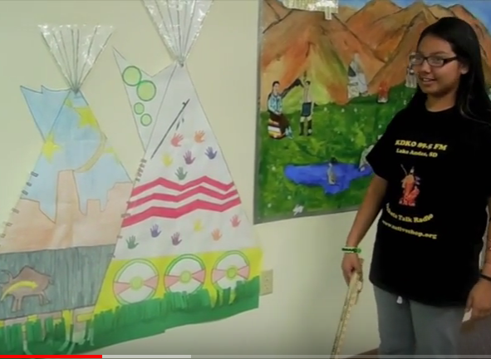



Txoj kev kawm Ob Hom Lus Yog Dab Tsi?
Ib Haiv Neeg Twg
Cov Lus
Kawm Lwm Hom Lus
Kev Kawm thiab Paub
Ob Hom Lus
Ke Kawm Ob Hom
Lus Thooj Txhim
NAWHERC
Minnetonka Public Schools
Pickit
Pickit
(Adapted from “The Dual Language Umbrella” in U.S. Schools [Howard et al., 2003])
Notes:
DLI education fosters the idea of additive bilingualism, where students become highly proficient in both English and the partner language, in our case, Hmong.
Kev kawm ob hom lus yog txoj kev txhawb nqa txhab kev paub ob hom lus- uas kom cov me nyuam paub ob hom lus zoo zoo thiab meej meej ib yam nkaus tsis hais lus Askiv los yog lus Hmoob.
There are four main program types that fall under the DLI umbrella.
Kev kawm ob hom lus muaj 4 txoj kev kawm nyob rau hauv lub kaus kawm ob hom lus.
Point to each section of the umbrella as you introduce the four program types.
Taw ib kem zuj zus thaum koj piav txog 4 yam kev kawm no.
Indigenous/Heritage language immersion: These programs are designed to revitalize endangered Indigenous – or native - cultures and languages. They typically enroll students of Indigenous heritage. In Minnesota we have Ojibwe and Dakota language immersion programs.
Indigenous/Heritage language immersion: Cov kev kawm (Programs) no tsim muaj los cawm los yog ceev cov neeg khab tej lus, tej kev lis kev cai thiab tej txuj ci cia. Lawv tsuas qhib rau cov tub ntxhais kawm ntawv uas yog los ntawm caj ces ntawd xwb. Nyob rau lub xeev Minnesota lawv muaj cov kev kawm cov khab Ojibwe thiab Dakota cov lus.
Developmental Bilingual Programs: These bilingual programs serve language learners with similar language and cultural backgrounds – for example, a group of students who speak Spanish at home. Learners have the opportunity to maintain and improve their home language as they learn English. In Minnesota the developmental programs are all in Spanish.
Developmental Bilingual Programs: Cov kev qhia ob ho lus no pab rau cov tub ntxhais uas txawj hais tib co lus thiab muaj kev li kev cai zoo tib yam – muab piv txwv, Ib pab tub ntxhais uas hais lus Mev nyob tom vaj tom tsev. Lawv muaj lub cib fim ceev lawv cov lus cia thiab txhim kho kom lawv cov lus zoo dua qub thaum lawv tab tom kawm Askiv. Nyob hauv xeev Minnesota cov Kev qhia ob hom lus li no puav leej rau neeg Mev xwb.
One-Way World Language Immersion: This program is designed for learners whose home language is English. In Minnesota there are one-way programs in Spanish, French, German, Mandarin and Korean.
One-Way World Language Immersion: Qhov kev kawm no yog tsim los qhia cov tub ntxhais uas hom lus lawv tham tom vaj tom tsev yog Askiv. Nyob hauv xeev Minnesota lawv muaj (one-way programs) rau neeg Mev, neeg Fab Kis, neeg Ntsaws Mes Nis, neeg Suav thiab neeg Kaus Lim.
And finally, the program that is represented here tonight is the Two-Way Immersion program. It is like a combination of developmental bilingual and one-way world language immersion because it intentionally brings together children from two language groups – English home language and those who speak the partner language (Spanish or Hmong) at home. And the students receive instruction in both languages.
Ces thaum kawg no, yog qhov kev kawm (program) uas yuav coj los qhia hmo no. Nws yog qhov kev Kawm Ob Hom Lus (Two-Way Immersion program) Nws zoo li muab ob qhov kev kawm (developmental bilingual and one-way world language immersion) tso ua ib qhov xwb. Vim nws coj cov tub ntxhais ntawm ob qhov kev kawm no los kawm ua ke – Cov hais lus Askiv thiab cov hais lawv thawj thawj hom lus (Hmong los yog Mev) tom vaj tom tsev. Tsis tas li ntawm kev qhia ntawv rau cov tub ntxhais los yog siv ob hom lus qhia (Askiv thiab Hmong los yog Mev).

Slide 10

Lub Hom Phiaj Ntawm Kawm Ob Hom Lus?
Kawm ntawv tau yooj yim
Keej nyeem, keej sau thiab keej hais ob hom lus
Khaws tau haiv neeg keeb kwm thiab tej kev lis kev cai
(Fortune, 2013)
Notes:
In the Hmong ppt, we changed this to the 3 Ks, so you’ll have to explain that.
All four of these program types share the same 3 goals. Think of the ABCs of Dual Language and Immersion.
Explain:
Academic achievement has to do with how well students do in school.
Bilingualism means speaking two languages to a high degree. Biliteracy means reading and writing in two languages.
Cultural competence is about understanding how culture (our own and other cultures) affects the way we think and act.
Tonight we are going to focus mostly on Academic Achievement.
Peb rov saib peb kawm li cas lawm. Peb lub hom phiaj ntawm kev kawm ob hom lus. Hmo no peb tham txog kev kawm thiab xeem tau ntaub ntawv. Lwm lub lim tiam peb yuav kawm txoj kev paub nyuam, sau, thiab hais ob hom lus. Ua ntej peb xaus hmo no, peb xav hais ob peb lo los txoj kev paub haiv neeg kab li kev cai thiab keeb kwm.

Slide 11

Kawm ntawv tau yooj yim

Slide 12

Kawm ntawv tau yooj yim
Raws li yam pom tag los, thaum sawv daws
kawm mus txog rau qib nrab (middle school),
lawv muab cov me nyuam txoj kev kawm los
sib piv. Ntawm ob pawg tub ntxhais kawm
ntawv no, ib pawg yog nyob rau chav kawm ob hom hos ib pawg nyob chav kawm lus Askiv xwb. Thaum muab ob pab no coj los xeem ua ntawv Askiv (Kev ua leb, sau ntawv, nyeem ntawv) pab uas kawm ob hom lus xeem tau zoo tib yam nkaus los yog tseem tau zoo dua zog pawg kawm ib yam lus xwb.
Maxpixel
(Lindholm-Leary & Genesee, 2014)

Slide 13

Kawm ntawv tau yooj yim
Tej zaum cov tub ntxhais hais lus Askiv tom tsev yuav pom tias lawv yuav ib nyuag poob qab me ntsis ntawm kev nyeem thiab sau ntawv Askiv, tiam sis tom qab kawm lus Askiv 1-2 xyoo ces lawv yuav caum cuag.
Rau cov me nyuam uas niam thiab txiv siv lus Hmoob tom tsev tiam sis tus me nyuam ho hais lus Askiv, txoj kev poob qab no yuav ntev zog lwm tus.
Pickit
(Genesee, 1987)
Notes:
For Hmong heritage learners who speak English at home but whose parents are English language learners themselves, this lag may take longer to disappear.
Rau cov tub ntxhais uas hais lus Askiv tom tsev tiam sis niam txiv yog Hmoob thiab kawm lus Askiv tom qab, yuav siv sij hawm ntev me ntsis thiaj li caum cuag.

Slide 14
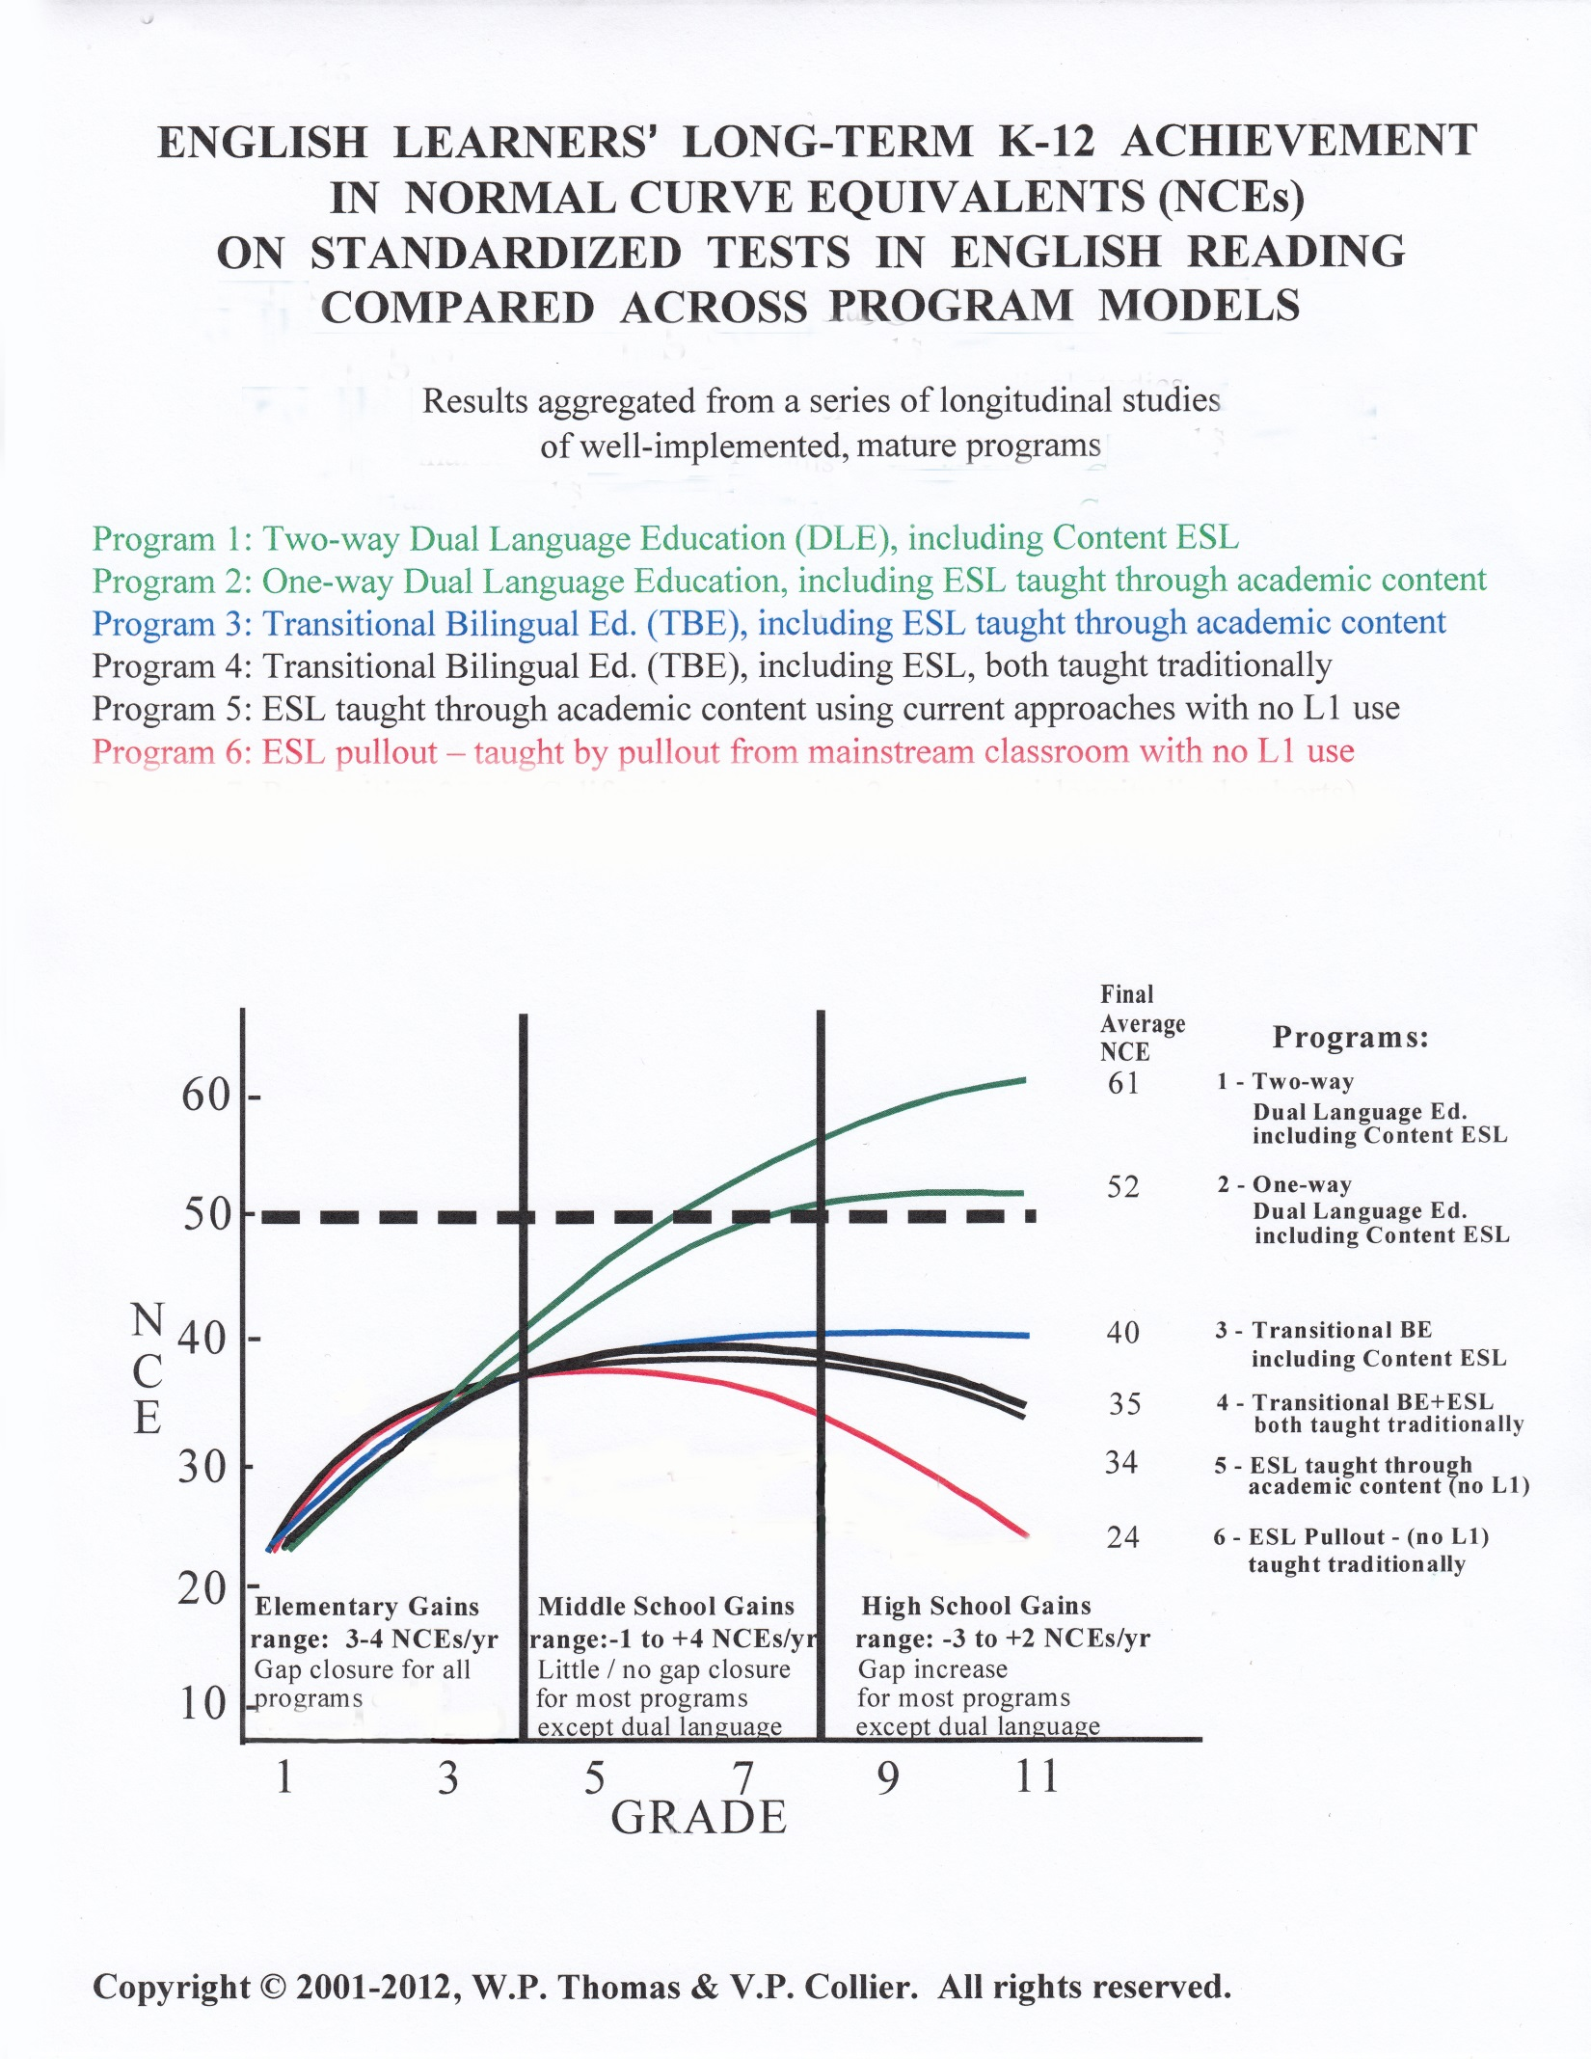
Notes:
This graph shows how English learners achieve in English reading in a variety of program models. It represents longitudinal research involving over 15,000 students in different programs and languages across several US states (but not including MN). Longitudinal research means that we’re looking at the same students over time. Let’s look at a larger version of the graphic to better interpret it.
Daim duab no qhia txog cov menyuam kawm lus Askiv ua hom lus thib ob txoj kev xeem kev nyeem ntawv ua lus Askiv. Nej yuav pom tias muaj ntau txoj kev qhia ntawv. Daim duab no piv txog txoj kev soj ntsuam tshaj 15,000 tus tub/ntxhais kawm thoob plaws teb chaws no (tiamsis tsis muaj MN). Txoj kev soj ntsuam no yog raws tus menyuam mus soj ntsuam ntev ntev. Cia peb mus saib daim duab loj zog kom peb thiaj pom tseeb thiab paub txhais zoo dua.

Slide 15
Kev Ntsuas Cov Tub Ntxhais Kawv Askiv
(ELL) Txoj Kev Nyeem Ntawv Tau Zoo
Rau cov tub ntxhais kawm nyob hauv chav ob hom lus, lawv yuav ncua thiab poob qab me ntsis ntawm txoj kev kawm nyeem ntawv Askiv thaum lawv nyuam qhuav pib mus kawm nyob rau chav ob hom lus. Tiam sis thaum kawm mus txog rau qib 5 los sis 6 ces lawv kawm tau zoo thiab paub tib yam li cov tub ntxhais kawm chav Askiv lawm.
Cov tub ntxhais uas pheej kawm lawv hom lus tauj mus ntxiv lawm tom ntej pom tau tias lawv kawm nyeem ntawv Askiv tau zoo dua cov tub ntxhais nyob rau chav qhia lus Askiv xwb.
(Thomas & Collier, 2002, 2012)
Notes:
Note: You don’t have to go into detail about all of the different kinds of programs on this graph. Point out the heavy dotted line, which represents average English-language reading achievement levels for native English speakers in English-only programs, and the top 2 lines for ELs (ELs in two-way and developmental bilingual programs).
Again, we might predict similar outcomes for Hmong students in two-way immersion as long as the program adheres to the general principles of the dual language and immersion model.
Note: Tsis tag koj you qhia txhua yam txog cov program qhia kawm ntawv kom paub lus no nyob hauv lub rooj teem cia. Taws thiab qhov qhia yog txoj kab dhoog dub dub rov tav uas yog qhia txog feem coob ntawm cov neeg paub lus Askiv tus xeem rau cov neeg ib txhwm hais lus Askiv xwb uas nyob rau chav kawm ntawv Askiv thiab ob kab nyob saum toj qhia txoj lwm hais neeg kawm ntawv Askiv ( lwm hais neeg kawm nyob rau chav kawm ob hom lus thiab chav qhiv kawv kom paub lus Askiv)
Rau cov Hmoob qhia lub rooj kawm: Ib zaum ntxiv, peb yuav muab piv txwv tau tias rau cov me nyuam Hmoob kawm rau chav kawm ob hom lus ces mus txog tim yam yog tias lawv taug tib txoj kev kawm li kev kawm ob hom lus.
For your information only: NCE = Normal Curve Equivalent – an NCE of 50 = the 50th percentile, which is the average performance of native English-speaking students - that’s depicted by the dotted line.
Nov yog rau koj paub xwb: NCE= yog txo kab ib nrab ntawm kev ntsuas sawv daws.- 50% 50 feem 100 ntawm ces yog ib nrab uas cov tub ntxhais hais lus Askiv - yog txog kab dub dhoog tab.

Slide 16
Vim li cas cov kawm tau zoo thiaj li kawm tau zoo?
Muaj kev txhawb lawv cov lus nyob rau tom tsev kawm ntawv
Tsev neeg siv lawv cov lus tom tsev los txhawb nws thiab
Notes:
One-way Dual language Ed. = Developmental Bilingual on Umbrella slide

Slide 17

Txoj kev mus kom Kawm ntawv tau Yooj Yim
pixshark
Txoj kev yuav tsis daig daig. Nyeem seb tej kev nyuab siab
koj yuav ntsib yog dab tsi?
Pab tawm tswv yim seb thaum ntsib cov kev nyuab siab no,
yuav ua dab tsi los pab?
Notes:
The road to bilingualism is a bumpy one! Tonight you will learn how to deal with those bumps with your child. The first two bumps are about Academic Achievement.
Tauj txoj kev paub ob hom lus yeej tsis nyooj yim. Koj thiab koj tus me nyuam yuav raug kev nyuam siab thiab muaj kev txhawj. Nyob rau hmo no thiab lwm lub lim tiam yog peb yuav tuaj kawm thiab sib txhawb cov teeb meem no ua ke.
Bumps in the Road Activity. Read/display each “bump” (slides 21, 22). Give parents a minute or two to discuss a possible response – how they might deal with this challenge. Share a few comments then click on the “bump” slide to show the response we created.

Slide 18


Pixabay.com
Rov qhia rau koj tus me nyuam kom nws nco tias muaj nuj nqis heev, yog nws txawj nyeem lwm hom lus.
Yog koj tus menyuam muaj kev ntxhov siab vim nws nyeem tsis tau tej phau ntawv ua lus Askis, ces koj yuav tsum los nrog nws nyeem ua ke yog koj paub, los siv mus qiv cov ntawv kaw suab tom tsev qiv ntawv los mloog ua ke.
Tiam sis yeej meem txhawb kom nws nyeem ntawv Hmoob thiab ua qhia koj tus me nyuam tias koj nyiam nyiam cov phau ntawv uas nws txawj nyeem.
Thaum koj tus me nyuam nyob Qib 2, tej zaum koj yuav txhawj tias nws pheej tseem tsis tau txawj nyeem ntawv Askiv. Tsis tag lis, nws los tseem pom nws cov phooj ywg nyeem tej phau ntawv Askiv nyuaj dua thiab haib haib ua rau nws xav xav nyeem ntawv zoo ib yam li lawv.

Slide 19

Pixabay
Nco tias yuav siv sij hawm ua ntej koj pom tus me nyuam txoj kev txawj ntawv tshwm sim.
Koj yuav tau nkag siab tias txoj kev koj tus me nyuam taug yog nws yuav paub nyeem, sau, thiab hais ob hom lus. Nco ntsoov tias txoj kev ntsuas no lawv tsis ntsuas txog tus me nyuam txoj kev paub hom lus lawv tsuas ntsuas sab Askiv xwb.
Thaum koj tus me nyuam nyob qib 3, nws yuav raug xeem. Koj yuav pom tias nws daim ntawv ntsuas xeem qhia tias nws xeem tau qis dua lwm cov tub ntxhais nyob nws qib uas kawm Askiv.

Slide 20

Keej nyeem, keej sau thiab keej hais ob hom lus
Notes:
The second goal of DLI is Bilingualism and Biliteracy. Because there is so much information to share about this goal, we will dedicate the entire next session to it. Be sure to come back for this important presentation.
Lub hom phiaj thib ob ntawm kev kawm ob hom lus yog kev keej nyeem, keej sau thiab keej hais ob hom lus. Vim yuav muaj ntau yam peb yuav qhia txog lub hom phiaj no, peb yuav siv txoj kev qhia tom ntej no txog qhov no xwb. Yog li, rov tuaj kawm vim tias qhov no tseem ceeb heev.

Slide 21

Khaws tau haiv neeg keeb kwm thiab tej kev lis kev cai

Slide 22
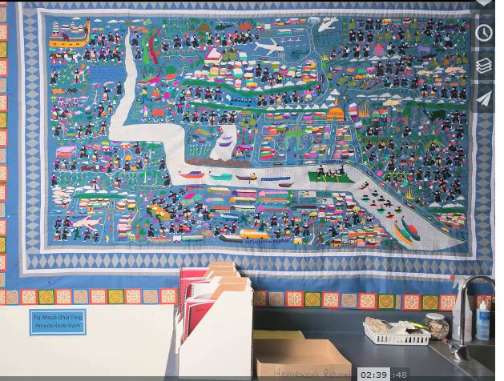

Khaws tau haiv heeg keeb kwm thiab tej kev lis kev cai
Nyob hauv chav kawm ob hom lus (DLI classroom), txoj kev kawm lus thiab kawm yus keeb kwm ces yeej sib ncab sib ncaws ua ke.
R.J. Lozada
Cov tub ntxhais yuav kawm kom sib tau taub, txawj sib txuas lus sib tham nrog lwm tus neeg thiab txawj sib raug zoo nrog lwm pab lwm pawg tsis thaum siv lus Askiv los yog yus hom lus Hmoob.
R.J. Lozada
(Australian Children’s Education and Care Quality Authority, 2014)

Slide 23


Paub Coj Kom Haum Xeeb Nrog Lwm Haiv Neeg
Ib Txhia Kev Tshawb Fawb Pom:
Muaj nuj nqi heev rau cov tub ntxhais kawm nyob chav ob hom lus vim muaj lwm tus tub ntxhais yog lwm haiv thiab paub hais lwm hom lus nrog lawv kawm ua ke.
Lawv tus cwj pwm zoo kawm tau hauv
chav ob hom lus nyob nrog lawv mus li.
(Feinauer & Howard, 2014)

Slide 24

Paub Coj Kom Haum Xeeb Nrog Lwm Haiv Neeg
Feem coob ntawm cov tub ntxhais nyob rau chav kawm ob hom lus txawj coj tus cwj pwm zoo kom los sib haum xeeb ntau duas lwm cov kev qhia kawm ntawv ( programs).
Cov tub ntxhais hauv chav qhia ob hom lus hais tias muaj 2 yam tseem ceeb rau lawv tus kheej:
                Tau kawm ntawv hauv chav qhia ob hom lus.
                Lub cib fim uas kev qhia ob hom lus muab rau lawv tau kawm lawv thawj hom lus thiab nthuav lawv lub tswv yim rau ntau txoj kev kawm paub ntaub paub ntawv.
MaxPixel
(Feinauer & Howard, 2014)

Slide 25

Khaws tau haiv heeg keeb kwm thiab tej kev lis kev cai
Txoj kev kawm thiab paub hom lus yus kawm mas yog yuav tsum paub txog haiv neeg ntawd tej kev lis kev cai thiab keeb kwm zoo. Muab piv txwv li, thaum yus ua haiv neeg ntawm tej zaub mov noj ces tsis siv lawv tshwj laj txhiam xwm ces yeej tsis qab thiab tsis xws li haiv neeg ntawd cov zaub mov. Nov ces yog tib yam li muab haiv neeg lawv cov lus zoo thiab muaj kuab tshem tawm ntawm hom lus lawv.
(Zart, 2012)

Slide 26

Txoj kev mus kom Khaws haiv neeg keeb kwm
thiab tej kev lis kev cai
pixshark
Txoj kev yuav tsis tus tus. Nyeem seb tej kev nyuab siab
koj yuav ntsib yog dab tsi?
Pab tawm tswv yim seb thaum ntsib cov kev nyuab siab no,
yuav ua dab tsi los pab?

Slide 27

Pixabay
Kev tshawb fawb qhia tias cov me nyuam kawm ob hom lus, tsis hais yam lus twg. Lawv xum hais lus Askiv. Thaum lawv kawm mus rau qib siab lawm los lawv tseem xum siv lub Askiv xwb. Cov niam thiab txiv txoj hauj lwm ces yog txhawb thiab nco ntsoov qhia kev muaj nuj nqis ntawm kev paub ob hom lus.
Thaum koj tus me nyuam nyob qib 4, nws tsis tau paub txog nws tus kheej. Nws pheej xav coj kom nws zoo li cov me nyuam Ameliska thiab. Thaum no, nws tsis xav hais lus Hmoob lawm. Lub sij hawj no, txhua txhua tus me nyuam kawm ntawv yeej coj tus cwj pwm li no.
Notes:
Share out with the “bump” slides by clicking on the statement and reading it, plus one more click to make the answer appear (read answer).
Ask if they came up with other ideas for responding to the bump.

Slide 28

Notes:
10 minutes
10 Feeb

Slide 29

Notes:
Distribute BINGO cards, one to each table or small group. Display and read one slide at a time. Participants find the answer on their bingo card and either mark it with a pencil or, if you want to reuse the sheets, give them bingo markers. After one table calls BINGO, check their answers. If time permits, continue playing until another table calls BINGO. You may not have time to go through all the questions.

Slide 30

Cov Ntsiab Hauv Kev Qhia Ob Hom Lus
Siv li 50% los ntau tshaj lus Hmoob coj los qhia ntawv thaum kawm nyob rau qib me.
Saib hom lus qhia thiab lawv keeb kwm
muaj nuj nqi nyob rau hauv chav kawm
los sis nyob rau hauv lub tsev kawm ntawv.
Ob pab tub ntxhais sib npaug zos: Cov tub ntxhais paub hais lus Askiv xwb thiab cov tub ntxhais hais lawv thawj hom lus, xws li lus Hmoob.
R.J. Lozada
(Christian, 2011; Fortune & Tedick, 2008; Hamayan, Genesee & Cloud, 2013)

Slide 31

Cov Ntsiab Hauv Kev Qhia Ob Hom Lus
Chav ob hom lus siv ntaub ntawv thiab lus ntawm cov tswv yim kev qhia thiab kawm ntawv los coj qhia cov tub ntxhais kawm kom paub thiab tau taub thaum kawm lwm hom lus.
(Christian, 2011; Fortune & Tedick, 2008; Hamayan, Genesee & Cloud, 2013)
Notes:
Here you see an example of a kindergarten calendar display in Hmong. Besides learning math concepts through this daily routine, DLI students learn the foundations of the partner languages: colors, numbers, days of the week, weather expressions and even clothing.
Nov yog ib cov qauv nyob hauv chav kindergarteen daim ntawv qhia txog hnub uas lawv kawm Hmoob. Tus txheej txheem kawm niaj hnub txog leb, Cov tub ntxhais kawm ob hom lus kawm txog cov xim, cov zauv, cov hnub, cov huab cua thiab cov khaub ncaw.

Slide 32

Cov Ntsiab Hauv Kev Qhia Ob Hom Lus
Siv ob hom lus los qhia nyeem thiab sau
ntawv rau txhua tus kawm hauv chav kawm
ob hom lus.
Pickit
Cov ntaub ntawv qhia xwb li ( leb, keeb txuj (science), neeg keeb kwm (social studies) thiab kev nyeem/sau ntawv) yeej qhia rau txhua txhua tus tub ntxhais thiab siv ob hom lus los qhia; lus Askiv thiab lus Hmoob.
Muab ob pab tub ntxhais, pab hais lus Hmoob thiab pab hais lus Askiv los kawm ua ke tib lub sij hawj.
(Christian, 2011; Fortune & Tedick, 2008; Hamayan, Genesee & Cloud, 2013)

Slide 33

Cov Ntsiab Hauv Kev Qhia Ob Hom Lus
Yeej qhia thiab siv tim yam ntaub ntawv li leb, kev nyeem thiab sau ntawv, kawm keeb kwm, los sis kawm txog keeb txuj los qhia thiab kawm tib yam li txhua txhua lub tsev kawm ntawv hauv tsoom fwv tsev kawm ntawv (district).
Pixabay
Kev qhia kom paub thiab keeb ces yim siv lub teb chaw Ameliska thiab lub xeem no txoj kab li kev cai nyob hauv ntaub ntawv thiab yeej siv lub tsev kawm ntawv tsoom fwv cov ntaub ntawv muaj los qhia.
(Christian, 2011; Fortune & Tedick, 2008; Hamayan, Genesee & Cloud, 2013)

Slide 34
Cov Ntsiab Hauv Kev Qhia Ob Hom Lus
Xib hwb thiab tub ntxhais kawm ntawv yuav tau siv lus Hmoob ntau thaum sij hawm kawm ntawv Hmoob.
R.J. Lozada
(Christian, 2011; Fortune & Tedick, 2008; Hamayan, Genesee & Cloud, 2013)
Notes:
Research on how we learn second languages shows that we have to use the language consistently in order to learn it. We have to prioritize, privilege and protect Hmong in these programs. Students WILL learn English – it’s Hmong that is more challenging for us to develop in these programs – even for Hmong home language students.
Kev tshawb fawb hais txog ntawm kev kawm ob hom lus pom tau tias thaum qhia ntawv, peb yuav tau siv lus Hmoob kom xwm yeem txhob hloov mus hloov los thiaj kawm tau. Peb yuav tau muab qhov kev qhia ntawv Hmoob saib hlob, xyuas kom rau nqis, thiab nrog tiv thaiv kom zoo. Cov tub ntxhais kawm ntawv YEEJ yuav tsum txawj lus Askiv xwb xwb—Qhov tsis yooj yim yog tsim kom tau cov ntaub ntawv Hmoob los qhia nyob rau hauv tsev kawm ntawv. Tsis yooj yim tib yam nkaus rau cov tub ntxhais hais Hmoob lus.

Slide 35

Tic-Tac-Toe! Koj paub npaum li cas?
Muab koj cov ntawv khwb.
Tus coj/thawj nyeem daim ntawv. Txhua leej hauv pab pawg ntawd,txiav txim siab ua ke tias daim ntawv ntawd hais tseeb los cuav.
Yog tseeb ces kos lub O rau ib lub thawv. Yog cuav ces kos tus X rau ib lub thawv.
Yog koj tau 3 qhos ( peb lub O los yog 3 tug X) sib cab daws qhia hais tias koj tau Tic-Tac-Toe! Tiam sis txhab ntxiv mus kom tag.
Notes:
Note: Since some parents may not be comfortable reading aloud in English, this game will be played cooperatively as a whole team. You will be provided with the bilingual materials you need to engage attendees in this activity. Explain how the game will proceed by following the text on the slide. You may need to model the first one (do an audience check to see if that will be necessary).
Nco cia: tej zaum muaj ib cov niam txiv yuav tsis kam nyeem ua us As kiv, qhov kev ua si no muab ua ib pab sawv daws ua. Koj yuav tau tsim qhov uas koj yuav ua kom cov niam txiv tau tau. qhia seb yuav ua li cas raws ntawm cov slide. tj zaum koj yuav tau ua qhia ua qauv ua ntej (Xyuas seb lawv puas yuav tas ua qhia yam ua qauv)
After 10 minutes, check answers (next few slides).
Li 10 feeb tom qab koj mam xyuas seb lawv teb li cas

Slide 36
Nyob hauv chav Qhia Ob Hom Lus, txhua tus tub ntxhais kawm yeej paub ob hom lus (Hmoob).
Nyob hauv chav Qhia Ob Hom Lus, cov tub ntxhais yeej tau txais kev qhia thiab kawm cov ntsiab (subjects) tib yam li cov tub ntxhais kawm hauv chav Askiv.
.
1
2
Nyob hauv chav Qhia Ob Hom Lus siv lus Hmong qhia ntaub ntawv rau cov tub ntxhais paub hais lus Hmong xwb. Hos siv lus Askiv qhia rau cov paub hais lus Askiv.
Nyob hauv chav Qhia Ob Hom Lus, 50% feem pua cov lus siv qhia ntawv yog lus Hmoob.
3
4
Notes:
You must be in presentation mode to see animations. To correct, click on each sentence to reveal the X or O. Be sure to go in order as the animations are sequenced in order 1-12. For each false answer, elicit the correct answer.
Koj yuav tsum nyob rau qhov so xai lais thiaj li yuav pom mus li yeej yam kiab. Thaum mus kuaj, nias ib kab lus ntawm kab ntawv thiaj mas qhia tias yog X los sis O. Nco ntsoov yuav tsum mus raws li tus zauv thiaj li yuav pom mus li yeej yam kiab los yog siv raws 1-12. Rau kab lus twb uas yog cuav, kom qhia qhov yog los qhov tseeb.

Slide 37
Nyob hauv chav kawm ob hom lus (DLI classroom), txoj kev kawm lus thiab kawm yus keeb kwm ces yeej sib ncab sib ncaws ua ke.
Lub ciaj cov xib hwb qhia ntaub ntawv rau cov tub ntxhais, lawv sib ob hom lus los qhia.
5
6
Thaum pib qhia ntaub ntawv Askiv lawv ces, lus Askiv yog hom lus siv heev tshaj rau hauv chav kawm lawm.
Txhua tus tub ntxhais hauv chav Qhia Ob Hom Lus yuav tsum kawm kom tau raws li txoj kev kawm Xeev MN. Teev tseg (MN State Standand).
7
8
8

Slide 38

Ua tsaug rau koj tuaj koom peb hmo no
Thiab rau koj txoj kev los koom tes nrog peb!
Thov mus teb cov lus soj ntsuam uas yuav qhia tau rau peb tias koj kawm tau dab tsi thiab ua li peb ho yuav ua li cas thiaj li ua kom txoj kev kawm no zoo tshaj qhov qub.
LUS SOJ NSUAM
Pixabay
USDE Grant: Dual Language and Immersion Pathways to English Learner Success

Slide 39
Cov Ntaub Ntawv Tshawb Fawb Siv Los Qhia (References)
Australian Children’s Education and Care Quality Authority (ACECQA). (2014). What does it mean to be culturally competent? Retrieved from https://wehearyou.acecqa.gov.au/2014/07/10/what-does-it-mean-to-be-culturally-competent/.
Christian, D. (2011). Dual language education. In E. Hinkel (Ed.), Handbook of research in second language teaching and learning. Vol. II (pp. 3–20). NY: Routledge.
Feinauer, E., & Howard, E.R. (2014). Attending to the third goal: Cross-cultural competence and identity development in two-way immersion programs. Journal of Immersion and Content-Based Language Education, 2(2), 257–272.
Fortune, T.W., & Tedick, D.J. (2008). One-way, two-way, and indigenous immersion: A call for cross-fertilization In T. W. Fortune, & D. J. Tedick (Eds.). Pathways to multilingualism: Evolving perspectives on immersion education. (pp. 3–21). Clevedon, England: Multilingual Matters, Ltd.
Genesee, F. (1987). Learning through two languages: Studies of immersion and bilingual education. Cambridge, MA: Newbury House.
Genesee, F. (2007). Top ten most consistent findings from research on foreign language immersion. The ACIE Newsletter, 10(3), 7 & 10.
Hamayan, E., Genesee, F., & Cloud, N. (2013). Dual language instruction from A to Z. Portsmouth, NH: Heinemann.
Howard, E.R., Olague, N., & Rogers, D. (2003). The dual language program planner: A guide for designing and implementing dual language programs (p. 3). Washington, DC & Santa Cruz, CA: Center for Research on Education, Diversity & Excellence.

Slide 40
Cov Ntaub Ntawv Tshawb Fawb Siv Los Qhia (References)
Thomas, W.P., & Collier, V.P. (2012). Dual language education for a transformed world. Albuquerque, NM: Dual Language Education of New Mexico and Fuente Press.
Zart, B. (2012). The importance of culture in language learning. Retrieved from https://billzart.wordpress.com/2012/03/04/the-importance-of-culture-in-language-learning/.

Slide 41
Acknowledgements and Permissions
Clipart taken from Creative Commons, Pickit, Pixabay, MaxPixel, and Pixshark are copyright-free and do not require permission or attributions.
The following images are reproduced with permission from their respective sources:
Slide 9: one-way immersion: Minnetonka Public Schools, Minnetonka, Minnesota (https://www.minnetonkaschools.org)
Slide 9: indigenous language immersion: The Native American Women’s Health Education Resource Center (https://www.nativeshop.org/)
Slides 14, 15, and 16, graph: Wayne P. Thomas and Virginia P. Collier (https://www.thomasandcollier.com)
Slides 22 & 34, R.J. Lozada (https://vimeo.com/55717676)

Slide 42
Cov Kws Sau
Cov neeg pab tsim cov lus qhia no
University of Minnesota:
Maureen Curran-Dorsano
Diane J. Tedick
Corinne Mathieu
Ua tsaug tshwj xeeb rau peb cov txhais ntaub ntawv:
Bounthavy Kiatoukaysy
See Pha Vang
May Lee Xiong
Phoua Yang
thiab rau peb tus los tawm tswv yim txhim kho:
Edward M. Olivos,
University of Oregon
Amanda Lea (Eastern Carver County)
Cathy Camarena (St. Paul)
Teresa Chavez (Roseville)
Carolina DuFault (Risen Christ)
Tara W. Fortune (UMN)
Leticia Guadarrama (Minneapolis)
Liz Hathaway-Castelán (St. Paul)
Laura Hofer (Richfield)
Bounthavy Kiatoukaysy (St. Paul)
Corina Pastrana (Minneapolis)
Melissa Richards de Campaña (St. Paul)
Anita Sasse (Northfield)
Kate Trexel (UMN)
Megan Unger (Minneapolis)

