Slide 1

Notes:
Notes to facilitators in italics.
Welcome the participants to the session. Introduce yourself and your role at the school/district.
Let them know there is one scheduled break but they are free to take personal breaks as necessary.
Thank you for coming here tonight. We hope you enjoy the learning activities we have planned for you. Please do not hesitate to ask questions along the way.

Slide 2

Dual Language and Immersion
Family Education
DLI
Family
Education
EDUCATE
EMPOWER
ENGAGE
USDE Grant: Dual Language and Immersion Pathways to English Learner Success
Notes:
The Dual Language and Immersion Family Partnership program is supported by a United States Department of Education grant from the Office of English Language Acquisition.
Facilitators: try to mix up your parents so that they are sitting in mixed language groups.
We are going to be giving these sessions bilingually rather than separating you into different language groups. Your children are together for instruction and that integration is key to program success. Keep in mind, however, that although we will be doing these sessions bilingually, your children are taught in one language or the other – the teachers don’t translate or use both languages during their instruction.

Slide 3

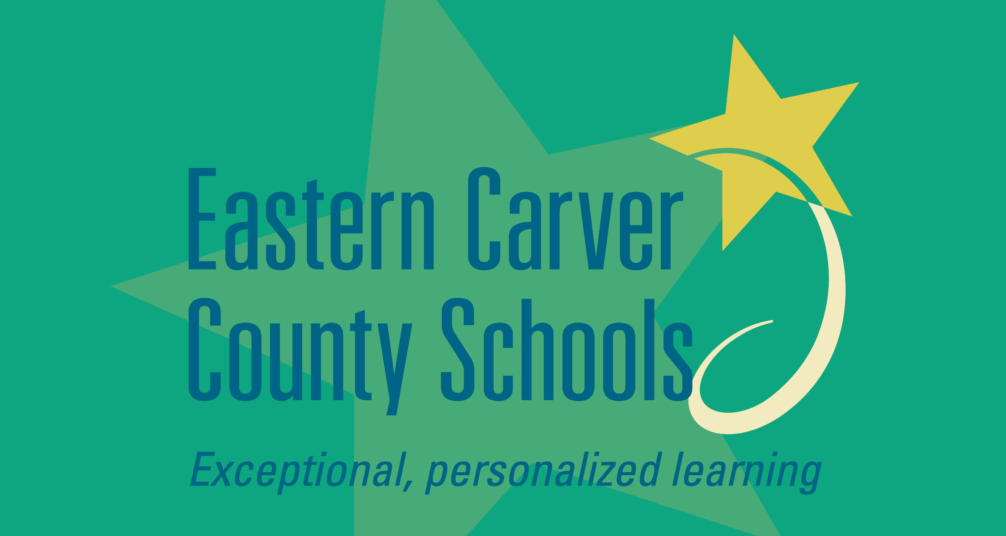





Partners
USDE Grant: Dual Language and Immersion Pathways to English Learner Success
Notes:
This grant was awarded to the University of Minnesota in partnership with the following districts/programs: Eastern Carver County Schools, Minneapolis Public Schools, Northfield Public Schools, Richfield Public Schools, Risen Christ Catholic School, Roseville Area Schools, and Saint Paul Public Schools.

Slide 4

Introductions
Pixabay
Your name
Number and ages of your children
Your school
Languages spoken at home
What motivated you to come here tonight
Notes:
Depending on the size of the group, do this as a whole group (fewer than 10) or at tables.
10 minutes

Slide 5
Mission Statement
To enrich the educational experience of Dual Language and Immersion (DLI) learners by engaging, educating, and empowering families.
USDE Grant: Dual Language and Immersion Pathways to English Learner Success
Notes:
Because many of the parents are L2 learners themselves, it is important to “read the room”: check frequently for understanding, rephrase as necessary, keep the acronyms to a minimum. Use your “teacher talk.” Assure parents that they should not hesitate to ask for clarification.

Slide 6
Student
EDUCATE
Success
in school
and beyond
EMPOWER
Family
ENGAGE
Teachers & School
USDE Grant: Dual Language and Immersion Pathways to English Learner Success
Notes:
So what does this mean? First, students, families, teachers and other school professionals work in partnership to ensure that students achieve success while in school and beyond into the future. Note: point to the 3 points of the triangle to emphasize this partnership.
It’s important for parents and families to be engaged in their children’s education. To be engaged means giving your full attention to something, to be in it – to give it your all. The same expectation holds for teachers and students – the idea is for everyone in this partnership to be committed to the child’s education and to give it their all.
The following text has been shortened and simplified:
It’s also important for parents and families to be educated and informed about the program – to understand what dual language and immersion programs offer children so that you are able to ask questions and offer feedback to teachers and other school professionals.
Finally, it’s critical for families and parents to become empowered. When you’re empowered you feel stronger and more confident, especially when it comes to supporting your child’s education and asserting your child’s educational rights.
When you are engaged and educated, you become more empowered. Those 3 attributes will help lead to your child’s success in school and beyond. You are your child’s strongest advocate and asset!

Slide 7
Workshop Topics
Dual Language and Immersion Basics
Bilingualism and Biliteracy
The Challenges of DLI
College and Career Opportunities
Notes:
These are the four topics to be covered in the Family Partnership workshops. We strongly encourage you to attend all four sessions. You will graduate and receive a certificate after completing all four classes.
As you read each session title, use these questions to clarify the academic language:
What do we mean by Dual Language and Immersion? What are the most important things to know about it?
What do we mean by “bilingualism” and “biliteracy”? How can you help your child become bilingual and biliterate?
What makes Dual Language and Immersion a good choice for students of different backgrounds, different home languages, different cultures? What can teachers and parents do to help children who struggle in a Dual Language and Immersion program?
How can bilingualism and biliteracy open doors for your child in the future?

Slide 8
Session Objective
I understand the goals and key features of
Dual Language and Immersion Education (DLI).
Notes:
We have one main objective for our session tonight: for you to understand the goals and key features of dual language and immersion education. We’ll use the acronym “DLI” to refer to dual language and immersion education. “DLI language” and “Partner language” refer to Hmong.

Slide 9

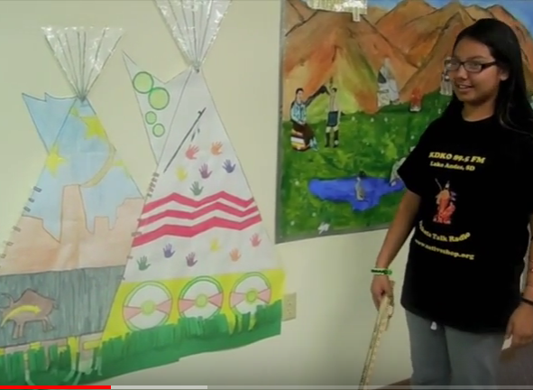



What is Dual Language and Immersion?
Developmental
Bilingual Education
Two-way
Immersion
Indigenous
Immersion
One-way Language
Immersion
NAWHERC
Minnetonka Public Schools
Pickit
Pickit
(Adapted from “The Dual Language Umbrella” in U.S. Schools [Howard et al., 2003])
Notes:
The other umbrella slides have been removed and this text has been slightly edited.
DLI education fosters the idea of additive bilingualism, where students become highly proficient in both English and the partner language.
There are four main program types that fall under the DLI umbrella.
Point to each section of the umbrella as you introduce the four prototypical program types that exist in the US. Some programs in MN might not correspond exactly to the four described here.
Indigenous/Heritage language immersion: These programs are designed to revitalize endangered indigenous – or native - cultures and languages. They typically enroll students of indigenous heritage. In Minnesota we have Ojibwe and Dakota language immersion programs.
Developmental Bilingual Programs: These bilingual programs serve language learners with similar language and cultural backgrounds – for example, a group of students who speak Spanish at home. Learners have the opportunity to maintain and improve their home language as they learn English. In Minnesota the developmental programs are all in Spanish.
One-Way World Language Immersion: This program is designed for learners whose home language is English. In Minnesota there are one-way programs in Spanish, French, German, Mandarin and Korean.
And finally, the program that is represented here tonight is the Two-Way Immersion program. It intentionally brings together children from two language groups – English home language and those who speak the partner language (Spanish) at home. In MN we have two-way programs in Spanish and Hmong.

Slide 10

The Goals of DLI Education
Openclipart
Academic Achievement
Bilingualism and Biliteracy
Cultural Competence
(Fortune, 2013)
Notes:
In the Hmong ppt, we changed this to the 3 Ks, so you’ll have to explain that.
All four of these program types share the same 3 goals. Think of the ABCs of Dual Language and Immersion.
Explain:
Academic achievement has to do with how well students do in school.
Bilingualism means speaking two languages to a high degree. Biliteracy means reading and writing in two languages.
Cultural competence is about understanding how culture (our own and other cultures) affects the way we think and act.
Tonight we are going to focus mostly on Academic Achievement.

Slide 11
The Goals of DLI Education
Openclipart
Academic Achievement

Slide 12

Academic Achievement
In general, by middle school, both English home language and partner home language/bilingual students do as well as or better on standardized tests given in English (Math, Reading, Language Arts) than their peers in English-only classrooms.
Maxpixel
(Lindholm-Leary & Genesee, 2014)
Notes:
Explain that we do not have data for middle-school Hmong programs, but that we would predict similar outcomes.

Slide 13

Academic Achievement
English home language students may experience a temporary lag in English reading and writing skills, but within a year or two after instruction in English language arts begins, the lag disappears.
For Hmong heritage learners who speak English at home but whose parents are English language learners themselves, this lag may take longer to disappear.
Pickit
(Genesee, 1987)

Slide 14
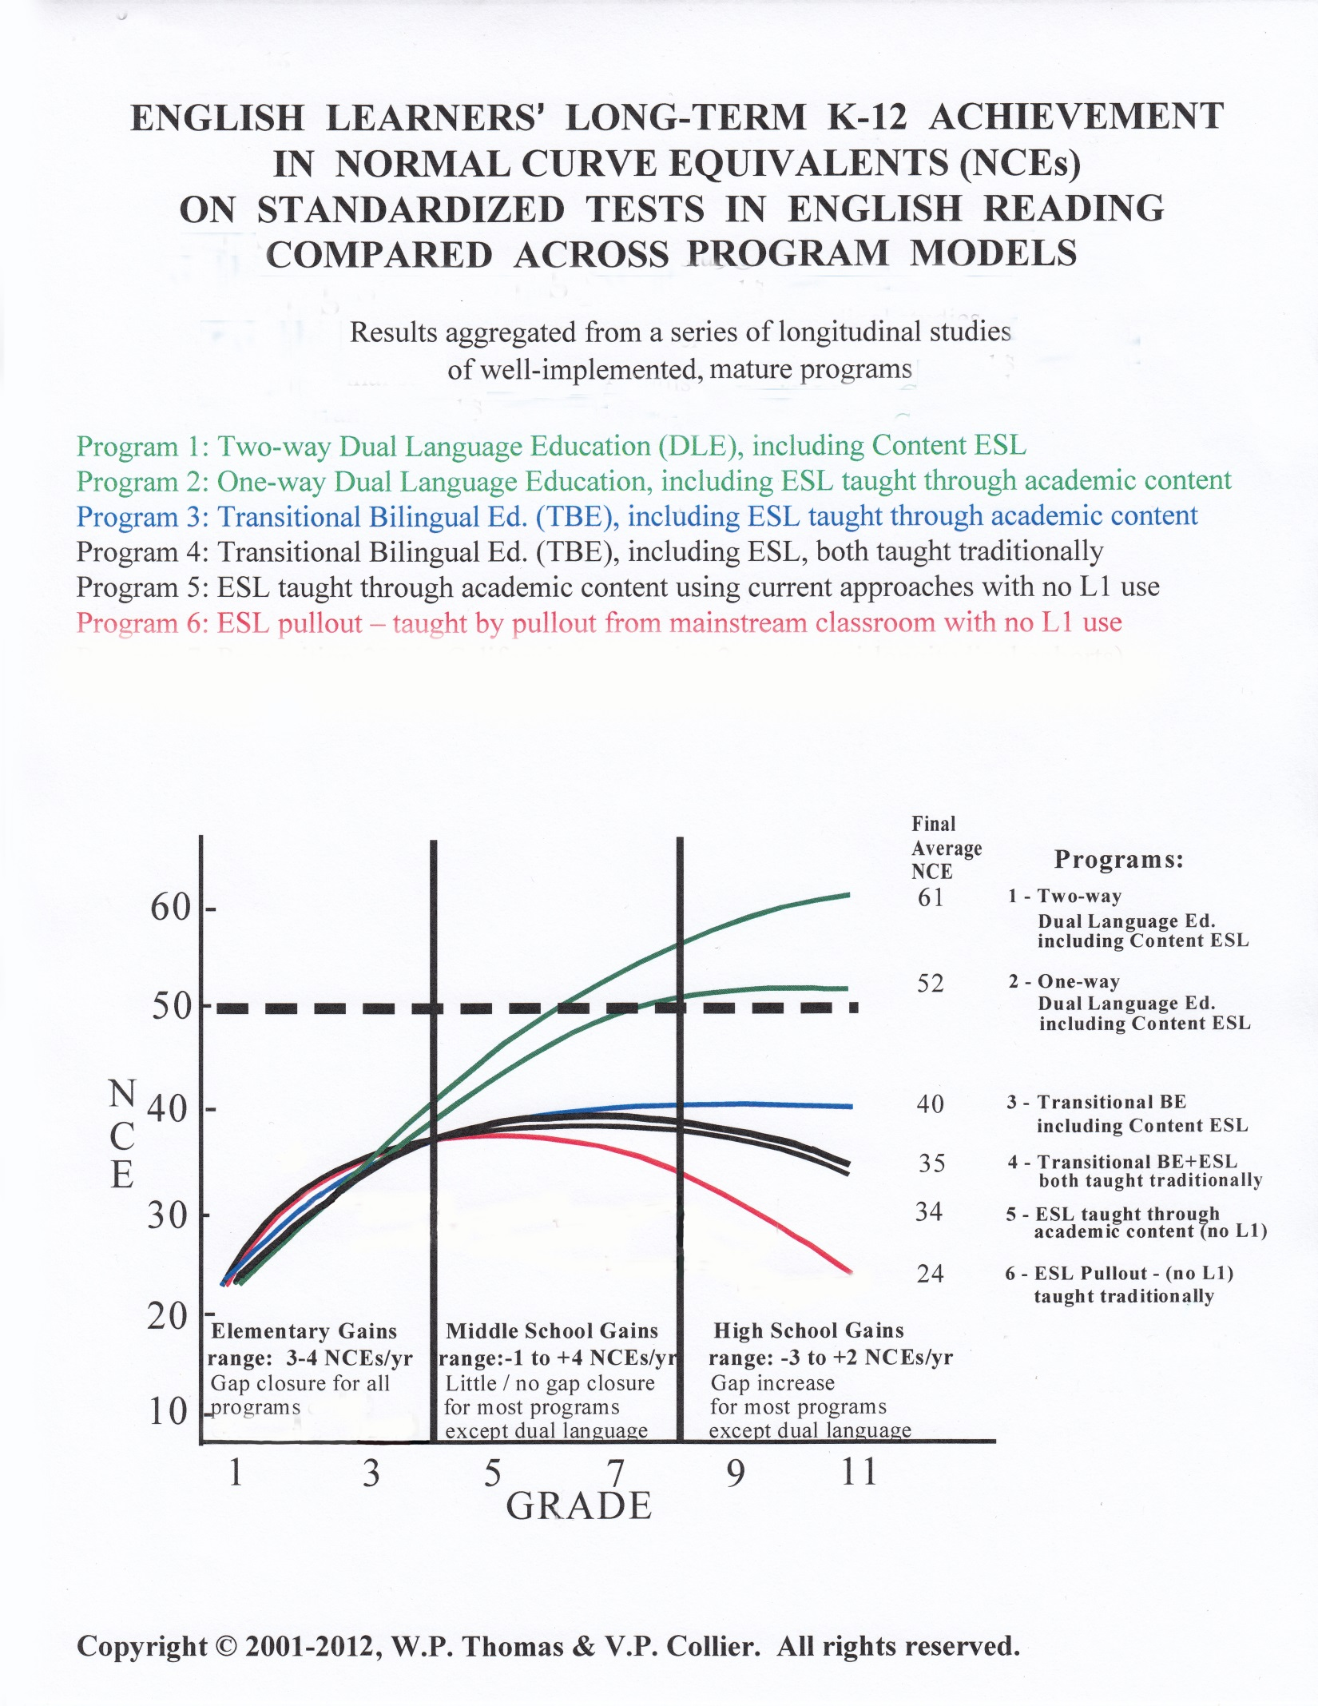
Notes:
This graph shows how English learners achieve in English reading in a variety of program models. It represents longitudinal research involving over 15,000 students in different programs and languages across several US states (but not including MN). Longitudinal research means that we’re looking at the same students over time. Let’s look at a larger version of the graphic to better interpret it.

Slide 15
English learners in DLI programs
catch up to their English-speaking peers in reading by Grade 5 or 6.
outperform average English-speaking peers if they continue in the program through high school.
Notes:
Note: You don’t have to go into detail about all of the different kinds of programs on this graph. Point out the heavy dotted line, which represents average English-language reading achievement levels for native English speakers in English-only programs, and the top 2 lines for ELs (ELs in two-way and developmental bilingual programs. One-way Dual language Ed. = Developmental Bilingual on Umbrella slide).
For your information only: NCE = Normal Curve Equivalent – an NCE of 50 = the 50th percentile, which is the average performance of native English-speaking students - that’s depicted by the dotted line.

Slide 16
What makes the difference for Hmong ELs?
continued learning in Hmong in school
ongoing use of Hmong in the home

Slide 17

The Road to Academic Achievement
pixshark
Read each “bump in the road” statement.
Share ideas you have for responding to these “bumps.”
Notes:
The road to bilingualism is a bumpy one! Tonight you will learn how to deal with those bumps with your child. The first two bumps are about Academic Achievement.
Bumps in the Road Activity. Read/display each “bump” (slides 18, 19). Give parents a minute or two to discuss a possible response – how they might deal with this challenge. Share a few comments then click on the “bump” slide to show the response we created.
The answers that we have supplied can be found at the end of the handout.

Slide 18

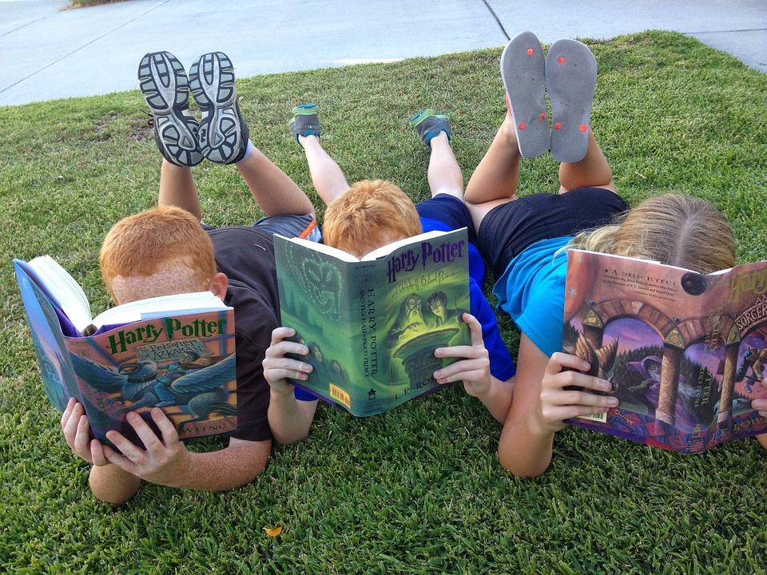
Pixabay.com
Remind your child just how special it is to be reading in another language.
If your child is feeling disheartened about not being able to read a certain book in English, read the book aloud together if that is possible or check out the audio book from the library.
But continue to encourage reading in the partner language and show enthusiasm for the books your child can read.
In 2nd grade, you might begin to worry that your child isn’t yet reading in English. Plus, your child may see friends reading much harder and more interesting books in English and may want to be part of that reading experience.

Slide 19
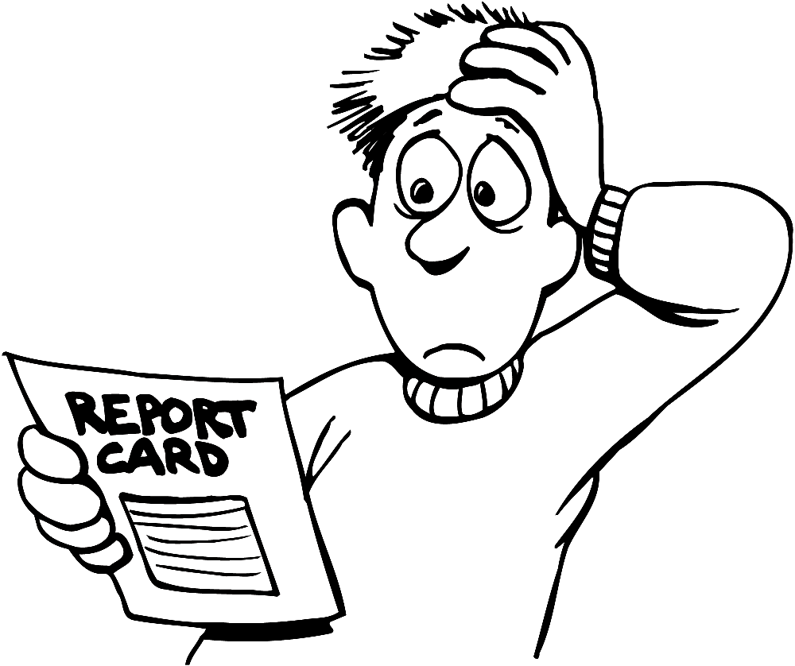
Pixabay
Remember that it takes time for positive academic outcomes to appear.
Your child is on the path to speaking, reading and writing in two languages, reaping many benefits along the way that are not measured on a standardized test.
In 3rd grade, when standardized testing begins, your child’s test scores may be lower than expected.
Notes:
Bullets have been added to the slide.

Slide 20
The Goals of DLI Education
Openclipart
Bilingualism and Biliteracy
(Fortune, 2013)
Notes:
The second goal of DLI is Bilingualism and Biliteracy. Because there is so much information to share about this goal, we will dedicate the entire next session to it. Be sure to come back for this important presentation.

Slide 21
The Goals of DLI Education
Openclipart
Cultural Competence
(Fortune, 2013)

Slide 22
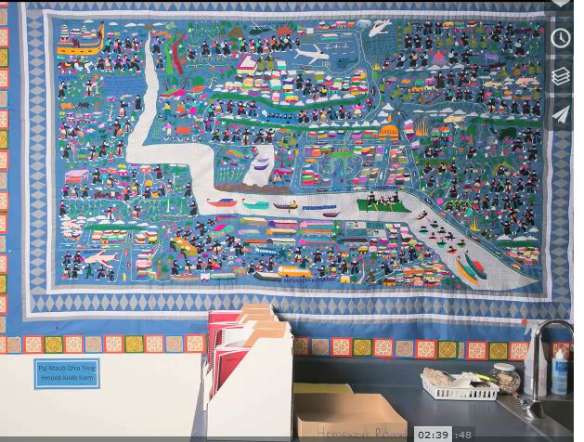
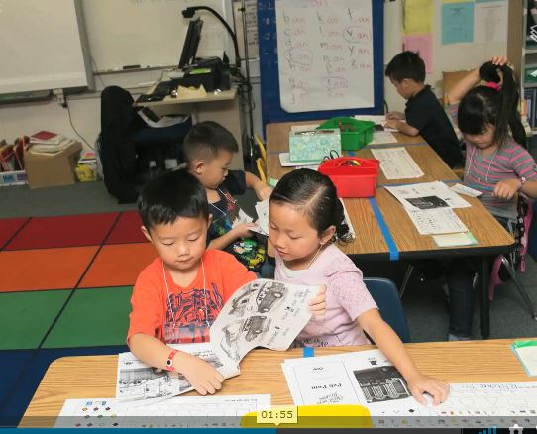
Cultural Competence
In a DLI program, partner language and culture are intertwined and are both highly valued.
R.J. Lozada
In a Hmong DLI program, students learn
to understand, communicate with, and
effectively interact with people both in
English and in Hmong.
R.J. Lozada
(Australian Children’s Education and Care Quality Authority, 2014)

Slide 23


Cultural Competence
Some research findings:
Two-way immersion students value having classmates from a variety of linguistic and cultural backgrounds.
(Feinauer & Howard, 2014)

Slide 24

Cultural Competence
2. Positive cross-cultural attitudes are frequently more common
among DLI students than among students in other types of
programs.
            3. Partner language students say 2 things are
            central to their identity:
                attending a two-way immersion program
                the opportunities two-way immersion
                gives them for extended home language
                and literacy development.
MaxPixel
(Feinauer & Howard, 2014)

Slide 25

Cultural Competence
Learning a language without the cultural
framework in which it exists is like
cooking ethnic food without the spices
of the region. You simply will remove all
of the flavor from the language.
(Zart, 2012)

Slide 26
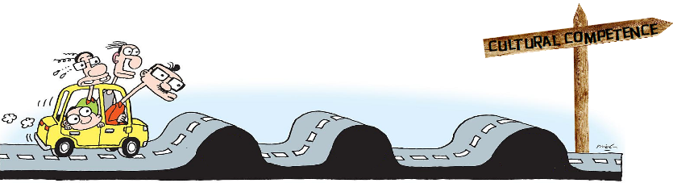
The Road to Cultural Competence
Pixsharkk
Read the “bump in the road” statement.
Share ideas you have for responding to these “bumps.”

Slide 27

Pixabay
Research shows that all DLI children – regardless of home language – prefer to use English, and that preference increases as they advance in grades (e.g., Ballinger & Lyster, 2011; Freeman, 1998; Hernández, 2015; Potowski, 2004).
It’s your job to remind your child of the value of bilingualism and to offer encouragement, praise, and support.
In 4th grade, many children begin to assert their identity and have a strong desire to “fit in” with U.S./English-speaking culture. They might not want to speak Spanish anymore. This is true for all learners.
Notes:
Bullets added.

Slide 28

Notes:
10 minutes
10 Feeb

Slide 29

Notes:
Distribute BINGO cards, one to each table or small group. Display and read one slide at a time. Participants find the answer on their bingo card and either mark it with a pencil or, if you want to reuse the sheets, give them bingo markers. After one table calls BINGO, check their answers. If time permits, continue playing until another table calls BINGO. You may not have time to go through all the questions.

Slide 30
Key Features of DLI
50% or more of partner language instruction (Hmong) through the elementary years.
High status of partner language and culture in the classroom and in the school community.
Fairly equal numbers of two groups of students are recommended: English-speakers and speakers of a partner language, such as Hmong.
(Christian, 2011; Fortune & Tedick, 2008; Hamayan, Genesee & Cloud, 2013)

Slide 31

Key Features of DLI
An integrated language and content model, which provides a wide variety of contexts in which to use the target language.
(Christian, 2011; Fortune & Tedick, 2008; Hamayan, Genesee & Cloud, 2013)
Notes:
Here you see an example of a kindergarten calendar display in Hmong. Besides learning math concepts through this daily routine, DLI students learn the foundations of the partner languages: colors, numbers, days of the week, weather expressions and even clothing.

Slide 32

Key Features of DLI
Literacy instruction in both languages
for all learners throughout the program.
Core subjects (math, science, social studies) divided between languages.
Integration of English-speaking and Hmong-speaking language learners for all instruction.
Pickit
(Christian, 2011; Fortune & Tedick, 2008; Hamayan, Genesee & Cloud, 2013)
Notes:
Two statements changed to three.

Slide 33
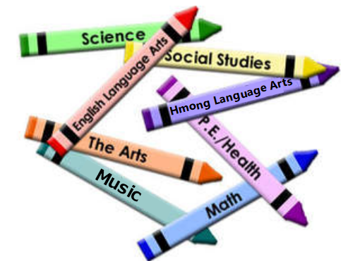
Key Features of DLI
Instruction in the same core subjects as in the other schools in the district:
mathematics, language arts, science, and
social studies.
Instruction based on national and state standards and district curricula.
Pixabay
(Christian, 2011; Fortune & Tedick, 2008; Hamayan, Genesee & Cloud, 2013)

Slide 34

Key Features of DLI
Maximizing teacher and student use of Hmong during instructional time in Hmong.
R.J. Lozada
(Christian, 2011; Fortune & Tedick, 2008; Hamayan, Genesee & Cloud, 2013)
Notes:
Slide text changed. Note added:
Research on how we learn second languages shows that we have to use the language consistently in order to learn it. We have to prioritize, privilege and protect Hmong in these programs. Students WILL learn English – it’s Hmong that is more challenging for us to develop in these programs – even for Hmong home language students.

Slide 35

Tic-Tac-Toe! What do you know?
Place your cards face down to form a grid, with the X/O “wild card” in the middle.
Turn over one card at a time and read the statement. Together, the team decides if the statement is true or false.
If it is true, place an O on the card. If it is false, place an X.
If you get 3 in a row, call out Tic-Tac-Toe! but continue filling in your grid.
Notes:
Note: Needs to be prepared ahead of time.
Explain how the game will proceed by reading the instructions on the slide. You may need to model the first one (do an audience check to see if that will be necessary).
After 10 minutes, check answers (next few slides).

Slide 36
In a two-way DLI program, all learners are partner language speakers (Hmong).
DLI students receive
instruction in the same core subjects as do English-only students.
1
2
In a two-way DLI program, students are separated by their home language for instruction.
In a DLI program, at least 50% of instruction is in the partner language (Hmong).
3
4
Notes:
You must be in presentation mode to see animations. To correct, click on each sentence to reveal the X or O. Be sure to go in order as the animations are sequenced in order 1-12. For each false answer, elicit the correct answer.

Slide 37
In the DLI classroom, language and culture are intertwined.
Teachers use both
languages during any
given lesson.
5
6
Once English begins, the majority culture (English) is dominant in the classroom.
DLI students must meet
state standards.
7
8

Slide 38

We thank you for coming tonight!
Please complete the short questionnaire to help us to see what you learned in this workshop and how we can improve it.
Pixabay
USDE Grant: Dual Language and Immersion Pathways to English Learner Success
Notes:
The grant that provides funds to support this project requires that we evaluate the program so that we can make improvements for the coming years – your input is absolutely essential and will be so helpful. This should only take about 15 minutes of your time.

Slide 39
References
Australian Children’s Education and Care Quality Authority (ACECQA). (2014). What does it mean to be culturally competent? Retrieved from https://wehearyou.acecqa.gov.au/2014/07/10/what-does-it-mean-to-be-culturally-competent/.
Center for Applied Linguistics. (2005). The two-way immersion toolkit. Retrieved from http://www.cal.org/twi/.
Center for Applied Second Language Studies. (2013). What levels of proficiency do immersion students achieve? Retrieved from https://casls.uoregon.edu/wp-content/uploads/pdfs/tenquestions/TBQImmersionStudentProficiencyRevised.pdf.
Christian, D. (2011). Dual language education. In E. Hinkel (Ed.), Handbook of research in second language teaching and learning. Vol. II (pp. 3–20). NY: Routledge.
Feinauer, E., & Howard, E.R. (2014). Attending to the third goal: Cross-cultural competence and identity development in two-way immersion programs. Journal of Immersion and Content-Based Language Education, 2(2), 257–272.
Fortune, T. W. (2013). The ABCs of dual language and immersion education. Immersion 101 Summer Institute, Center for Advanced Research on Language Acquisition. Minneapolis, MN: University of Minnesota.
Fortune, T.W., & Tedick, D.J. (2008). One-way, two-way, and indigenous immersion: A call for cross-fertilization In T. W. Fortune, & D. J. Tedick (Eds.). Pathways to multilingualism: Evolving perspectives on immersion education. (pp. 3–21). Clevedon, England: Multilingual Matters, Ltd.
Genesee, F. (1987). Learning through two languages: Studies of immersion and bilingual education. Cambridge, MA: Newbury House.

Slide 40
References
Genesee, F. (2007). Top ten most consistent findings from research on foreign language immersion. The ACIE Newsletter, 10(3), 7 & 10.
Hamayan, E., Genesee, F., & Cloud, N. (2013). Dual language instruction from A to Z. Portsmouth, NH: Heinemann.
Howard, E.R., Olague, N., & Rogers, D. (2003). The dual language program planner: A guide for designing and implementing dual language programs (p. 3). Washington, DC & Santa Cruz, CA: Center for Research on Education, Diversity & Excellence.
Lindholm-Leary, K.J., & Genesee, F. (2014). Student outcomes in one-way, two-way, and indigenous language immersion education. Journal of Immersion and Content-Based Language Education, 2(2), 165–180.
Thomas, W.P., & Collier, V.P. (2012). Dual language education for a transformed world. Albuquerque, NM: Dual Language Education of New Mexico and Fuente Press.
Zart, B. (2012). The importance of culture in language learning. Retrieved from https://billzart.wordpress.com/2012/03/04/the-importance-of-culture-in-language-learning/.

Slide 41
Acknowledgements and Permissions
Clipart taken from Creative Commons, Pickit, Pixabay, MaxPixel, and Pixshark are copyright-free and do not require permission or attributions.
The following images are reproduced with permission from their respective sources:
Slide 9: one-way immersion: Minnetonka Public Schools, Minnetonka, Minnesota (https://www.minnetonkaschools.org)
Slide 9: indigenous language immersion: The Native American Women’s Health Education Resource Center (https://www.nativeshop.org/)
Slides 14, 15, and 16, graph: Wayne P. Thomas and Virginia P. Collier (https://www.thomasandcollier.com)
Slides 22 & 34, R.J. Lozada (https://vimeo.com/55717676)

Slide 42
Authors
Contributors
University of Minnesota:
Maureen Curran-Dorsano
Diane J. Tedick
Corinne Mathieu
Special thanks to our translators,
Bounthavy Kiatoukaysy
See Pha Vang
May Lee Xiong
Phoua Yang
and to our external consultant,
Edward M. Olivos,
University of Oregon
Amanda Lea (Eastern Carver County)
Cathy Camarena (St. Paul)
Teresa Chavez (Roseville)
Carolina DuFault (Risen Christ)
Tara W. Fortune (UMN)
Leticia Guadarrama (Minneapolis)
Liz Hathaway-Castelán (St. Paul)
Laura Hofer (Richfield)
Bounthavy Kiatoukaysy (St. Paul)
Corina Pastrana (Minneapolis)
Melissa Richards de Campaña (St. Paul)
Anita Sasse (Northfield)
Kate Trexel (UMN)
Megan Unger (Minneapolis)

