Slide 1

Notes:
Notes to facilitators in italics.

Slide 2

Dual Language and Immersion
Family Education
DLI
Family
Education
EDUCATE
EMPOWER
ENGAGE
USDE Grant: Dual Language and Immersion Pathways to English Learner Success
Notes:
Welcome back the participants. Remind parents to sit in mixed language groups.

Slide 3

Introductions
Pixabay
Your name
Number and ages of your children
Your school
Languages spoken at home

Slide 4
Workshop Topics
Dual Language and Immersion Basics
Bilingualism and Biliteracy
Challenges of DLI
College and Career Opportunities
USDE Grant: Dual Language and Immersion Pathways to English Learner Success
Notes:
Last session we talked about the challenges of DLI. Tonight’s topic is College and Career Opportunities.

Slide 5
Session objectives
I understand that
students can earn college credit in a variety of ways by demonstrating high levels of bilingualism and biliteracy;
there are many different jobs, careers and other enriching opportunities open to those who are bilingual and biliterate.

Slide 6
Objective 1
I understand that students can earn college credit
in a variety of ways by demonstrating high levels of bilingualism and biliteracy.

Slide 7
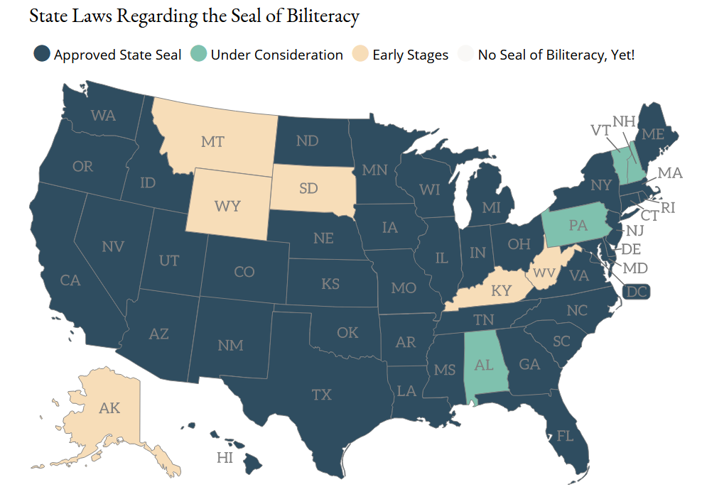
Participation in Seal of Biliteracy Programs
(Seal of Biliteracy, 2020)
Notes:
The first Seal of Biliteracy was created in 2008 as part of a grassroots effort by the nonprofit group, “Californians Together.” Their goal was to recognize high school graduates who had obtained high levels of competency in one or more languages in addition to English. The seal has gained in popularity throughout the United States in recent years.
https://sealofbiliteracy.org/

Slide 8
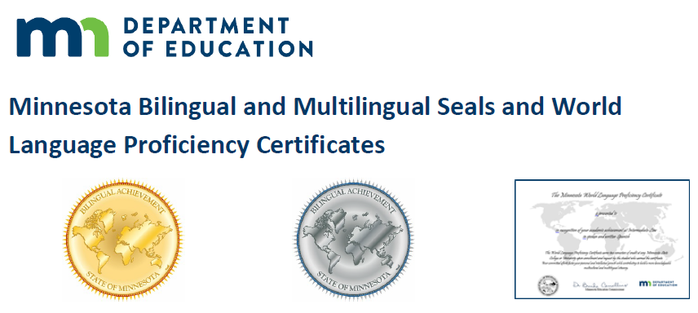
Minnesota Department of Education
1. What are Bilingual and Multilingual Seals and World Language Proficiency certificates?
Minnesota districts award Minnesota bilingual and multilingual seals to high school graduates who demonstrate the required levels of language proficiency in speaking, writing, reading and listening for languages other than English.
(Minnesota Department of Education, 2020)

Slide 9
Minnesota Department of Education
2. What are the benefits of earning a bilingual seal or a world language
proficiency certificate?
Minnesota State Colleges and Universities (Minnesota State) will
award free college semester credits to graduating high school students who receive bilingual and multilingual seals and world language
proficiency certificates.
(Minnesota Department of Education, 2020)

Slide 10
Minnesota Department of Education
3. How many semesters will Minnesota State colleges and universities award for seals and world language proficiency certificates?
World language proficiency certificate | Intermediate-Low | 2 semesters
Gold bilingual or multilingual seal | Intermediate High | 3 semesters per language
Platinum bilingual or multilingual seal | Advanced Low | 4 semesters per language
(adapted from Minneapolis Public Schools, n.d.)

Slide 11
Minnesota Department of Education
4. What are the other requirements for a bilingual or multilingual seal?
In addition to demonstrating the required proficiency levels in a language
other than English, students must:
demonstrate mastery of Minnesota's English language proficiency standards;
satisfactorily complete all required English language arts credits.
(Minnesota Department of Education, 2020)

Slide 12
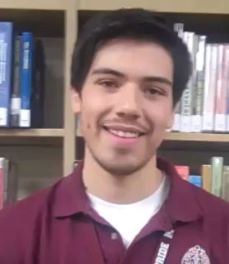
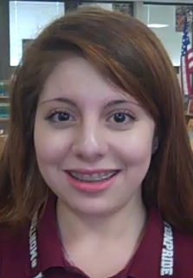
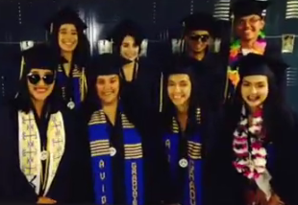

SELLOS DE BILINGÜISMO
SEALS OF BILINGUALISM
(Del Norte County, 2017; District 201, 2019)
Notes:
Click on each of the two pictures on the left to see the videos or on the video icon to take you to the home page: https://il01904869.schoolwires.net/Page/681 The home page includes all of the videos. You could just use that, but just in case their site links don’t work, here are the YouTube URLs:
https://www.youtube.com/watch?time_continue=74&v=xDUVP1Jdrn0
https://www.youtube.com/watch?time_continue=2&v=plSHKr9bpVI
Click on the video icon on the right for the second video. This one is all in English, but it does show an English and a Chinese home language (or heritage?) speaker as well as Spanish speakers. You can stop at 2:06.
https://www.youtube.com/watch?v=8uBStCM9Fw8
It's unfortunate that most of these students are Spanish home language speakers. You should add that many seals have been awarded to English speaking students who have learned Spanish (and other languages) as a second language.

Slide 13
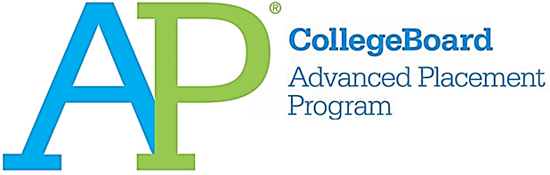


Other Ways to Obtain College Credits
Based on Language Proficiency
Advanced Placement (AP) language & literature courses in second language
Retroactive credits based on language proficiency exams
Higher level exam for IB diploma
Notes:
Students with high levels of bilingualism and biliteracy can earn college credits even before going to college through several different paths. These are great ways to earn college credit for FREE! Read the slide. Provide information only about the options specific to your district.
Advanced Placement is a program in the United States and Canada that offers college courses and exams to high school students. Most colleges and universities nationwide offer college credit, advanced placement, or both, for qualifying AP Exam scores.
PSEO and College in the Schools: These programs allow high school students (typically 12th gr.) to take college classes for credit and for free while still in high school.
Minnesota State colleges award credits based on Language Proficiency Exam.
For the IB diploma: Students who don’t earn the IB diploma are still eligible for college credit. However, students who earn the IB diploma receive more college credit than those who don’t. IB Foreign language requirement: students must be at Level 6 – DLI students have a jumpstart for completion of language requirement.

Slide 14

flickr
You have learned how your child can earn college credit (for free!) by achieving a high level of proficiency in both English and Spanish.
Why is it important for you to know this now, while your child is still in elementary school?
Notes:
Discuss at tables. Share out a few ideas.

Slide 15
Objective 2
I understand that there are many different jobs, careers and other enriching opportunities open to those who are bilingual and biliterate.

Slide 16


Career Opportunities for Bilinguals
Notes:
Bilingual speakers are in demand right now and will be even more so in the future. Here are just a few headlines from various news outlets. What can your child expect from a bilingual career?
It’s important to note that these jobs tend to go to Spanish home language students or those raised bilingually. This is because it is so challenging to get English home language speakers to high levels of bilingualism and biliteracy. That’s why continuing the program into high school and taking advantage of opportunities to use Spanish outside of school are so important.
Whole group: Ask a few parents to share their expectations, then go on to the next slide.

Slide 17
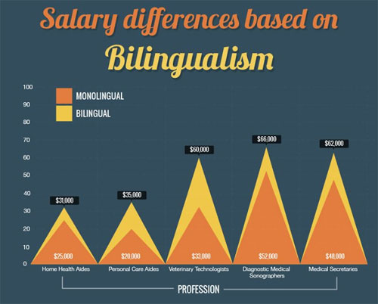
(Alpert, 2015)
Notes:
Very often, bilingual speakers earn more money than monolinguals. Here is an example of salary differences in the health care field based on bilingualism.

Slide 18
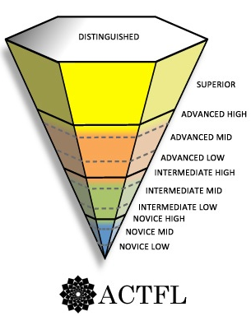
Language Proficiency and the Work Place
University Professor, Lawyer
Physician, Military Linguist Medical Interpreter
K-12 language teacher
Many DLI students
Fire fighter, Utilities Installer,
Auto Inspector, Aviation Personnel,
Tour Guide
Almost all DLI students
(ACTFL, 2012, 2015)
Notes:
Enrolling your child in a DLI program is not enough to ensure the level of proficiency necessary for the most demanding careers. such as physician or lawyer. However, you are setting your child on a solid path to a bilingual future. Almost all DLI students who remain in the program from kindergarten through grade 12 achieve proficiency in the Intermediate Mid range. At this level, students are well able hold everyday conversations with native speakers. Many immersion students even reach the Advanced Low range by the end of grade 12.
This graph shows some traditional careers for today’s bilinguals. There will be many other careers for bilinguals in the future that don’t even exist today.

Slide 19






Bilingualism in the Digital Era
pixabay
WEB DESIGN
pxhere
GAMING
pxhere
DIGITAL
CONTENT
maxpixel
pxhere
MOBILE APPS
TV, FILM,
RADIO
and
Notes:
Bilinguals have an advantage in the digital economy, which is global by nature and requires a globally-minded work force.

Slide 20
In summary:
Children of immigrants who can speak, read and write in both English and the language spoken at home have an advantage in the labor market.
Individuals with immigrant backgrounds who only speak English and don’t retain the home language lose between $2,000 and $5,000 annually.
In contrast, those with immigrant backgrounds who know both English and the language spoken at home — also known as “balanced bilinguals”—are more likely to earn more money than those who only know English.
(Agirdag, 2014; Navarez, 2015; Rumbaut, 2014)
Notes:
According to a report by the Civil Rights Project at UCLA and the Educational Testing Service…Read the slide.
After reading bullet points add…
In fact, a study in Belgium found that balanced bilinguals earn about $5,200 more annually at the beginning of their careers than do monolinguals – the findings were the same for different language groups. So there is a substantial loss to a person in earnings over time if they lose the home language.

Slide 21
Research has shown that individuals who:
  are high use bilinguals – who use both languages frequently for personal and professional purposes, and
  have very high levels of biliteracy
are those who…
  are more likely to attend and graduate from 4-year colleges, which increases opportunities in the labor market;
  are likely to have more prestigious and higher paying careers; and
  have greater opportunities for career advancement.
These benefits are increasingly critical for young people in today’s global economy!
(Porras, Ee & Gándara, 2014; Santibañez & Zárate, 2014)
Notes:
Read the slide – be sure to emphasize the critical importance of HIGH levels of biingualism and biliteracy – THAT’s what makes the difference when it comes to college and careers.

Slide 22
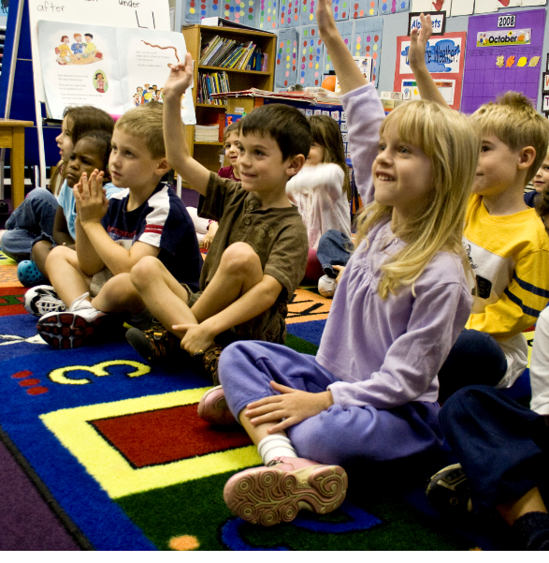

The future begins now!
High school students who participate in
two-way immersion programs, from
elementary through high school have:
high levels of academic competence and motivation;
ambitions to go to college;
knowledge about how to apply to and get
into college;
and pride in bilingualism.
T
O
D
A
Y
Wikimedia commons
T
O
M
O
R
R
O
W
dreamstime
(Lindholm-Leary & Borsato, 2001)
Notes:
We know that…Read the slide.

Slide 23

Language Proficiency and Careers of the Future
We don’t know what the future holds, but….
“Integration of our global economy is not the only driving force for the need for higher-level soft skills; large global migration driven by both economic and political forces also has a large impact on workforce demands. To respond to both our current and future workforce needs, we have to redefine what an educated and talented workforce looks like. The answer includes one that is multilingual and multicultural.”
Pixabay
(Price, 2018)
Notes:
Let parents know that this is not a translation of the quote used in the Spanish ppt but offers the same message.
https://englishclassviaskype.com/blog/how-to-learn-english/redefining-the-talented-workforce/

Slide 24


Slide 25
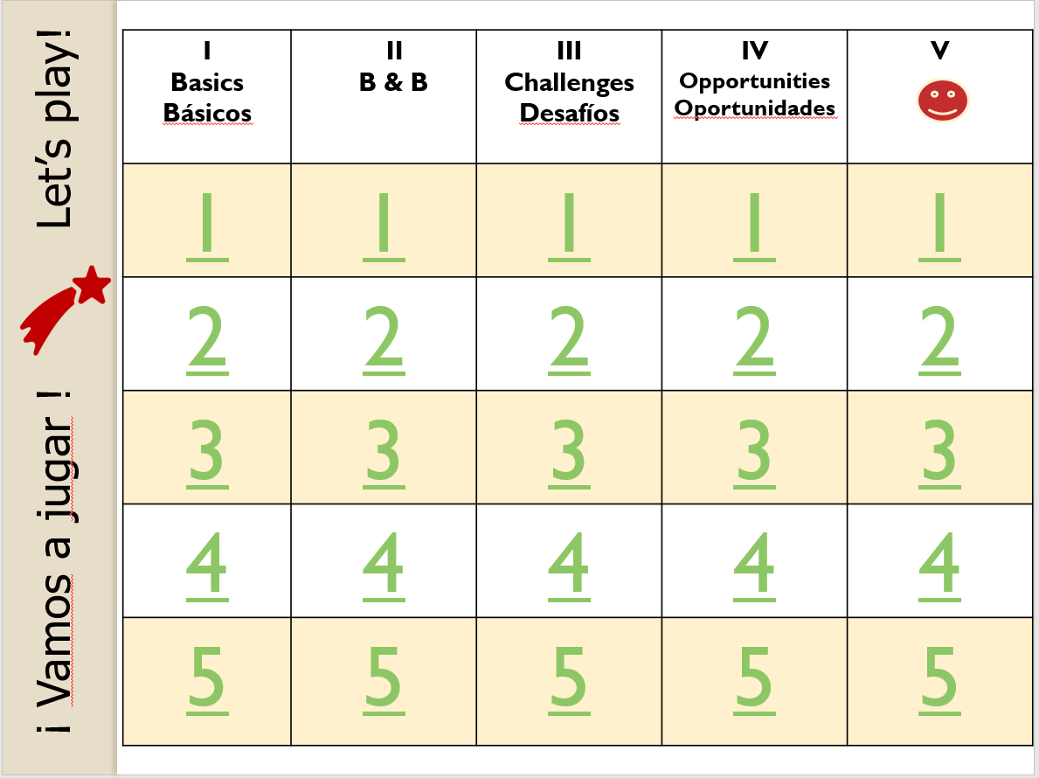
Notes:
IMPORTANT! This slide is a place holder. The game is a separate PowerPoint presentation in the Games folder.

Slide 26
Check out our website
for more information
on this topic and others.
DLI
Family
Partnership
Website
EDUCATE
EMPOWER
ENGAGE
http://carla.umn.edu/immersion/parentinfo/index.html
USDE Grant: Dual Language and Immersion Pathways to English Learner Success
Notes:
See Facilitator’s script.

Slide 27
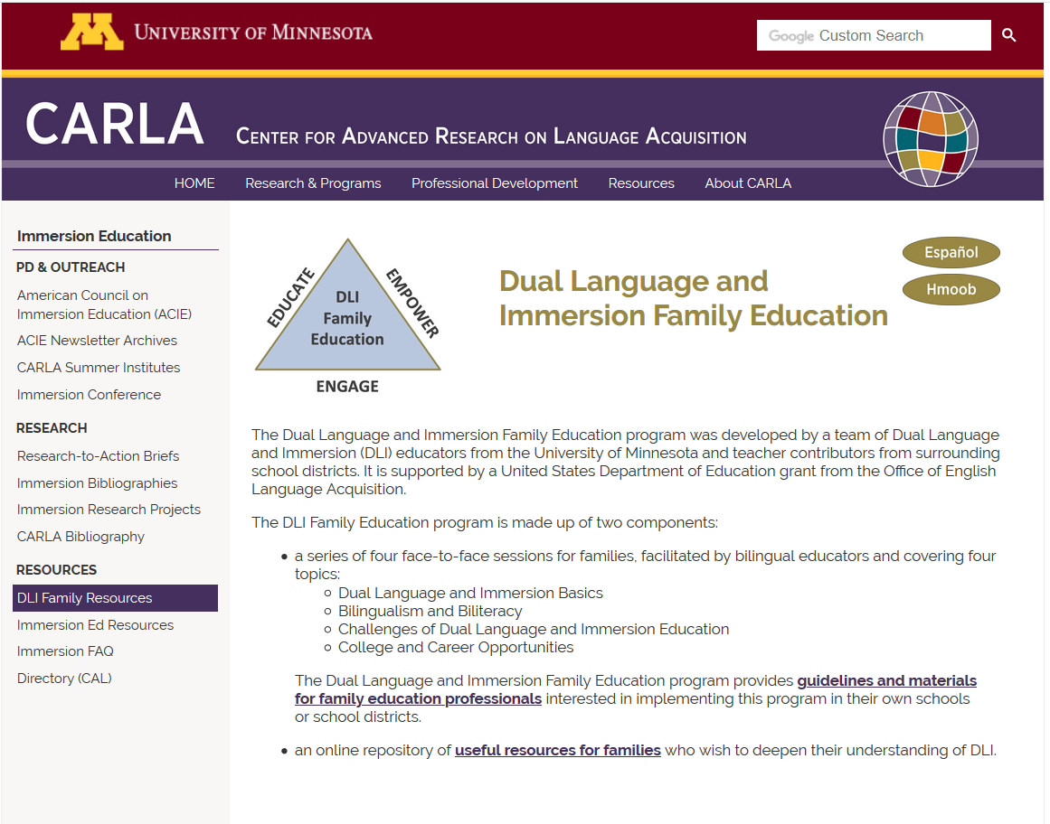
http://carla.umn.edu/immersion/parentinfo/index.html

Slide 28
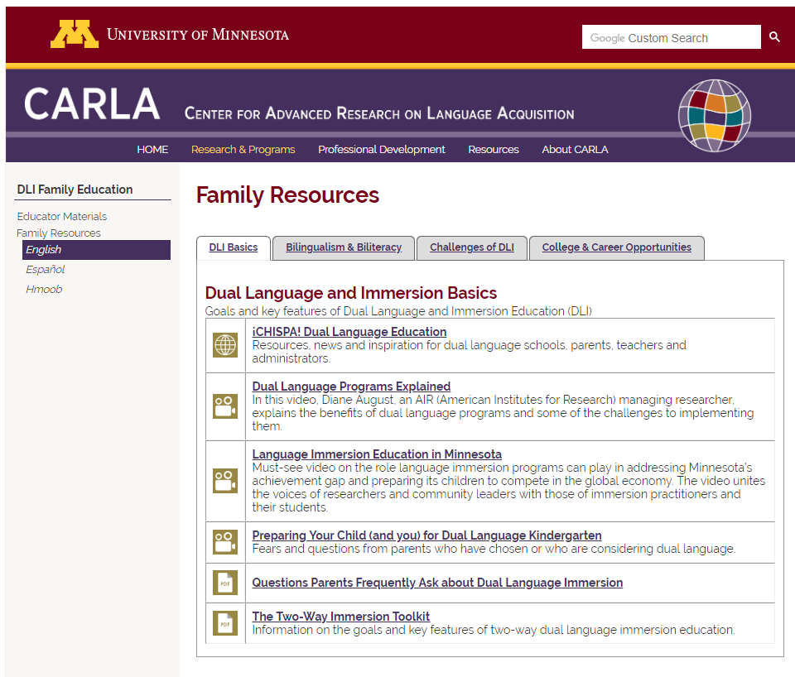
http://carla.umn.edu/immersion/parentinfo/english.html

Slide 29

We thank you for coming this evening
and for your active participation!
Please complete the short questionnaire to help us to see what you learned in this workshop and how we can improve it.
Pixabay
USDE Grant: Dual Language and Immersion Pathways to English Learner Success
Notes:
Surveys. Since this is the final session, participants will fill out the session IV survey and go right into the final general survey. Let them know that upon completion of the surveys, there will be a brief celebration with participants.

Slide 30

Time to celebrate!
Pixabay
Notes:
You made it! You’ve completed all four workshops! It’s time to get your certificate and time to celebrate! We are so grateful for your participation and hope that we’ve helped you to understand more about your children’s educational program and how you can help your children to succeed in school and beyond!
If you have decided to have a two-tier certificate (one for those who came to all 4 sessions, and one for those who missed one), be sure to acknowledge those who came to all the sessions. Hopefully, you will also have a special treat to end the evening.

Slide 31
References
ACTFL – American Council on the Teaching of Foreign Languages. (2012). ACTFL proficiency guidelines. Alexandria, VA: ACTFL. Available at: https://www.actfl.org/publications/guidelines-and-manuals/actfl-proficiency-guidelines-2012.
ACTFL. (2015). Oral proficiency levels in the workplace. Retrieved from https://www.actfl.org/sites/default/files/pdfs/TLE_pdf/OralProficiencyWorkplacePoster.pdf.
Alpert, D. (2015). Education in multiple languages gives kids a big boost, which means high demand for DC’s programs. Greater, Greater Washington. Retrieved from https://ggwash.org/view/38406/education-in-multiple-languages-gives-kids-a-big-boost-which-means-high-demand-for-dcs-programs.
Agirdag, O. (2014). The long-term effects of bilingualism on children of immigration: Student bilingualism and future earnings. International Journal of Bilingual Education and Bilingualism, 17(4), 449–464.
Del Norte County. (2017). Seal of Biliteracy. Seal of Biliteracy recipients of Del Norte County share their thoughts on the importance of knowing more than one language. Retrieved from https://www.youtube.com/watch?v=8uBStCM9Fw8.
District 201. (2019). The Seal of Biliteracy at J. Sterling Morton High School. Videos of students’ reflections on the Seal of Biliteracy. Retrieved from https://il01904869.schoolwires.net/Page/681.
Lindholm-Leary, K. J., & Borsato, G. (2001). Impact of two-way bilingual elementary programs on students’ attitudes toward school and college. University of California, Santa Cruz: Center for Research on Education, Diversity & Excellence, Research Report 10.
Minneapolis Public Schools. (n.d.). Bilingual seals and world language proficiency certificates. Retrieved from http://worldlanguages.mpls.k12.mn.us/bilingual_seal_testing.
Minnesota Department of Education. (2020). Minnesota Bilingual Seals Program. Retrieved from https://education.mn.gov/MDE/dse/stds/world/seals/index.htm.

Slide 32
References
Navarez, G. (2015). Bilinguals have been college outcomes, labor advantages: New study. NBC News. Retrieved from https://www.nbcnews.com/news/latino/bilinguals-have-better-college-outcomes-labor-advantages-n444046.
Price, S. (2018). Redefining the Talented Workforce. Retrieved from https://englishclassviaskype.com/blog/how-to-learn-english/redefining-the-talented-workforce/.
Porras, D.A., Ee, J., & Gándara, P.C. (2014). Employer preferences: Do bilingual applicants and employees experience an advantage? In R.M. Callahan & P.C. Gándara (Eds.), The bilingual advantage: Language, literacy and the US labor market (234–257). Bristol, UK: Multilingual Matters.
Rumbaut, R.G. (2014). English plus: Exploring the socioeconomic benefits of bilingualism in Southern California. In R.M. Callahan & P.C. Gándara (Eds.), The bilingual advantage: Language, literacy and the US labor market (182–210). Bristol, UK: Multilingual Matters.
Santibañez, L., & Zárate, M.E. (2014). Bilinguals in the US and college enrollment. In R.M. Callahan & P.C. Gándara (Eds.), The bilingual advantage: Language, literacy and the US labor market (211–233). Bristol, UK: Multilingual Matters.
Seal of Biliteracy. (2019). Seal of Biliteracy. Retrieved from https://sealofbiliteracy.org/. [Map retrieved on November 3, 2019.]
Acknowledgements
Clipart taken from Clipart.email, Clipartpanda, Goodfreephotos, Phillipmartin, Pickit, and Pixabay are copyright-free and do not require permission or attribution.

Slide 33
Authors
Contributors
University of Minnesota:
Maureen Curran-Dorsano
Diane J. Tedick
Corinne Mathieu
Special thanks to our translator, Anselmo C. Castelán
and to our external consultant,
Edward M. Olivos,
University of Oregon
Amanda Lea (Eastern Carver County)
Cathy Camarena (St. Paul)
Teresa Chavez (Roseville)
Carolina DuFault (Risen Christ)
Tara W. Fortune (UMN)
Leticia Guadarrama (Minneapolis)
Liz Hathaway-Castelán (St. Paul)
Laura Hofer (Richfield)
Bounthavy Kiatoukaysy (St. Paul)
Corina Pastrana (Minneapolis)
Melissa Richards de Campaña (St. Paul)
Anita Sasse (Northfield)
Kate Trexel (UMN)
Megan Unger (Minneapolis)

