Slide 1
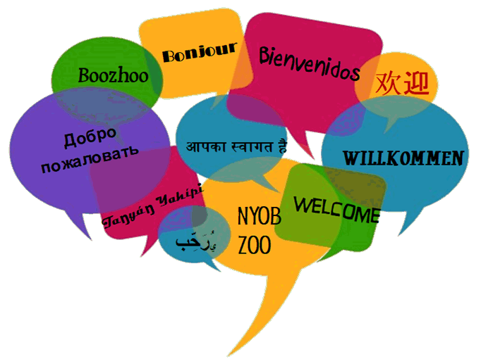
Notes:
Notes to facilitators in italics.
Welcome the participants to the session. Reintroduce yourself.
Let them know there is one scheduled break but they are free to take personal breaks as necessary.

Slide 2

Dual Language and Immersion
Family Education
DLI
Family
Education
EDUCATE
EMPOWER
ENGAGE
USDE Grant: Dual Language and Immersion Pathways to English Learner Success

Slide 3

Introductions
Pixabay
Your name
Number and ages of your children
Your school
Languages spoken at home
Notes:
Facilitators: try to mix up your parents so that they are sitting in mixed language groups. Make sure there is at least one bilingual at each table who can give linguistic support as needed.

Slide 4
Workshop Topics
Dual Language and Immersion Basics
Bilingualism and Biliteracy
The Challenges of DLI
College and Career Opportunities
Notes:
Last time we spoke about Dual Language and Immersion Basics. Tonight’s topic is Bilingualism and Biliteracy and how we can help our children achieve those two goals.

Slide 5
Session Objectives
I understand:
  what bilingual and biliteracy development typically looks like;
  how bilingualism and biliteracy develop in DLI programs.
Notes:
Slide text changed slightly for clarity.

Slide 6
Session Objective 1
I understand what bilingual and biliteracy development typically looks like.
Notes:
Matches previous slide.

Slide 7


What is bilingualism?
Bilingualism = being able to understand and speak two languages.
Pixit
Notes:
Some of you here tonight are bilinguals, hoping to pass that on to your children. Others of you want to offer your children a language you never had a chance to acquire. All of you see the value of speaking another language, which we can see in this video clip.
Click on the star to access YouTube video https://www.youtube.com/watch?v=y4fiRxQMay4
.

Slide 8
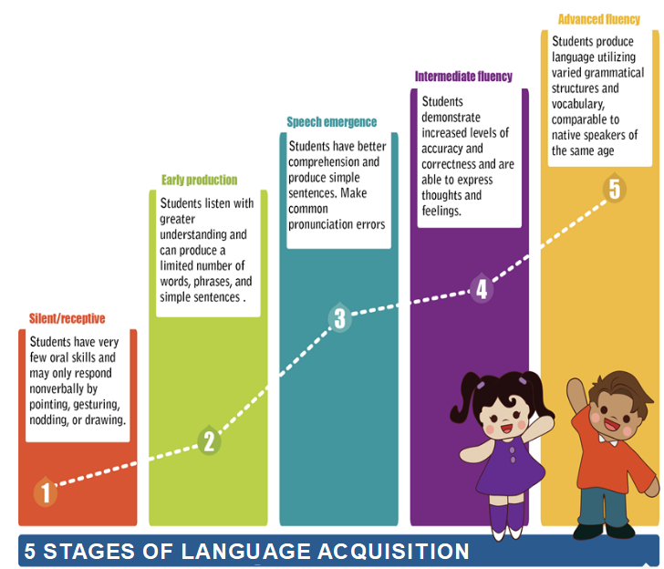
Bilingualism
Advanced fluency
Intermediate fluency
Speech emergence
Early production
Silent/receptive
(Mi Chu Chu Tren, n.d., adapted from Krashen & Terrell, 1983 )
Notes:
Team activity. Distribute the “5 Stages of Language Acquisition” sentence strips to each table.
What does typical bilingual development look like? Here are 5 statements (show them a set of cards) that describe each stage of language acquisition or language learning. At your table, see if you can put the statements in the right order from the first stage to the last one.
After participants have put the cards in order, share the answers on the PPT by clicking on yellow box, adding the descriptive headings as you go along.

Slide 9
Advanced fluency
Bilingualism
Intermediate fluency
Speech emergence
Formal education
Family background
Opportunities to use the language
Connections between the two languages being learned
Early production
Silent/receptive
Notes:
Every language learner goes through these five typical stages of language learning. But each learner is unique and it may take more time for some to reach high levels of proficiency in both languages. There are several factors that can affect one’s language learning journey. These factors include:
Formal education in the language. Going to school in a DLI program sets your child on the path toward bilingualism.
Family Background. If your family language is represented in the DLI program (Spanish), your child will be more motivated to speak that language both at home and at school. She will have more opportunities to use the language with family members and in the community.
Opportunities to use the language. We know that people learn languages by using them so we need to ensure that children have many different kinds of opportunities to use the languages they’re learning with different types of people. This is true for both English-language speakers and Spanish-language speakers. It may be face-to-face interactions with speakers of the partner language, films, online games, cultural events or travel opportunities. There are lots of ways to create opportunities for children to use the languages they’re learning.
Connections and similarities between the two languages. English and Spanish have many similar words – family/familia, television/televisión , so in some ways Spanish speakers might learn English a little more easily because of the close relationship between Spanish and English. The same is true for English language speakers learning Spanish.

Slide 10
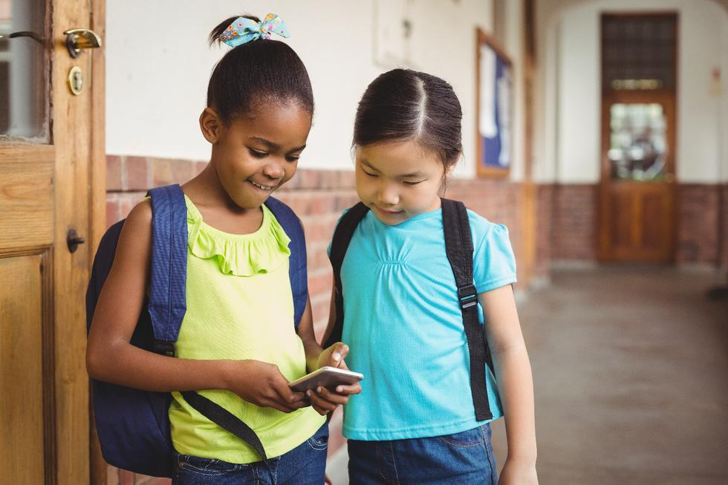

Social vs Academic Language
Pixit
Pixit
Social Language
Conversational, simple, interactive language
Needed for social interaction
Academic Language
Textbook and school language
Needed for academic and professional success
Notes:
For Spanish-speaking children, social language begins at home. At school, social language is used at recess, in the lunchroom and on the bus. For English-speaking students, social language in Spanish is much more difficult to learn, since it must be taught in the same way that academic language is taught.
Academic language is the language used in formal learning in school and textbooks. Examples of academic language are words such as "therefore," "however," "as a result," for example, and all vocabulary related to content areas such as math and science.
Academic language is really important for success in school and in the professional world and it takes, at least, 5 to 7 years to acquire it. This is one more reason why it is so important that students remain in the DLI program through high school and continue their study of the language even further.

Slide 11
Social vs. Academic Language
1. There was no rain for a very long time, so all the crops died.
2. The people had nothing to eat, so many of them died.
3. The soldiers got a medal because they were so brave.
4. The caterpillar changes its form and out pops a beautiful butterfly.
  The extended drought caused the crops to fail.
  There was widespread famine, resulting in many deaths.
  The soldiers were awarded a medal due to their extraordinary courage.
After a certain amount of time, the metamorphosis is complete, and the butterfly emerges from its chrysalis.
(some examples from Gibbons, 2015)
Notes:
In the early grades, the language of instruction is more social in nature. Students begin by talking about themselves, their families, their pets, and even the instructional language in math or science is very simple. As students move up in the grades, concepts become more complex and the language becomes much more academic. Here are some examples of the two kinds of language.
Activity: Distribute worksheet to tables. Display only the Social Language column. Parents match up the social language statement with the matching academic language statement on their worksheet by filling in the circles with 1, 2, 3 or 4. To correct, click to bring up the corresponding sentence. End by pointing out that parents are getting an understanding of the challenges of academic language just by attending these sessions. Correct the answers by clicking

Slide 12
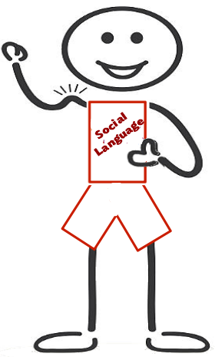
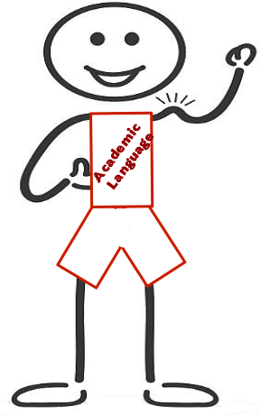

=
+
Both groups of students need to work hard
to develop all their language muscles!

Slide 13

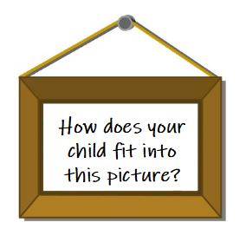
flickr
Think about what you’ve learned about the five stages of bilingualism and the two types of language skills children need to acquire in order to become bilingual.
Pixabay
Notes:
After ten minutes, do a brief share-out.

Slide 14

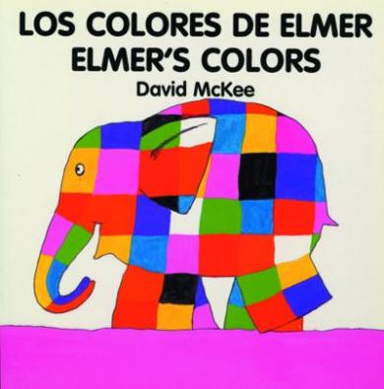

What is biliteracy?
Biliteracy = being able to read and write in two languages.

Slide 15
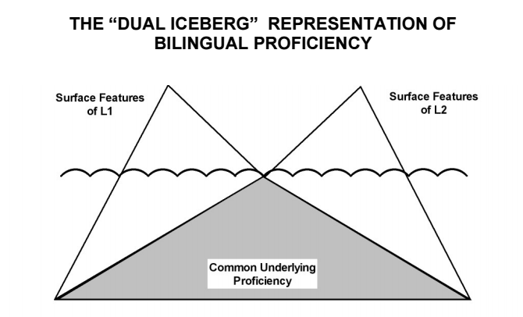
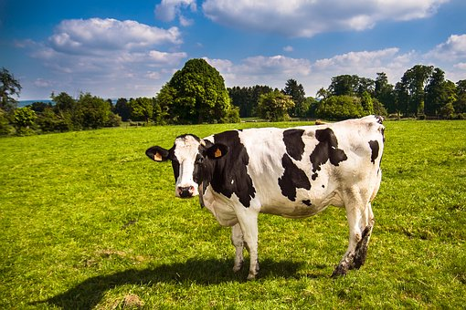
Biliteracy
Surface Features
of Spanish
Surface Features
of English
la vaca
cow
Common understandings between both languages
(Cummins, 1980)
Notes:
To understand how bilingualism and biliteracy work, we can use the Dual Iceberg Representation of Bilingual Proficiency. Let’s imagine some icebergs – we know that the part of the iceberg that we see above the surface of the water is only a small part – underneath the water is a much larger part of the iceberg. In this figure, the part of the iceberg that’s below the surface of the water represents the common knowledge that crosses languages. Above the surface are two peaks or the part of the iceberg that we can see. They represent the things that are different between the two languages. The words for “cow” are different in the partner languages, but the idea of “cow” is the same. The same thing applies to reading. Students have to learn how to read the word vaca or nyuj, but they don’t have to learn what a cow is since they already know what a cow is.

Slide 16
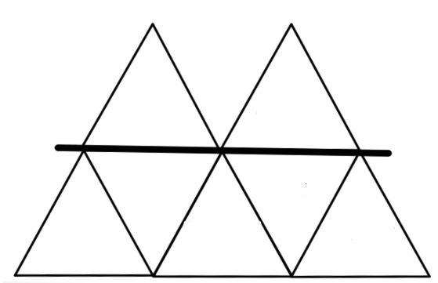
Picture clues
Print direction
Expressive reading
Difference between
n and ñ
Blending sounds
Accent marks
Rhyming
Difference
between
n and ñ
Vowels with
accent
(á, é, í, ó, ú, ü)
Print
direction
Blending
sounds
Picture
clues
Expressive
reading
Rhyming
Notes:
Students also rely on many reading strategies that they have already learned in one language in order to read in the other language. So children aren’t learning everything all over again – they just learn a new way to express the concepts in the new language. Here are some examples of early literacy reading concepts. Some are “above the surface” – they have to be learned for a particular language. Some are “below the surface” and can be transferred from one language to another.
Whole-group activity. You should have on hand a read-aloud in each language so that you can demonstrate each one of these strategies. Call out the first item on the list (in the red box) and give an example in Spanish and English. Ask the group if it goes above or below the surface. Be sure to follow the order of the list. Participants can find the answers at the end of the ppt handout.

Slide 17
Session Objective 2
I understand how bilingualism and biliteracy
develop in DLI programs.

Slide 18
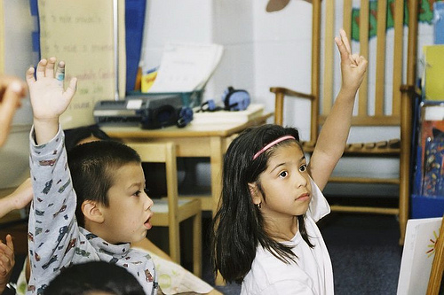
Bilingualism and Biliteracy
Spanish language learning
ALL students in DLI programs develop proficiency in Spanish
Spanish home language/bilingual students develop higher levels of Spanish than English home language students, but their level of Spanish depends on:
  the continued use of Spanish in the home;
  highly developed academic language in
  Spanish through a rigorous DLI curriculum.
t
Creative Commons
(Lindholm-Leary & Genesee, 2014)

Slide 19
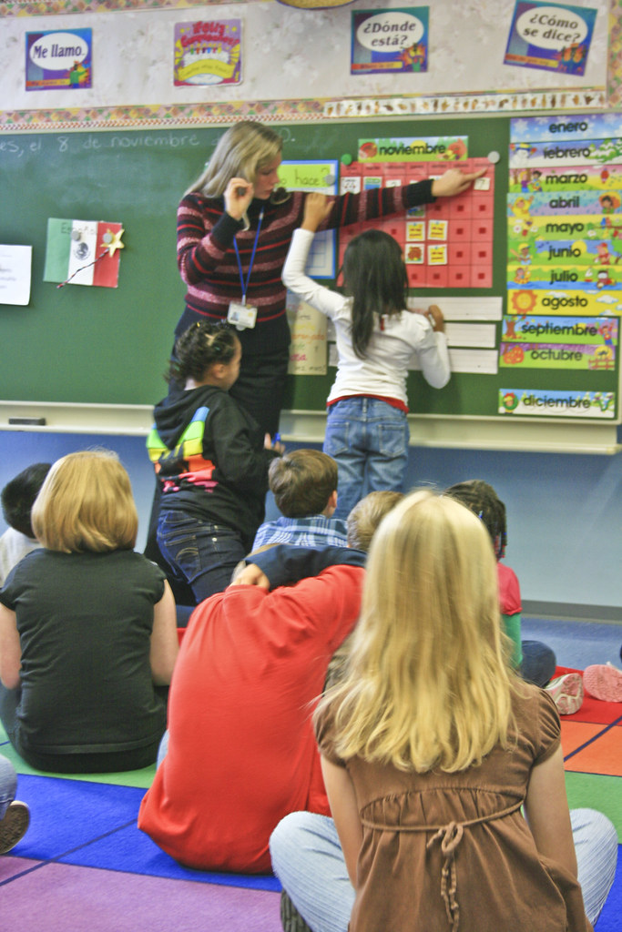
Bilingualism and Biliteracy
Spanish language learning
English home language DLI students develop
stronger proficiency in Spanish than students who
study Spanish in a traditional world language class.
They achieve high functional levels of proficiency,
but:
  their Spanish often lacks grammatical accuracy;
  their vocabulary tends to be limited.
Flickr
(Center for Applied Second Language Studies, 2013; Lindholm-Leary & Genesee, 2014)
Notes:
Slide text changed slightly for clarity.

Slide 20
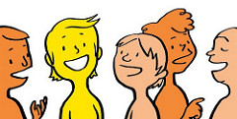
Bilingualism and Biliteracy
Spanish language learning
English home language students need to be given many opportunities to use Spanish outside of the classroom and beyond grade 12 if they are to reach advanced levels of proficiency.
Pixabay
(Genesee, 2007)

Slide 21
Bilingualism and Biliteracy
English language learning
ALL DLI students do as well as or better in English than similar students schooled only in English – why?
  The DLI program supports English development.
  Students have ongoing support for the development of English in the community (and, for some, at home).
(Lindholm-Leary & Genesee, 2014)

Slide 22
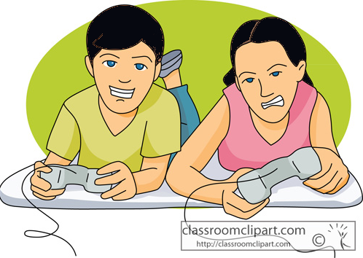
Bilingualism and Biliteracy
English language learning
Spanish home language/bilingual students are surrounded by English and are highly motivated to use it outside of the classroom. But they need many years of formal instruction to acquire English proficiency, especially in terms of academic language.
(Lindholm-Leary, 2001)

Slide 23
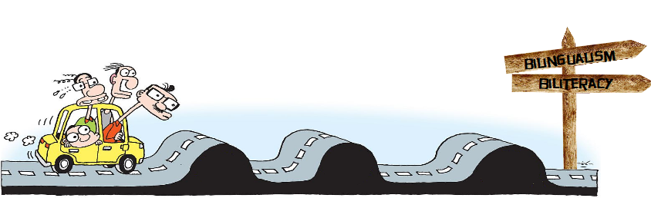
The Road to Bilingualism & Biliteracy
pixshark
Read each “bump in the road” statement.
Share ideas you have for responding to these “bumps.”

Slide 24

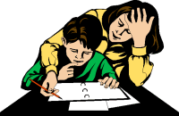
Pixabay
Children often feel it’s not fair that they have to work so much harder than their non-DLI friends.
As parents, you will probably feel bad you can’t help more.
Acknowledge your child’s feelings as well as your own, but don’t let them overpower you. The struggle is worth it!
In 5th grade, when the content becomes much more complex and difficult, your child might get very discouraged and you may feel helpless, especially if you don’t speak the language of instruction.
Notes:
Bulleted

Slide 25

Pixy
The road to bilingualism and biliteracy is a long one.
Students need to continue their studies in both languages through high school and even beyond.
Research is clear that DLI education offers Spanish-speaking students the best shot at maintaining their home language and developing high levels of English proficiency.
At the end of elementary, when it comes time to move into middle school, your child may want to quit the DLI program and go to middle school in English only. You may even be ready to give up!
Notes:
Bulleted

Slide 26

Notes:
10 minutes

Slide 27

bealearninghero.org
DLI superparents!
Notes:
Enrolling your child in a DLI program is not enough to ensure that your child will be bilingual and biliterate. Parents have an important role to play – and it will be different depending on whether your home language is English or Spanish.
Activity: Divide the group into four (for small groups, they may work in pairs). Each group gets one slide (part of handout) to discuss. They should address each how-to tip from their point of view as an English home language or Spanish home language speaker. They can share ways they have been or hope to be a DLI superparent. After 5 minutes, do a share-out, going through the four slides, with each group sharing their ideas.

Slide 28
DLI superparents - tip #1
Support your home language. Speaking your home language and providing a rich language environment for your child is the most important thing you can do for them.
Share your hopes and dreams for your child’s future as a bilingual.

Slide 29
DLI superparents - tip #2
Read to your child in your strongest language to encourage development of the home language and to model fluent reading.
Listen to your child read, even if you do not speak/read the language.

Slide 30
DLI superparents - tip #3
Bring Spanish into your home: music, TV, DVDs, educational websites, audio books, etc.
Look for authentic opportunities to use Spanish: restaurants, markets, family and friends who speak the language, etc.

Slide 31
DLI superparents - tip #4
Ask questions about the homework so the child explains the assignments in his/her first language.
Find a “homework buddy.” If your child does not understand an assignment, he or she can contact this child for help.

Slide 32
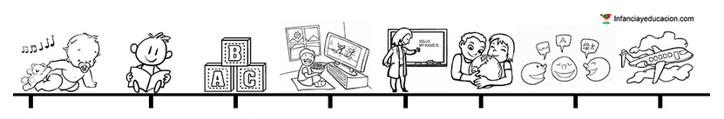
The basis of learning a language begins in early childhood. Language skills will develop depending on the exposure and experience that the learner has with the language throughout his or life.

Slide 33

The stakes
are high

Slide 34

Ojibwe
Spanish
Hmong
freepnglogos
(Fortune, 2018)
Notes:
In the U.S., English is the Pac-man of all languages! Across the United States we have tens of thousands of children who come into our school system as bilinguals and leave the system as monolinguals. This break with the language oftentimes means a loss of cultural identity as well.

Slide 35
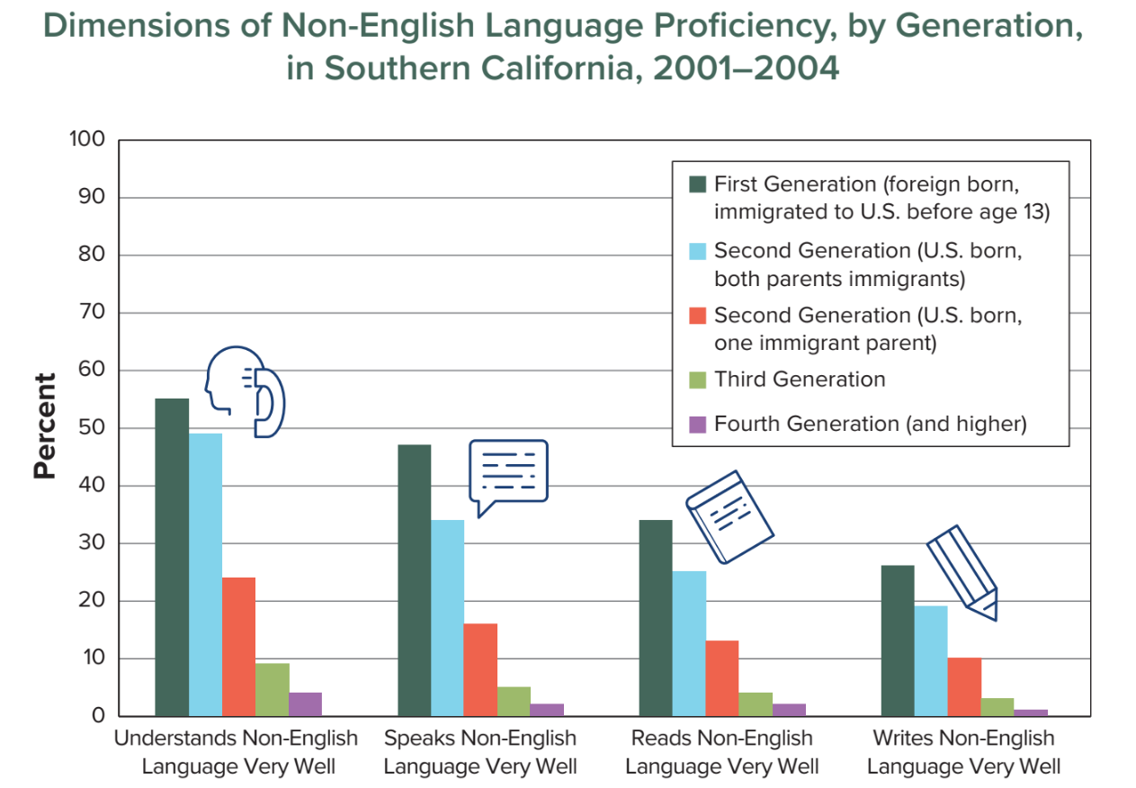
(American Academy of Arts and Sciences 2016)
Notes:
Walk them through the chart. Focus on the speaking data (the second set of bars).
For immigrant families, the ability to understand, speak, read, and write the home language disappears very quickly. A study in Southern California found that only 45% of first-generation adults who immigrated to the United States before the age of 13 could still speak the language of their parents well. Only 35% of second generation immigrants could speak their home language. And only 5% of third generation immigrants could speak the language of their grandparents. Without making a conscious effort to maintain it, families can lose their home language in 3 to 4 generations, showing just how powerful English is in the U.S. Take an informal survey of how many participants have experienced this.

Slide 36
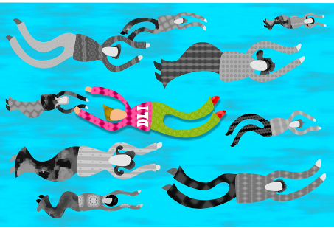
Publicdomain.net
Notes:
If you are an English home language parent, you have different challenges. Despite the tremendous growth in Dual Language and Immersion programs over the last 45 years, you are still swimming against the tide. Most Americans - who could include your family, friends and coworkers - don’t know about, don’t understand or don’t agree with DLI education and you may be criticized for the choice you made. Your child will also have a harder time developing high levels of proficiency without additional exposure to the second language.

Slide 37

Pickit
“One language sets you in a corridor for life. Two languages open every door along the way.”
- Frank Smith

Slide 38

We thank you for coming this evening
and for your active participation!
Please complete the short questionnaire to help us to see what you learned in this workshop and how we can improve it.
Pixabay
USDE Grant: Dual Language and Immersion Pathways to English Learner Success

Slide 39
References
American Academy of Arts and Sciences. (2016). The state of languages in the U.S.: A statistical portrait. Cambridge, MA: Author. Retrieved from https://www.amacad.org/content/publications/publication.aspx?d=22429.
Center for Applied Second Language Studies. (2013). What levels of proficiency do immersion students achieve? Retrieved from https://casls.uoregon.edu/wp-content/uploads/pdfs/tenquestions/TBQImmersionStudentProficiencyRevised.pdf.
Cummins, J. (1980). The entry and exit fallacy in bilingual education. NABE Journal, 4, 1–7.
Fortune, T. W. (July, 2018). Dual language and immersion education: An introduction. Presentation given during the 2018 Center for Advanced Research on Language Acquisition (CARLA) Summer Institute: Immersion 101: An Introduction to Immersion Education, University of Minnesota, Minneapolis, MN.
Genesee, F. (2007). Top ten most consistent findings from research on foreign language immersion. The ACIE Newsletter, 10(3), 7 & 10.
Gibbons, P. (2015). Scaffolding language scaffolding learning: Teaching English language learners in the mainstream classroom (2nd ed.). Portsmouth, NH: Heinemann.
Krashen, S.D., & Terrell, T.D. (1983). The natural approach: Language acquisition in the classroom. NY: Prentice Hall Macmillan.
Lindholm-Leary, K. J. (2001). Dual language education. Clevedon, UK: Multilingual Matters.
Lindholm-Leary, K. J., & Genesee, F. (2014). Student outcomes in one-way, two-way, and indigenous language immersion education. Journal of Immersion and Content-Based Language Education, 2(2), 165–180.
Mi Chu Chu Tren. (n.d.). Stages of second language acquisition. Retrieved from http://michuchutren.com/stages-second-language-acquisition/.

Slide 40
Acknowledgements and Permissions
Clipart taken from Classroom Clipart, Creative Commons, Flickr (CC), Freepnglogos, Pickit, Pixabay, Pixshark, Pixy, and Publicdomain are copyright-free and do not require permission or attributions.
The following images are reproduced with permission from their respective sources:
Slide 8: Mi Chu Chu Tren (https://michuchutren.com)
Slide 27: Be a Learning Hero (https://bealearninghero.org)
Slide 32: Infancia y educación (http://www.infanciayeducacion.com)
Slide 35: American Academy of Arts and Sciences (https://www.amacad.org/publication/state-languages-us-statistical-portrait/section/4)

Slide 41
Authors
Contributors
University of Minnesota:
Maureen Curran-Dorsano
Diane J. Tedick
Corinne Mathieu
Special thanks to our translator, Anselmo C. Castelán
and to our external consultant,
Edward M. Olivos,
University of Oregon
Amanda Lea (Eastern Carver County)
Cathy Camarena (St. Paul)
Teresa Chavez (Roseville)
Carolina DuFault (Risen Christ)
Tara W. Fortune (UMN)
Leticia Guadarrama (Minneapolis)
Liz Hathaway-Castelán (St. Paul)
Laura Hofer (Richfield)
Bounthavy Kiatoukaysy (St. Paul)
Corina Pastrana (Minneapolis)
Melissa Richards de Campaña (St. Paul)
Anita Sasse (Northfield)
Kate Trexel (UMN)
Megan Unger (Minneapolis)

