Slide 1

Notes:
Notes to facilitators in italics.

Slide 2

Dual Language and Immersion Family Education:
Supporting Students in Secondary Programs
Session 2
DLI
Family
Education
EDUCATE
EMPOWER
ENGAGE
USDE Grant: Dual Language and Immersion Pathways to English Learner Success
Notes:
Facilitators: Encourage participants to sit with new people tonight. Make sure they are sitting in mixed language groups with at least one bilingual at each table who can give linguistic support as needed.

Slide 3

Introductions
Pixabay
Your name
Number and ages of your children
Your school
Languages spoken at home
Notes:
Reintroduce yourself. Encourage participants to sit with new people tonight. Make sure they are sitting in mixed language groups with at least one bilingual at each table who can give linguistic support as needed.

Slide 4
Objective 3
  I understand that
  how I support my child will change as he or she moves from elementary, to middle, to high school.
  how I support my child in high school will have implications for college readiness

Slide 5

              At the elementary level, parent involvement
              is commonly front and center.
Involvement at the secondary level is often much less visible,
though just as valuable.
Pngitem.com
(Ferguson & Rodríguez, 2005; https://sedl.org/connections/resources/rb/rb3-Secondary.pdf)
Notes:
Parental involvement at any level of a DLI program can be challenging. For Spanish home language speakers, there are often linguistic and cultural barriers to overcome, while English home language speakers are uncertain of their role if they do not speak Spanish. Nevertheless, at the elementary level, families commonly assist with homework, eat lunch at school, volunteer as reading tutors, room parents, field trip chaperones or classroom helpers. Involvement at the secondary level, however, looks quite different.

Slide 6

School involvement at the secondary level might include:
        special meetings to communicate test information or test preparation strategies;
        discussions on college planning;
        participation on a school improvement team;
        workshops designed to teach homework strategies or methods to address adolescent issues.
Freepik
(Ferguson & Rodríguez, 2005; https://sedl.org/connections/resources/rb/rb3-Secondary.pdf)
Notes:
This kind of support can be daunting, especially for families who have not gone through test preparation and the college planning process themselves.

Slide 7

Creative Commons
What are some of the challenges DLI families face when it comes to helping/guiding/supporting their children in middle or high school?
Notes:
Using index cards, participants write down one challenge they have faced or are facing when it comes to helping/guiding/supporting their child in middle or high school. Have them share what they wrote at their table. Whole group: Ask tables if there were any similar challenges discussed. Then share out 2 or 3 examples of challenges and possible solutions. If, for example, parents say they don’t understand the college admissions process, be prepared to tell them where they could go for help. (Just as for Objective 1, you can probably anticipate some of the challenges that will be mentioned, so it would be a good idea to have a district-specific FAQ sheet to hand out.)

Slide 8

How can you successfully support your teenager’s academic achievement?
          Talk often with your child about school and about what your child is learning.
          Monitor homework.
          Keep your child focused on learning during the school year.
          Communicate with your child’s teachers.
          Help your child make plans for postsecondary education.
(Ferguson & Rodríguez, 2005; https://sedl.org/connections/resources/rb/rb3-Secondary.pdf)
Notes:
Emphasize: The first four points are things all parents can do, right now.

Slide 9

How can you help your child make plans for postsecondary education?
  Monitor your child’s course choices.
  Communicate your high expectations for academic performance, which includes:
            enrollment in college-credit courses while in high school;
            enrollment in advanced math classes;
            strong cumulative high school Grade Point Average (GPA);
            no failures in core subjects.
All Free Download
(Camara, 2013)
Notes:
Explain: A semester GPA is an average of the grades a student receives in a given semester. A cumulative GPA is an average of the grades a student will have received in all courses throughout high school.
It is important that you encourage your child to enroll in advanced math classes and college-credit courses. There are a number of ways that your child can receive high school and college credit at the same time.

Slide 10

What are the options for college-credit courses in high school?
The Advanced Placement Program
is an educational partnership between secondary schools and colleges and universities;
provides high school students with the opportunity to take college-level courses in a high school setting.
(Minnesota Office of Higher Education, 2017a; https://www.ohe.state.mn.us/dPg.cfm?pageID=1068)
Notes:
Let participants know whether or not this is a possibility in your district.

Slide 11
Additional benefits and opportunities for DLI students:
  Advanced language and literature courses are offered in Spanish.
  Most colleges and universities nationwide offer college credit (to satisfy language requirements), advanced placement (for further language study), or both, for qualifying AP Exam scores.

Slide 12

Postsecondary Enrollment Options (PSEO) Program
allows high school students to enroll in courses taught by college instructors on college campuses;
offers high school students the opportunity to earn college credit at no cost and, after graduation from high school, to potentially enter into postsecondary institutions with some course requirements already met.
(Minnesota Office of Higher Education, 2017b; https://www.ohe.state.mn.us/mPg.cfm?pageID=797)
Notes:
Let participants know whether or not this is a possibility in your district.

Slide 13

Concurrent Enrollment Program
  serves public high school students enrolled in a college-level course taught at the high school during the regular school day;
  allows students to earn high school and college credit concurrently.
(Minnesota Office of Higher Education, 2017b; https://www.ohe.state.mn.us/mPg.cfm?pageID=797)
Notes:
Let participants know whether or not this is a possibility in your district.

Slide 14

The International Baccalaureate Diploma Program
(full program)
is a comprehensive two-year international curriculum offered in the high school, for students aged 16-19;
requires students to study and pass exams in six different academic subjects, including a language other than English; and
is accepted as an admissions credential at more than 1,000 North American Colleges and in more than 100 countries.
(Minnesota Office of Higher Education, 2017c; https://www.ohe.state.mn.us/mPg.cfm?pageID=797)
Notes:
Let participants know whether or not this is a possibility in your district.

Slide 15
Additional benefits and opportunities for DLI students:
  Students who do not earn the IB diploma are still eligible for college credit. However, students who earn the IB diploma receive more college credit than those who don’t.
  To meet the Language requirement for the IB diploma, students must be at Level 6, which is the equivalent of Advanced Low on the ACTFL standards. Many DLI students achieve this level by the end of grade 12.
(Global Seal of Biliteracy; https://theglobalseal.com/ib-test-state-seal-of-biliteracy-resources)

Slide 16

      ADVANCED LOW speakers can
  communicate with native speakers on a variety of familiar and general topics;
  read and understand a variety of fiction and nonfiction texts if not too complex; and
  present information in writing, though academic language is weak.
(ACTFL, 2017; https://www.actfl.org/resources/ncssfl-actfl-can-do-statements)

Slide 17

Why is enrollment in college-credit courses so important?
Students who enroll in college-credit courses:
  are more likely to immediately enroll - and stay - in college
  than their peers;
  have significant flexibility in how to tailor their academic programs to their specific needs; and
  reduce the time and cost to earn degrees and enter the workforce.
Freepik
(College in High School Alliance, 2020; https://www.collegeinhighschool.org/)

Slide 18
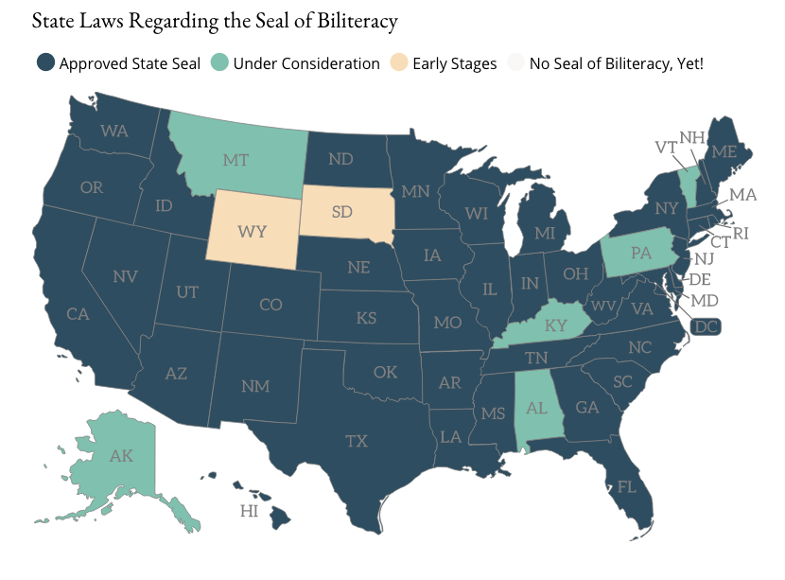
Another Benefit for DLI Students: Seal of Biliteracy
and World Language Proficiency Certificates
(Seal of Biliteracy, 2020)
Notes:
The first Seal of Biliteracy was created in 2008 as part of a grassroots effort by the nonprofit group, “Californians Together.” Their goal was to recognize high school graduates who had obtained high levels of competency in one or more languages in addition to English. The seal has gained in popularity throughout the United States in recent years.

Slide 19
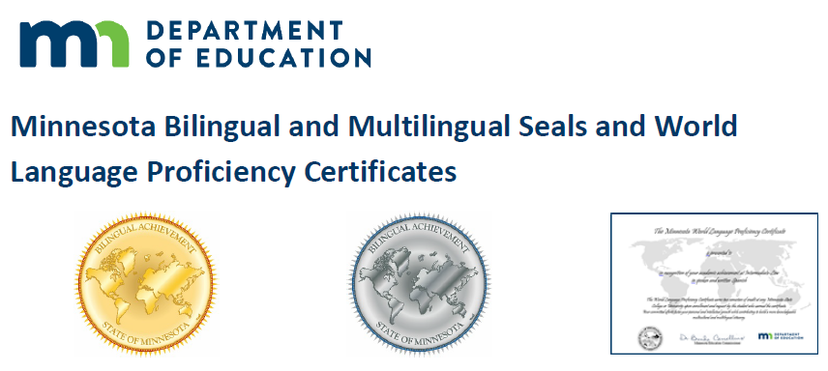
What are Bilingual and Multilingual Seals and World Language Proficiency certificates?
Minnesota Department of Education
  Minnesota districts award Minnesota bilingual and multilingual seals to high school graduates who demonstrate the required levels of language proficiency in speaking, writing, reading and listening for languages other than English.
(Minnesota Department of Education, 2020)

Slide 20
What are the benefits of earning a bilingual seal
or a world language proficiency certificate?
Minnesota Department of Education
  Many universities will award free college semester credits to graduating high school students who receive bilingual and multilingual seals and world language proficiency certificates.
(Minnesota Department of Education, 2020)

Slide 21
What are the other requirements for a bilingual or multilingual seal?
Minnesota Department of Education
  In addition to demonstrating the required proficiency levels in a language other than English, students must:
  demonstrate mastery of Minnesota's English language proficiency standards; and
  satisfactorily complete all required English language arts credits.
(Minnesota Department of Education, 2020)

Slide 22
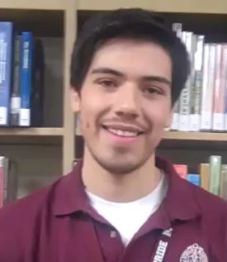
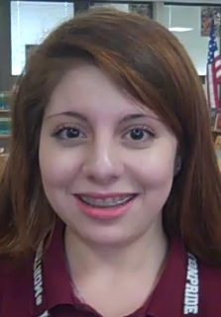

SEALS OF BILITERACY
(District 201, 2019)
Notes:
These two students are Spanish home language speakers. You should add that many seals have been awarded to English home language speakers who have learned Spanish (and other languages) as a second language.
Click on each of the two pictures on the left to see the videos or on the video icon to take you to the home page: https://il01904869.schoolwires.net/Page/681 The home page includes all of the videos. You could just use that, but just in case their site links don’t work, here are the YouTube URLs:
https://www.youtube.com/watch?time_continue=74&v=xDUVP1Jdrn0
https://www.youtube.com/watch?time_continue=2&v=plSHKr9bpVI

Slide 23

The Value of Language Study for College Admission
          No matter where students apply for college, demonstrated proficiency in a language other than English will improve their chances of being admitted.
          Life in college and after college has become increasingly globalized, so strength in a second language carries a lot of weight with admissions counselors.
Line17qq
(Grove, 2020; https://www.thoughtco.com/foreign-language-requirement-college-admissions-788842)

Slide 25

How can you support your child’s DLI experience at the
secondary level?
In a DLI program, the best way for Spanish home language speakers
to have a positive impact on their child’s future as a bilingual is to
  commit to DLI through grade 12;
  continue to speak Spanish and expect their child to speak Spanish in the home;
  encourage their child to speak Spanish in the community.
Clipart Library
Notes:
When students see that their parents value their language and culture, they are more likely to embrace those values themselves and are more motivated to continue in the DLI program through grade 12.
Take a few minutes to elicit some suggestions for how Spanish language speakers can use their language outside the classroom.

Slide 26
The best way for English home language speakers to have a positive impact on their children’s future as a bilingual is to
  commit to DLI through grade 12;
  help them find ways to use Spanish outside of the classroom and school; and
  encourage them to continue language study in college and to pursue study abroad.
Notes:
The more students use their language in culturally authentic contexts, the more they begin to see a future for themselves as bilinguals and the more motivated they are to pursue advanced language study in college.
Take a few moments to elicit some suggestions for how English home language speakers can develop their Spanish outside the classroom.

Slide 27
Creative Commons
If students were asked to rate themselves on a 1-5 scale, with 1 being “I don’t want to stay in the DLI program through grade 12” and 5 being “I am 100% committed to DLI through grade 12,” what do you think your child’s response would be?
Notes:
Using index cards, participants write down how they think their child would respond and, on the back side, one thing they can do to encourage and motivate their child to stick with DLI through high school. Share out a few ideas.

Slide 28
Objective 4
I understand that there are many different careers open to those who are bilingual and biliterate.

Slide 29
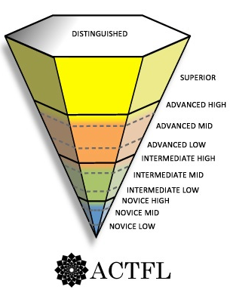
Language Proficiency and the Workplace
University Professor, Lawyer
Physician, Military Linguist Medical Interpreter
K-12 language teacher
Many DLI students
Almost all DLI students
Fire fighter, Utilities Installer,
Auto Inspector, Aviation Personnel,
Tour Guide
(ACTFL, 2012, 2015)
Notes:
Enrolling your child in a DLI program is not enough to ensure the level of proficiency necessary for the most demanding careers, such as physician or lawyer. However, you are setting your child on a solid path to a bilingual future. We have already seen that almost all DLI students who remain in the program from kindergarten through grade 12 achieve proficiency in the Intermediate Mid range and many immersion students even reach the Advanced Low range by the end of grade 12. But in order to achieve the high level of language proficiency required to work in a bilingual environment, students will need many additional opportunities to use Spanish and will have to continue formal study of the language as well.
This graph shows some traditional careers for today’s bilinguals. There will be many other careers for bilinguals in the future that don’t even exist today.

Slide 30

Bilingual Careers
Pixabay
Research has shown that individuals who are high use bilinguals – who use both languages frequently for personal and professional purposes – and who have very high levels of biliteracy
  are more likely to attend and graduate from 4-year colleges, which increases opportunities in the labor market;
  are likely to have more prestigious and higher paying careers; and
  have greater opportunities for career advancement.
These benefits are increasingly critical for young people in today’s global economy!
(Porras, Ee & Gándara, 2014; Santibañez & Zárate, 2014)
Notes:
According to a report by the Civil Rights Project at UCLA and the Educational Testing Service…Read the slide.
After reading bullet points add…
In fact, a study in Belgium found that balanced bilinguals earn about $5,200 more annually at the beginning of their careers than do monolinguals – the findings were the same for different language groups. So there is a substantial loss to a person in earnings over time if they lose the home language.

Slide 31






Maya
Manuel
Jessica
Maria
Peter
Notes:
This activity will help you make the connection between language proficiency and actual careers.
Five recent college graduates are attending a job fair. All attended DLI programs growing up. Can you match them with their future career possibilities?
Descriptions of each graduate are included in the session handout. Introduce each of the five job seekers by reading the first three columns of slides 32-36. Participants will read the fourth column at their table, then try to put the five candidates in order according to their language proficiency. This will be based on language spoken at home, formal schooling, other language experiences and the description of their proficiency. When they have ordered the five from highest to lowest proficiency, show slide 37.

Slide 32
Language spoken at home | Years of Spanish language study | Other language experience | Spanish Proficiency
English | K–12 DLI Spanish | 4-week volunteer service program in Costa Rica during college | Can initiate and maintain conversations on familiar topics by asking and responding to a variety of questions. Can read and understand short, straightforward texts. Can communicate in writing in social contexts but with errors. Professional writing is beyond her capability.
Jessica
(ACTFL, 2017)

Slide 33
Language spoken at home | Years of Spanish language study | Other language experience | Spanish Proficiency
Spanish | K–12 DLI Spanish, 4 years of college (Spanish major) | Extended stays with family in Mexico | Can maintain spontaneous conversations and discussions with native speakers on familiar and unfamiliar topics in academic, social, and professional contexts. Can make oral and written presentations on complex topics. Can read and understand complex fiction and nonfiction texts.
Manuel
(ACTFL, 2017)

Slide 34
Language spoken at home | Years of Spanish language study | Other language experience | Spanish Proficiency
English | K–12 DLI Spanish, 4 years of college (Spanish major) | Year-long study abroad in Spain | Can converse effectively with native speakers about familiar topics, including some academic and professional. Can present orally and in writing but on a limited range of topics. Can read and understand a variety of fiction and nonfiction texts.
Maya
(ACTFL, 2017)

Slide 35
Language spoken at home | Years of Spanish language study | Other language experience | Spanish Proficiency
English | K–6 DLI and two years traditional Spanish classes in middle school | none | Can understand if the topic is familiar and the speaker speaks slowly. Can maintain a very simple conversation. Can read and understand short, uncomplicated texts. Poor writing skills.
Peter
(ACTFL, 2017)

Slide 36
Language spoken at home | Years of Spanish or language study | Other language experience | Spanish Proficiency
Mostly English though parents speak to her in Spanish | K–12 DLI, 4 years college Spanish (Spanish minor) | Spanish Club in college | Can communicate with native speakers on a variety of familiar and general topics. Can read and understand a variety of fiction and nonfiction texts if not too complex. Can present information in writing, though with errors.
Maria
(ACTFL, 2017)

Slide 37
ORAL PROFICIENCY LEVELS IN THE WORKPLACE
Advanced High | Physician, Financial Services Consultant, Military Linguist, Translation Officer
Advanced Mid | Banking and Investment Services, Customer Service Representative, Medical Interpreter, Court Interpreter
Advanced Low | K–12 Language Teacher, Nurse, Social Worker, Police Officer, Legal Secretary
Intermediate High | Fire Fighter, Utilities Installer, Auto Inspector, Aviation Personnel, Tour Guide
Intermediate Mid | Cashier, Sales Clerk, Receptionist
Intermediate Low
(ACTFL, 2015)
Notes:
Debrief placement of candidates by pointing out:
Spanish home language speakers like Manuel who continue to speak Spanish in the home, spend extended periods of time in a Spanish-speaking environment and continue their Spanish studies in college are the most likely to achieve high levels of proficiency.
English-language speakers like Maya need four years of advanced Spanish in college and an extended stay in a Spanish-speaking country if they are to achieve the high levels of language proficiency and cultural competence necessary for a bilingual career.
Students like Maria may have good speaking skills, but they still need advanced language study in college to acquire the necessary academic language and writing skills required in higher level careers.
Students at the Intermediate Mid level like Jessica may be able to get by orally if the task is not too demanding, but they are limited in their use of the language and their skill level would have low marketability.
Students like Peter are out of luck! Staying in the program through high school is the minimum requirement, even for low-level jobs.
All candidates can improve their skills just by using their language every day at home, in their jobs, traveling, reading or watching TV/movies in Spanish, etc. But if they do nothing to maintain and further develop their language skills during their four years of college, much of the proficiency gained during their K-12 DLI education will be lost by the time they are ready to enter the workforce.

Slide 38

“Education is our passport to the future, for tomorrow belongs to the people who prepare for it today.”
- Malcolm X
Notes:
Ask parents to write down one goal – one thing they will do, starting now, to help their child prepare for college and a career as a bilingual. Share out some ideas.

Slide 39

We thank you for coming this evening
and for your active participation!
Please complete the short questionnaire to help us to see what you learned in this workshop and how we can improve it.
Pixabay
USDE Grant: Dual Language and Immersion Pathways to English Learner Success

Slide 40
References
ACTFL – American Council on the Teaching of Foreign Languages. (2012). ACTFL proficiency guidelines. Alexandria, VA: ACTFL. Available at: https://www.actfl.org/publications/guidelines-and-manuals/actfl-proficiency-guidelines-2012.
ACTFL. (2015). Oral proficiency levels in the workplace. Retrieved from https://www.actfl.org/sites/default/files/pdfs/TLE_pdf/OralProficiencyWorkplacePoster.pdf.
American Council on the Teaching of Foreign Languages (ACTFL). (2017). ACTFL-NCSSFL Can-Do Statements. Alexandria, VA: Author. Retrieved from: https://www.actfl.org/resources/ncssfl-actfl-can-do-statements.
Camara, W. (2013). Defining and measuring college and career readiness: A validation framework. Educational Measurement: Issues and Practice, 32(4), 16–27.
College in High School Alliance. (2020). Promoting effective transitions between high school and college. Retrieved from: https://www.collegeinhighschool.org/
District 201. (2019). The Seal of Biliteracy at J. Sterling Morton High School. Videos of students’ reflections on the Seal of Biliteracy. Retrieved from https://il01904869.schoolwires.net/Page/681.

Slide 41
Ferguson, C., & Rodríguez, V. (2005). Engaging families at the secondary level: What schools can do to support family involvement. A strategy brief of the National Center for Family and Community Connections with Schools. Retrieved from: https://sedl.org/connections/resources/rb/rb3-Secondary.pdf
Global Seal of Biliteracy. (n.d.). International Baccalaureate Language Exam. Retrieved from: https://theglobalseal.com/ib-test-state-seal-of-biliteracy-resources.
Grove, A. (2020). Foreign language requirement for college admissions. ThoughtCo.com. Retrieved from https://www.thoughtco.com/foreign-language-requirement-college-admissions-788842.
Minnesota Department of Education. (2020). Minnesota Bilingual Seals Program. Retrieved from https://education.mn.gov/MDE/dse/stds/world/seals/index.htm.
Minnesota Office of Higher Education. (2017a). Advanced Placement. Retrieved from https://www.ohe.state.mn.us/dPg.cfm?pageID=1068
Minnesota Office of Higher Education. (2017b). Postsecondary Enrollment/Concurrent Enrollment. Retrieved from https://www.ohe.state.mn.us/mPg.cfm?pageID=797
Minnesota Office of Higher Education. (2017c). International Baccalaureate. Retrieved from https://www.ohe.state.mn.us/mPg.cfm?pageID=797

Slide 42
Porras, D.A., Ee, J., & Gándara, P.C. (2014). Employer preferences: Do bilingual applicants and employees experience an advantage? In R.M. Callahan & P.C. Gándara (Eds.), The bilingual advantage: Language, literacy and the US labor market (234–257). Bristol, UK: Multilingual Matters.
Santibañez, L., & Zárate, M.E. (2014). Bilinguals in the US and college enrollment. In R.M. Callahan & P.C. Gándara (Eds.), The bilingual advantage: Language, literacy and the US labor market (211–233). Bristol, UK: Multilingual Matters.
Permissions
Clipart and images taken from Berserkon, Creative Commons, Pixabay, Pixy, Clipart Library, Freepik, ClassroomClipart and All Free Download are copyright-free and do not require permission or attributions.

Slide 43
Authors
Contributors
University of Minnesota:
Maureen Curran-Dorsano
Diane J. Tedick
Un agradecimiento especial al traductor, Anselmo C. Castelán
y a los padres de los estudiantes de nivel secundaria de DLI que brindaron información e ideas sobre el contenido de estos talleres.
Camila Carroll, Saint Paul Public Schools
Elizabeth Dwight, Minneapolis Public Schools
Robyn Eliason, Minneapolis Public Schools
Liz Hathaway-Castelán, Saint Paul Public Schools
María Lara, Risen Christ Catholic School
Leah Laurent, Minneapolis Public Schools
Corina Pastrana, Minneapolis Public Schools
Carmen Grace Poppert, Risen Christ Catholic School
Amanda Sell, Saint Paul Public Schools
Sarah Streitz, Richfield Public Schools
Ana Vásquez, Minneapolis Public Schools

