Slide 1

Notes:
Notes to facilitators in italics.

Slide 2

Dual Language and Immersion Family Education:
Supporting Students in Secondary Programs
Session 1
DLI
Family
Education
EDUCATE
EMPOWER
ENGAGE
USDE Grant: Dual Language and Immersion Pathways to English Learner Success
Notes:
The Dual Language and Immersion Family Education program is supported by a United States Department of Education grant from the Office of English Language Acquisition.
Facilitators: Encourage participants to sit in mixed language groups. Make sure there is at least one bilingual in each group.
We are going to be giving these sessions bilingually rather than separating you into different language groups. Your children are together for instruction and that integration is key to program success. Keep in mind, however, that although we will be doing these sessions bilingually, your children are taught in one language or the other – the teachers don’t translate or use both languages during their instruction.
Do not present the information in both languages. Remind participants that everything you’re saying is in their handout. You can however, translate questions or comments, as they come up.

Slide 3

Introductions
Pixabay
Your name
Number and ages of your children
Your school
Languages spoken at home
What motivated you to come here tonight
Notes:
Depending on the size of the group, do this as a whole group (fewer than 10) or at tables.
5-10 minutes

Slide 4
Mission Statement
To enrich the educational experience of Dual Language
and Immersion (DLI) learners
by engaging, educating and empowering families.
USDE Grant: Dual Language and Immersion Pathways to English Learner Success
Notes:
Because many of the parents are L2 learners themselves, it is important to “read the room”: check frequently for understanding, rephrase as necessary, keep the acronyms to a minimum. Use your “teacher talk.” Assure parents that they should not hesitate to ask for clarification.

Slide 5
Objective 1
I understand that a strong DLI community of parents, school staff and students
will enhance students’ success.

Slide 6
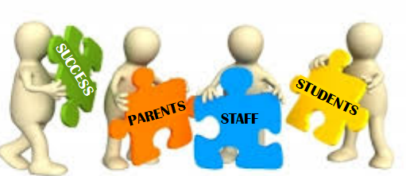
Clipart Library
“Developing a climate in which all members of the school community are understood, valued and respected, and in which a genuine desire is fostered to achieve improved educational outcomes and greater success for students….should be the aim of all stakeholders.”
(School Learning Support Program, 2010 - https://teachingmattersamy.weebly.com/uploads/1/3/9/9/13999466/positively_engaging_parents.pdf)
Notes:
Ask participants to think about what such a community might look like. Distribute index cards. On one side participants write down one thing that makes them feel (or would make them feel) “understood, valued and respected.” On the other side, they write down how this might affect their child’s success and attitude toward school.

Slide 7

Creative Commons
1. What is one thing that makes you feel (or would make you feel)
“understood, valued and respected”?
2. How might this affect your child’s success in school?
Notes:
Break into small groups. Parents share what they wrote on the first side of the card and place their cards face up on the table, grouping them by common themes (if there are any). Whole group: Ask if any tables had similar ideas and share those out. Ask parents to look at what they wrote on the back and to share those ideas at their table. Share out a few ideas from both English and Spanish speakers.
End by giving parents some ideas of where to go/what to do in your school or district to make their “understood, valued and respected” ideas known. Have a handout prepared with pertinent information – members and schedule of meetings for school board, PTO, contact info for liaison officers, school principals, etc. (This is part of empowering parents to advocate for themselves, one of three goals in our mission statement.)

Slide 8
Objective 2
I understand that
achieving high levels of proficiency in two languages is
a long-term process; and
my understanding and support of DLI education will help sustain my child’s commitment to the program through high school.

Slide 9
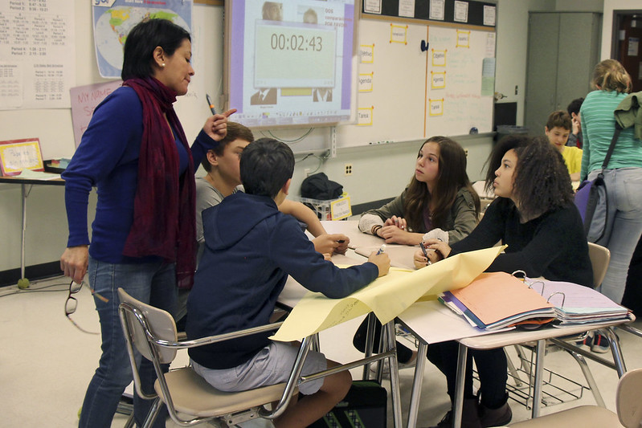
DLI at the secondary level
An important developmental milestone happens just before puberty and lasts until the mid-twenties. This second surge of brain development means two things for DLI education:
Creative Commons
(Lazar, 2019 https://medium.com/@mehdilazar/why-immersion-is-important-in-middle-school-f73a77390ab5)

Slide 10
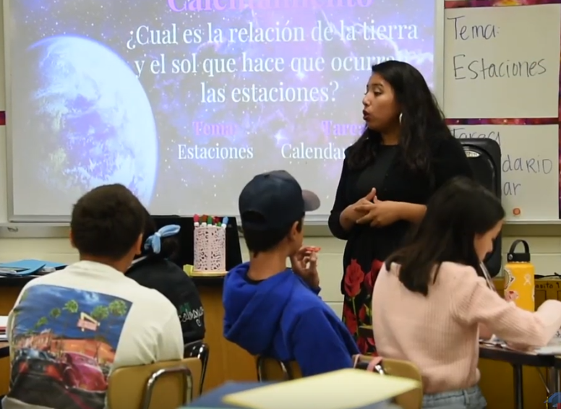
If students continue to be exposed to and have opportunities to communicate in Spanish, they will use it in more sophisticated and complex ways and therefore develop higher critical thinking, problem-solving skills, and academic language and literacy.
YouTube
(Lazar, 2019 https://medium.com/@mehdilazar/why-immersion-is-important-in-middle-school-f73a77390ab5)

Slide 11
BUT if students do not continue to hear and use Spanish during these middle school years,
  English home language students can lose the proficiency they gained in K-5; and
  Spanish home language students may not develop the academic language and literacy they need to succeed in school and beyond.
(Lazar, 2019 https://medium.com/@mehdilazar/why-immersion-is-important-in-middle-school-f73a77390ab5)

Slide 12

“Middle School… is therefore not the end, but rather just the beginning of a wonderful academic journey where students can use fully the cognitive advantages of their multilingualism.”
Pxhere
(Lazar, 2019 https://medium.com/@mehdilazar/why-immersion-is-important-in-middle-school-f73a77390ab5)
Notes:
Your child may not see this. It’s up to you to keep your child on course.

Slide 13

TRANSITION FROM ELEMENTARY TO SECONDARY SCHOOL
When students begin to question staying in the DLI program, it is most often due to here-and-now issues:
          interest in taking more electives,
          wanting to expand their social circle,
          a sense of having reached a plateau in language skills, etc.
DLI?
Pixabay

Slide 14

What are some of the challenges of rigorous course work in the partner language for DLI students?
          As there are usually fewer courses offered in the partner language at the secondary level, students’ language growth is likely to plateau with fewer opportunities to use the language.
          DLI students may feel overwhelmed as classes get more demanding and the language more complex.
Clipart Library
(School Learning Support Program, 2010 - https://teachingmattersamy.weebly.com/uploads/1/3/9/9/13999466/positively_engaging_parents.pdf)
Notes:
“We know that adolescence is a period both of self-discovery and self-doubt.
Parents can support their child and the work of the school by working with their child to develop a positive self-esteem and self-belief.
By assisting their child to have a positive attitude towards staff and the work of the school, and by helping them to develop organizational strategies to support learning, parents can positively impact on their child’s learning.”

Slide 15
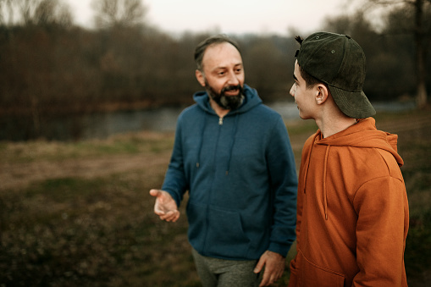
It is up to parents to look beyond today and remind their child of future benefits of staying in the program.
Pixabay

Slide 16
Creative Commons
What benefits have you already seen at the middle
or high school level?
Notes:
Ask participants what benefits they have personally observed since their child began middle school. Share out with the whole group a couple responses from both English and Spanish speakers.

Slide 17
BENEFITS OF DLI PROGRAMS AT THE SECONDARY LEVEL
  Continued development of bilingualism and biculturalism
  Continued development of academic language and literacy in both program languages
  Continued development of cross-cultural attitudes
  Continued provision of an efficient and effective model for serving the second language needs of English learners (Spanish home language students) and English speakers (Spanish learners)
(adapted from Montone & Loeb, 2003 https://carla.umn.edu/immersion/acie/vol6/bridge-6(3).pdf)

Slide 18
BENEFITS OF DLI PROGRAMS AT THE SECONDARY LEVEL
  Preparation to enter advanced language and content courses in high school or college
  Preparation for International Baccalaureate (IB) programs in high school
  Preparation for additional languages in high school or beyond
  Preparation to earn college credit through Advanced Placement language exams
(adapted from Montone & Loeb, 2003 https://carla.umn.edu/immersion/acie/vol6/bridge-6(3).pdf)
Notes:
Ask participants what word stands out in this list: PREPARATION.
It is clear that high school is not the end point, but a steppingstone. We will look more closely at the additional benefits during our next session.

Slide 19
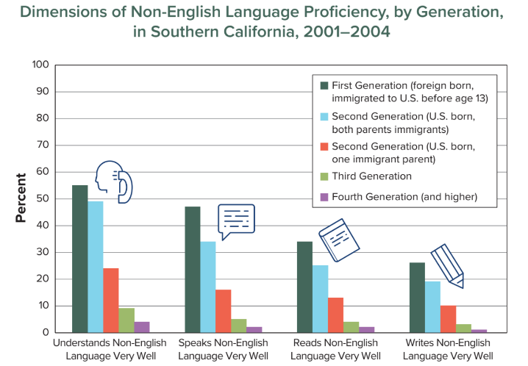
  An additional benefit of DLI at the secondary level for Spanish home language speakers is being able to maintain their cultural heritage and family connections.
(American Academy of Arts and Sciences, 2016)
Notes:
Walk them through the chart. Focus on the speaking data (the second set of bars).
For immigrant families, the ability to understand, speak, read, and write the home language disappears very quickly. A study in Southern California found that only 45% of first-generation adults who immigrated to the United States before the age of 13 could still speak the language of their parents well. Only 35% of second-generation immigrants could speak their home language. And only 5% of third-generation immigrants could speak the language of their grandparents. Without making a conscious effort to maintain it, families can lose their home language in 3 to 4 generations, showing just how powerful English is in the U.S.

Slide 21

WHAT RESEARCH TELLS US ABOUT DLI EDUCATION
AT THE SECONDARY LEVEL
            1. Students learning Spanish as a second language have a greater chance of reaching high levels of proficiency if they are in a DLI program and remain in it through grade 12.
Cleanpng

Slide 22
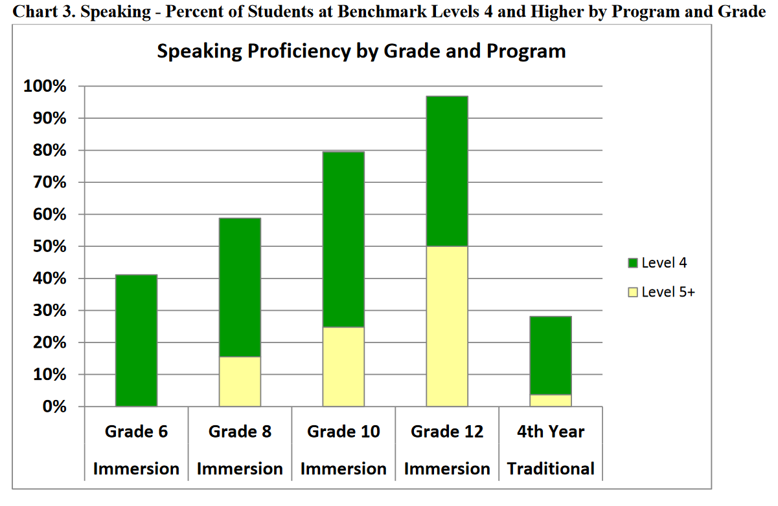
Almost 100% of 12th grade immersion students attained a Level 4 (ACTFL Intermediate Low) on the speaking assessment used for this study, and 50% attained a level 5 (Intermediate Mid) or higher.
About 30% of 12th grade students in a traditional world language program attained a Level 4 and only 2% attained level 5.
(CASLS, 2013 https://casls.uoregon.edu/wp-content/uploads/pdfs/tenquestions/TBQImmersionStudentProficiencyRevised.pdf)
Notes:
In a 2011 study, sponsored by the U.S. Department of Education, researchers used a database of 1,477 students enrolled in Spanish, French, Japanese, or Chinese immersion language programs in 14 states across the U.S. By grade 12, DLI Students outperformed their non-DLI peers in reading, writing and, especially, speaking the second language.
Explain: ACTFL stands for American Council on the Teaching of Foreign Languages. The ACTFL Proficiency Guidelines are a description of what individuals can do with language in terms of speaking, writing, listening, and reading in real-world situations in a spontaneous and non-rehearsed context. Next slide shows descriptors.

Slide 23

    LEVEL 4 / ACTFL INTERMEDIATE LOW language learners can:
    understand native speakers if the topic is familiar and the speaker speaks slowly;
    maintain a simple conversation;
    read and understand short, uncomplicated texts;
    express their ideas in writing but with many errors.
    LEVEL 5 / ACTFL INTERMEDIATE MID language learners can:
    initiate and maintain conversations with native speakers on familiar topics by asking and responding to a variety of questions;
    read and understand short, straightforward texts;
    communicate in writing in social contexts though professional writing is beyond their capability.
Clipart Library
(ACTFL, 2017 https://www.actfl.org/resources/ncssfl-actfl-can-do-statements)
Notes:
Here are some general descriptions of speaking, reading and writing levels of Intermediate Low and Intermediate Mid language learners.

Slide 24
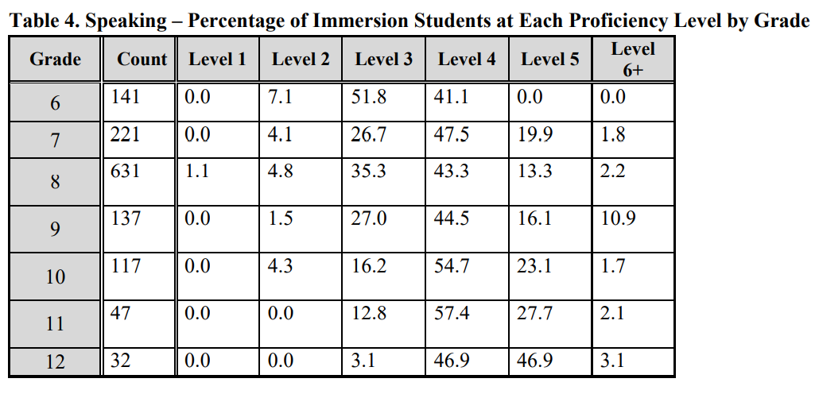
(CASLS, 2013 https://casls.uoregon.edu/wp-content/uploads/pdfs/tenquestions/TBQImmersionStudentProficiencyRevised.pdf)
Notes:
This graph from the same study shows speaking scores of immersion students from grade 6 to grade 12. Only about 41% of sixth graders were at a combined score of levels 4-6. It took until grade 12 to reach the combined score of 96.9% for levels 4 - 6. This graph also shows a dramatic drop-off in level 6+ between 9th and 10th grade. This is often the point between middle and high school, where fewer courses are offered in the immersion language.

Slide 25
WHAT RESEARCH TELLS US ABOUT DUAL LANGUAGE
AND IMMERSION EDUCATION AT THE SECONDARY LEVEL
            2. English Language Learners (e.g., Spanish speakers) who continue to develop their home language and literacy skills achieve higher levels of proficiency in English than those students in non-DLI programs.
Cleanpng
(Thomas & Collier, 2012)

Slide 26
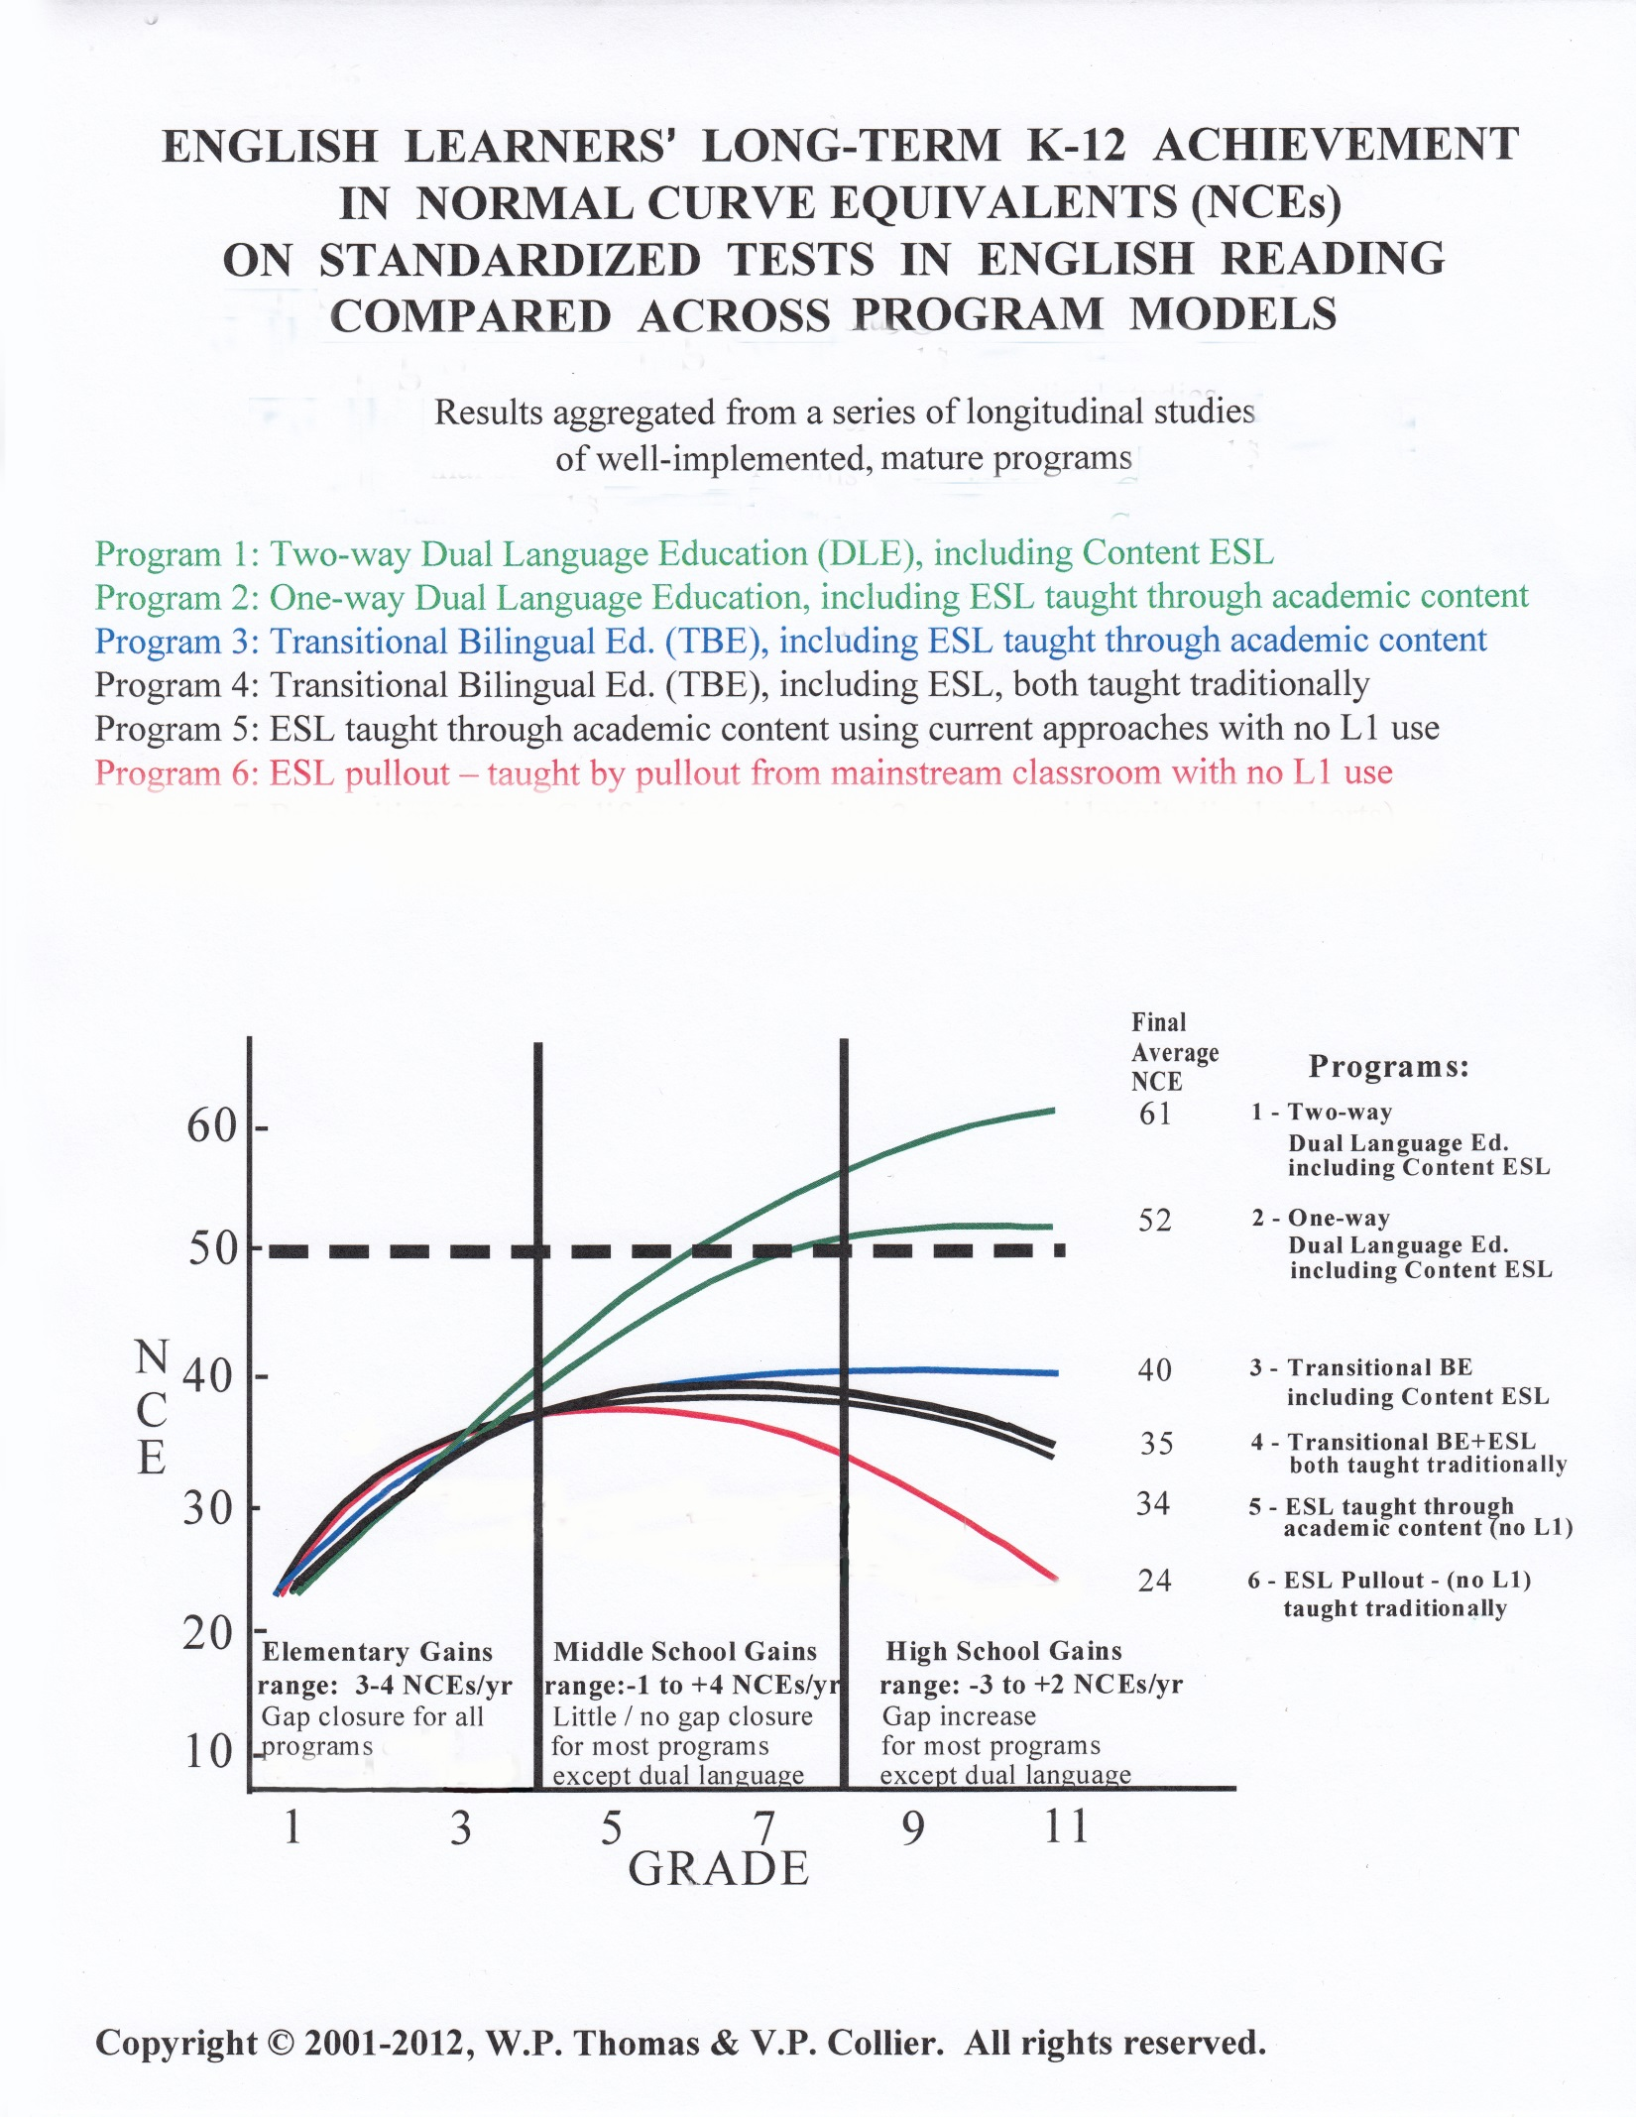
Notes:
Despite the many benefits of DLI at the secondary level, Spanish home language parents often fear that their child will not acquire the skills necessary to be successful in English. The benefits mentioned above are in addition to English language learners’ achieving high levels of proficiency in English. This graph shows English learners’ achievement levels in English reading in a variety of program models. It represents longitudinal research involving over 15,000 students in different programs and languages across several US states. Longitudinal research means that we’re looking at the same students over time. Let’s look at a larger version of the graphic to better interpret it.

Slide 27
English learners in DLI programs generally
catch up to their English-speaking peers in reading by Grade 5 or 6; and
outperform average English-speaking peers if they continue in the program through high school.
Notes:
You don’t have to go into detail about all of the different kinds of programs on this graph. Point out the heavy dotted line, which represents average English-language reading achievement levels for native English speakers in English-only programs (for your information only: NCE = Normal Curve Equivalent – an NCE of 50 = the 50th percentile, which is the average performance of native English-speaking students) that’s depicted by the dotted line and the top 2 lines for ELs in two-way and developmental bilingual programs.
Point to the two top lines as you explain: Two-Way DLI programs intentionally bring together students from two language groups – English home language and those who speak the partner language (Spanish) at home. One-Way Dual Language programs - also known as Developmental Bilingual Education - serve language learners with similar language and cultural backgrounds – for example, a group of students who speak Spanish at home. These students have the opportunity to maintain and improve their home language as they learn English. The two-way model shows the best outcomes, and the scores continue to improve from one year to the next.

Slide 28
WHAT RESEARCH TELLS US ABOUT DUAL LANGUAGE
AND IMMERSION EDUCATION AT THE SECONDARY LEVEL
          3. Students taught subjects like math and science in a non-English language are not at a disadvantage when taking standardized tests or when applying for college admission.
(Montone & Loeb, 2003 https://carla.umn.edu/immersion/acie/vol6/bridge-6(3).pdf)
Notes:
As their children face more serious academic studies, both English and Spanish home language parents may grow more concerned about having their children taught subjects like math and science in a non-English language, fearing that they will not do as well on standardized tests and college entrance exams.

Slide 29

  Findings of a study of 85,662 students in North Carolina Public Schools:
        Overall, two-way DLI students showed greater educational gains in reading and math compared to similar students not in DLI education.
Clipart Library
After three years of study, they concluded that two-way DLI education is an effective way to improve the reading and math scores of all students: English learners, language minority students who are not English learners, and native English speakers.
(Thomas & Collier, 2011 http://dcimmersion.org/wp-content/uploads/2014/11/north-carolina-longitudinal-study.pdf)
Notes:
Research over the past five decades has shown similar results. After an initial lag in English literacy skills, DLI students do as well as or better than their non-DLI peers on standardized tests in reading and math, even when the tests are in English and the instruction has been in the immersion language.

Slide 30

IN SUMMARY
If language study is not continued in middle school, the benefits from K-5 will eventually be lost. In other words, use it or lose it!
DLI through high school is the best way for English home language students to achieve high levels of proficiency in Spanish.
DLI through high school is the best way for Spanish home language students to achieve high levels of proficiency in English, along with academic language proficiency and strong literacy in both languages.

Slide 31
DLI through high school helps Spanish home language students maintain their language and cultural heritage.
Taking math and science in Spanish does not put students at a disadvantage later on. On the contrary, DLI students generally do as well as or better than non-DLI students on standardized tests.

Slide 32

Notes:
This slide is a place-holder only. The game is a separate PowerPoint named Sp-Eng BINGO 6-12

Slide 33

We thank you for coming this evening
and for your active participation!
Please complete the short questionnaire to help us to see what you learned in this workshop and how we can improve it.
Pixabay
USDE Grant: Dual Language and Immersion Pathways to English Learner Success
Notes:
Distribute surveys, have them write responses. Tell them you’ll ask for the surveys when they leave. If individuals are not comfortable writing, facilitators can have them share their responses orally while facilitator writes for them.

Slide 34
References
American Academy of Arts and Sciences. (2016). The state of languages in the U.S.: A statistical portrait. Cambridge, MA: Author. Retrieved from: https://www.amacad.org/content/publications/publication.aspx?d=22429.
American Council on the Teaching of Foreign Languages (ACTFL). (2017). ACTFL-NCSSFL Can-Do Statements. Alexandria, VA: Author. Retrieved from: https://www.actfl.org/resources/ncssfl-actfl-can-do-statements.
Center for Advanced Second Language Studies (CASLS). (2013). What levels of proficiency do immersion students achieve? Eugene, OR: Author. Retrieved from: https://casls.uoregon.edu/wp-content/uploads/pdfs/tenquestions/TBQImmersionStudentProficiencyRevised.pdf
Lazar, M. (2019). Why immersion is important in Middle school? Retrieved from https://medium.com/@mehdilazar/why-immersion-is-important-in-middle-school-f73a77390ab5
Montone, C. L., & Loeb, M. I. (2003). Implementing two-way immersion programs in secondary schools. ACIE Newsletter, 6(3), 1–8. Retrieved from: https://carla.umn.edu/immersion/acie/vol6/bridge-6(3).pdf
School Learning Support Program. (2010). Positively engaging parents. Retrieved from: https://teachingmattersamy.weebly.com/uploads/1/3/9/9/13999466/positively_engaging_parents.pdf

Slide 35
References
Thomas, W. P., & Collier, V. P. (2011). English learners in North Carolina dual language programs: Year 3 of this Study: School Year 2009–2010. Executive Summary. Retrieved from: 2011 http://dcimmersion.org/wp-content/uploads/2014/11/north-carolina-longitudinal-study.pdf
Thomas, W. P., & Collier, V. P. (2012). Dual language education for a transformed world. Albuquerque, NM: Dual Language Education of New Mexico and Fuente Press.

Slide 36
Acknowledgements and Permissions
Clipart and images taken from Creative Commons, Pixabay, Pixy, Clipart Library, Pxhere, Cleanpng, IMGBIN, and Line17qq are copyright-free and do not require permission or attributions.
The following images are reproduced with permission from their respective sources:
Slides 22 and 23, graph: Wayne P. Thomas and Virginia P. Collier
(https://www.thomasandcollier.com)

Slide 37
Authors
Contributors
University of Minnesota:
Maureen Curran-Dorsano
Diane J. Tedick
Special thanks to our translator, Anselmo C. Castelán,
and to the parents of secondary DLI students who provided input and ideas regarding the content of these workshops
Camila Carroll, Saint Paul Public Schools
Elizabeth Dwight, Minneapolis Public Schools
Robyn Eliason, Minneapolis Public Schools
Liz Hathaway-Castelán, Saint Paul Public Schools
María Lara, Risen Christ Catholic School
Leah Laurent, Minneapolis Public Schools
Corina Pastrana, Minneapolis Public Schools
Carmen Grace Poppert, Risen Christ Catholic School
Amanda Sell, Saint Paul Public Schools
Sarah Streitz, Richfield Public Schools
Ana Vásquez, Minneapolis Public Schools

