Slide 1

Increasing Spanish Complexity
in TWI Math Classes K-2
CARLA
October 20, 2012
Pete Cobin, Ph.D., Washoe County School District
Abby Barajas, Gisela Daniel, and Lucy Castillo
Mt. Rose Elementary, Reno, NV

Slide 2
Language Development
for CCSS Math Practices
Description
1. Can students name things they see at school?
  Draw a picture and label it.— “Door.”
2. Can students describe quantities?
  How many are there?— “13 race car on my road.”
3. Can students express facts using simple sentences?
  What did you learn?— “You make a sphere with your hands because it is a 3D shape.”
4. Can students put information together to describe a scene?
  Tell me what you know about…?— “It looks like a box. It has 4 corners. It has 4 sides.”
5. Can students describe a scene specifying both known and unknown information?
  Tell me the problem.— “Tina has 15 dog and she gave to me 7 dog. How many does she have now?”

Slide 3
Language Development
for CCSS Math Practices
Explanation as recount
6. Can students explain their thinking using the genre of recounts?
  What is the answer and how did you get it?
  —“I counted both of their legs.”
  —“I figured out 20 – 7 = 13 because I drew 20 baseballs and I circled 7 and that’s how I got 13 baseballs.”

Slide 4
Language Development
for CCSS Math Practices
Explanation as instructions
7. Can students explain their thinking using the genre of instructions?
  Explain how to solve the problem.
  — “First I will add the ones column. Next I add the tens column and the one. Finally I write the answer.”
  —“Yes, you could solve this problem differently than doing it on your fingers. One thing you could do is subtract 12-5. Another thing is use a number line and count down five. One other way to do it is write down the fact family and leave blank spots where the seven could be and then try to solve it like you usually would solve those kinds of problems.”

Slide 5
Language Development
for CCSS Math Practices
Explanation as informational report
8. Can students explain their thinking using the genre of informational reports?
  Explain the solution.
  — “Charles weighs 84 kg because when he weighed 82 kg, he lost 4 kg and then he gained 6 kg. So over a month, he weighed more.”
  —“The relationship between the number of small pizzas sold and the amount of pepperoni used is for every number of small pizzas sold 11 pieces of pepperoni are used.”

Slide 6
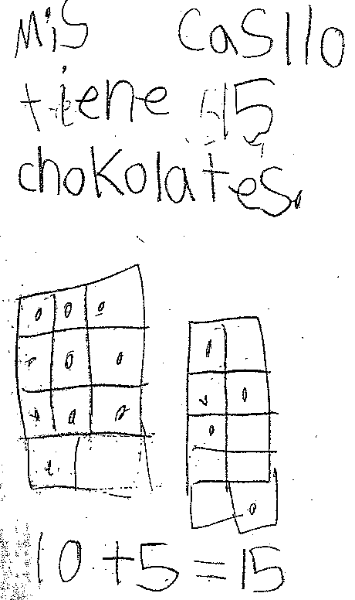
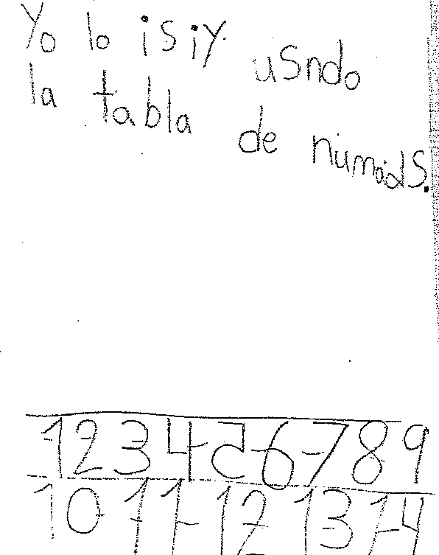
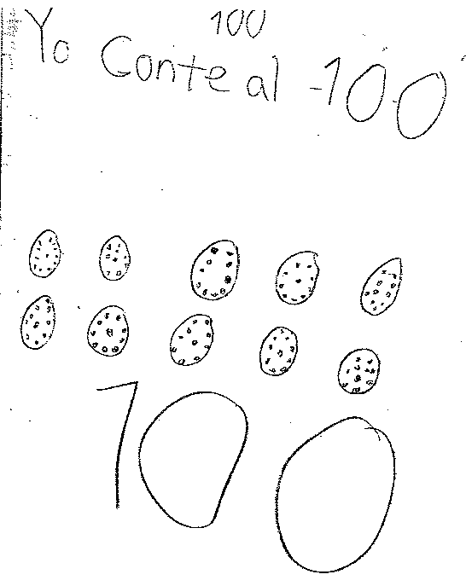
“Julia” K-1
4/24
Miss Castillo tiene 15 chocolates.
9/5
Yo lo hice usando la tabla de números.
10/9
Yo conté al 100.

Slide 7
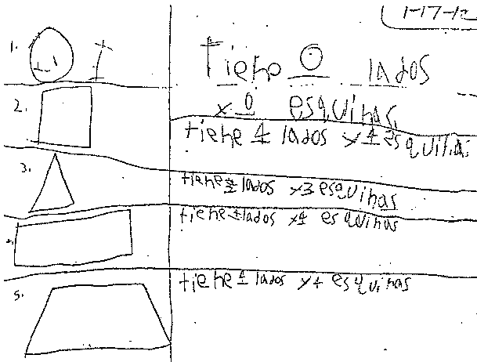
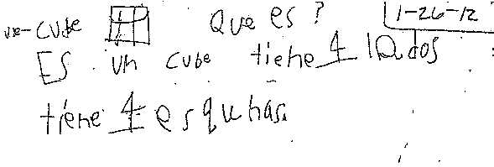
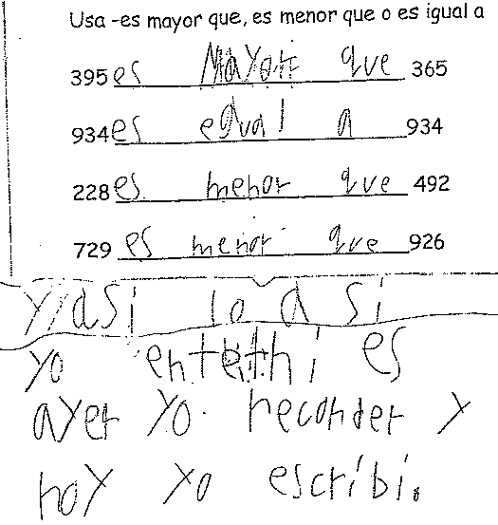
“Sandra” 1-2
1/17
Tiene 0 lados y 0 esquinas.
Tiene 4 lados y 4 esquinas…
1/26
¿Qué es? Es un cube. Tiene 4 lados. Tiene 4 esquinas.
9/25
Yo así lo hice
Yo entendí es. Ayer yo recorder y hoy yo escribí.

Slide 8
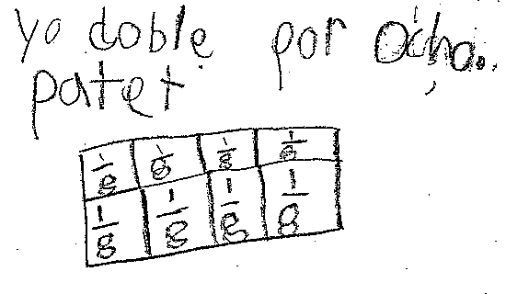
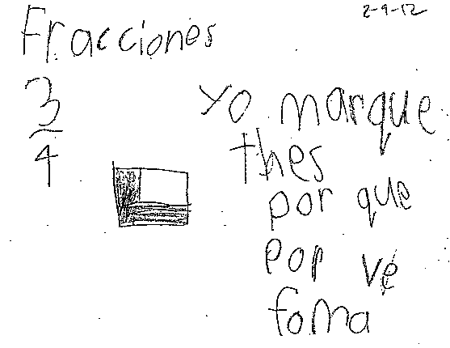
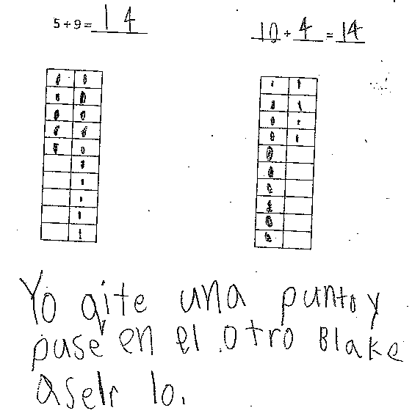
“Joseph” 1-2
2/7
Yo doblé por ocho partes.
2/9
Fracciones. Yo marqué tres porque por ve forma.
10/4
Yo quité una punto y puse en el otro bloque hacerlo.

Slide 9
Conclusions
“What I cannot build, I cannot understand.”
—Richard Feynman, Nobel laureate in physics
Language helps students build math problems and solutions.
Math problem solving helps students build complex language.

